Slide 1




Our Key Offerings
Digital
Workplace Solutions
Hybrid
Cloud Solutions
Sustainability
Solutions
Vertical
Solutions
Security, Performance, and Employee Satisfaction
The power of a public cloud; the security of a private one
Solutions for meeting sustainability goals
Tailored to specific industries and sectors
AI Powered
Lenovo TruScale
The simplicity and scalability of a flexible, pay-as-you-go model
1

Slide 2

Modular services
Lenovo TruScale
Modular approach
Our solution provides your customers and partners greater choices to select the right technology, modular services, and flexible financing. All with on-premises security for control and peace of mind.
Customers achieve flexibility, scale, and control with the support that meets their unique needs.
TruScale
Scalable IT & infrastructure
Flexible financing
Notes:
Lenovo TruScale is a streamlined and customizable way to deliver hybrid infrastructure solutions to your customers. We've expanded TruScale IaaS from a consumption-based model with required services to a more flexible approach that provides more options for your customers.
Now, in three easy steps, you can help customers select the technology, services, and financing options that best fit their needs. Channel partners are afforded greater options to deliver solutions that can be right sized to both their customers and their organization capabilities while providing incentives with every Lenovo service included.
What’s new with TruScale IaaS? We are expanding TruScale Infrastructure as a Service (IaaS) from a consumption-based model with required services to a more flexible approach for bringing infrastructure and modular services to customers with multiple financing options. Customers can still choose to pay for what they use with a consumption-based model, however they now have increased flexibility to procure our portfolio of modular services with Lenovo TruScale predictable pricing and infrastructure financing options. The Lenovo TruScale message for your customers is now a simple 1 + 1 + 1 equation: choose your infrastructure, choose your services, choose your financing.

Slide 3
What is Capex to Opex Indirect?
The Capex to Opex Indirect solution provides a more scalable, automated, and partner‑friendly financing solution, enabling channel partners to directly initiate financing quotes, view indicative pricing, and trigger automated Lenovo Global Financial Services engagement.
Why it Matters:
Partners can initiate financing quotes directly in LBP‑e, removing reliance on Lenovo and accelerating quote creation
Dynamic indicative financing pricing gives partners real‑time visibility, improving customer conversations and reducing manual interventions / conversations
Triggers Opex pricing in every quote which creates additional visibility for the opportunity to position this to customers. Auto-routes Partner Rep to the right contact in LGFS/LFS for credit check and final contract pricing

Slide 4


Slide 5
What to Know
Partner Initiated Quotes
Channel partners can now start financing quotes directly in LBP‑e, reducing dependency on Lenovo sellers and speeding up indirect deal cycles
Expanded Funding Options
Deals can be funded through an ecosystem of approved funding partners so that the best pricing is secured
Dynamic Indicative financing Price
Partners can view non‑binding financing estimates during quote simulation
Sales Opportunity Integration
Prompts partner reps to propose an Opex pricing solution alongside Capex pricing
Automated LGFS Engagement
Partner rep can select to move forward with the quote and the opportunity information will automatically be shared with an LGFS representative
Solution scope
Available for DaaS and ISG Leasing, LGFS can include other elements to the pricing at partner request

Slide 6
High Level Process Flow: Partner Initiated Financing Quote
Partner rep initiates quote
Add Products & Configure
Resell price with uplift approved
Financing Quote Request
Financing Quote Generation
Share Indicative price with customer
Request ‘Move to Next Step”
Request sent to LGFS / Funder
Partner
Partner
Partner
Partner
Automatic
Partner
Partner
Automatic

Slide 7
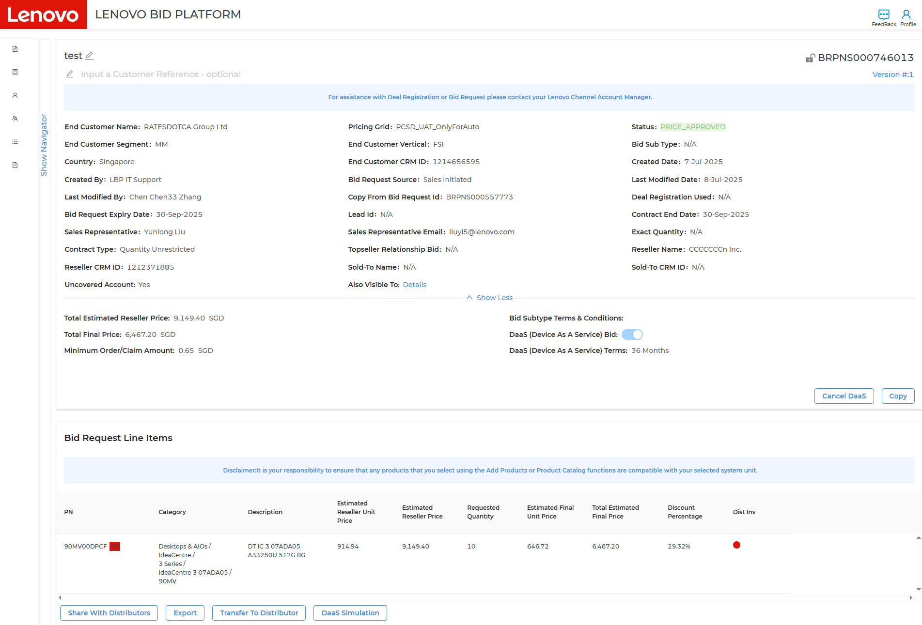
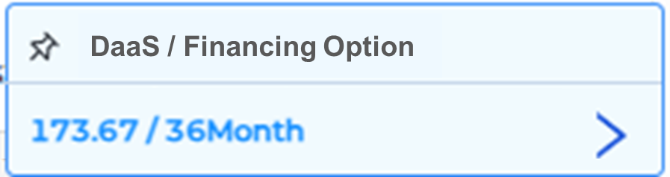
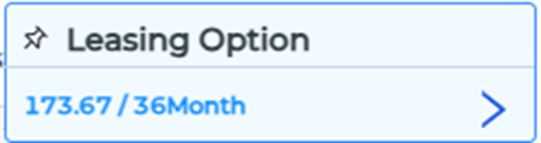



Partner Initiated Quote: Financing in LBP-e Bid
Executed by Channel Partner
Displaying Monthly Price based on 36 Month Option
Price displayed in same currency as LBP-e quote
Displaying Financing Window only when quoted price is meeting or above minimum funding amount (minimum funding amount is set in USD, and it is converted to the currency in a quote to compare)

Slide 8
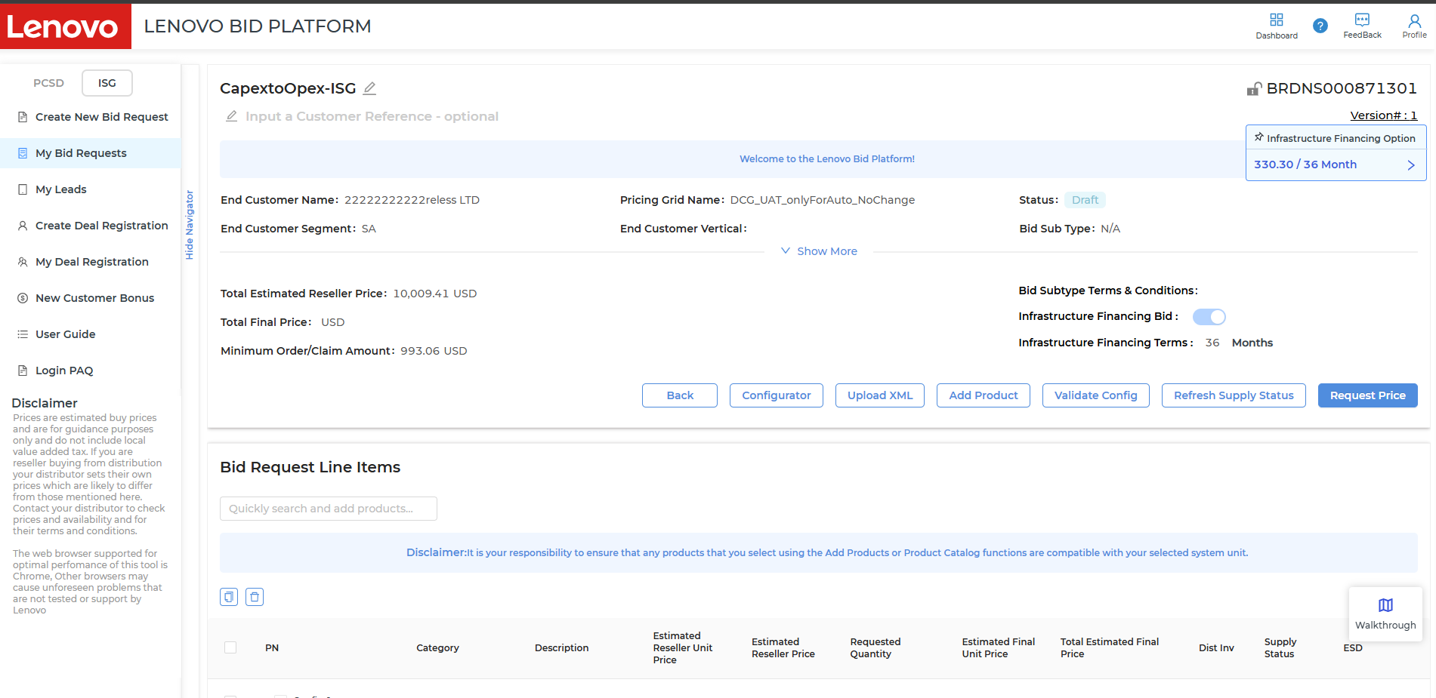

Slide 9
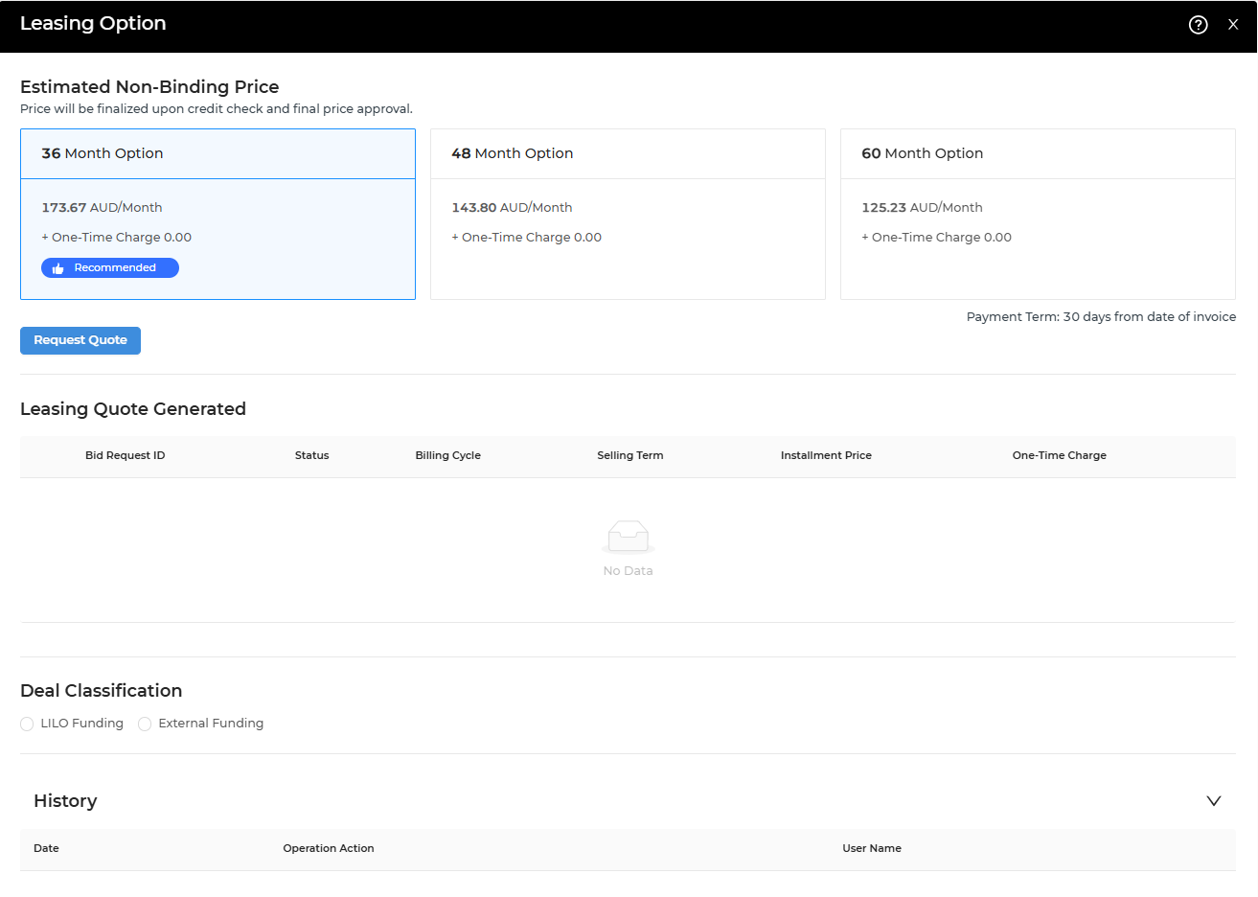
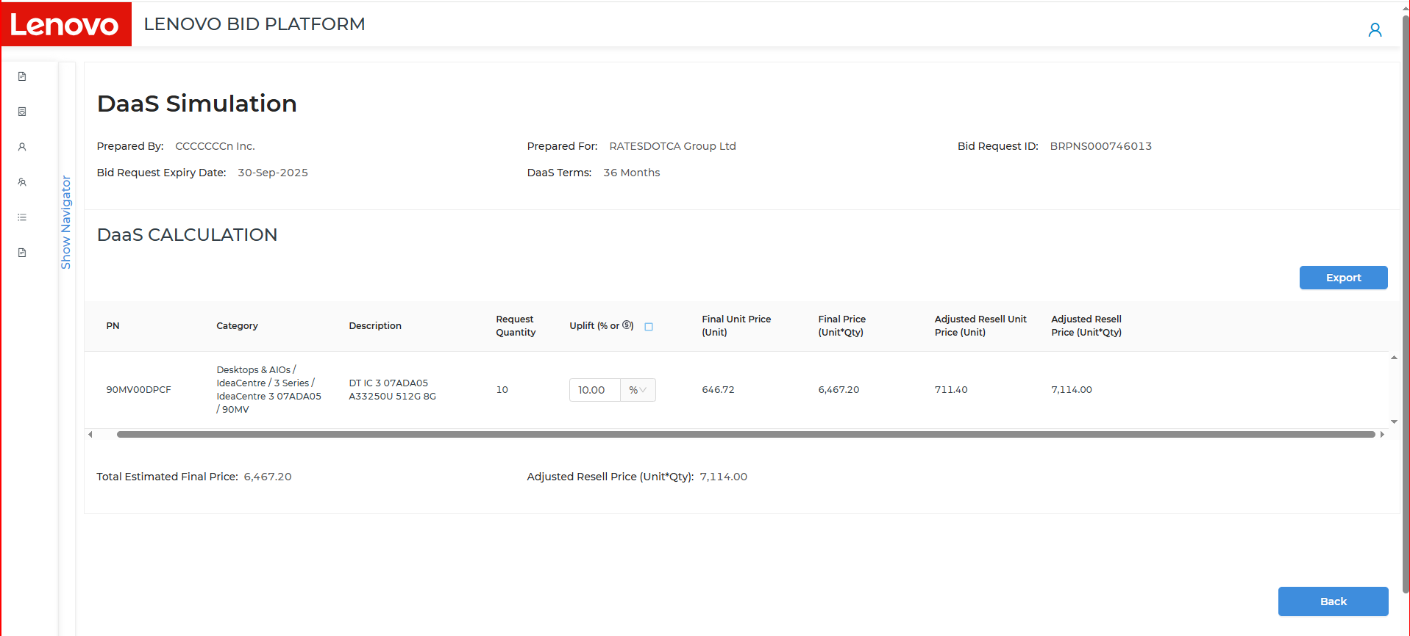
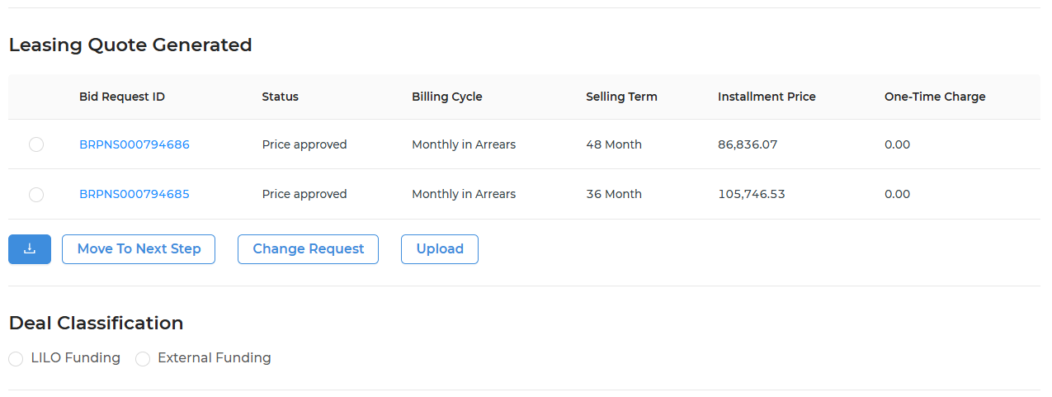

Financing quote in LBP-e Bid
Executed by Channel Partner
Resell Price Calculation
Resell Price Adjustment per Line Item
Name of LGFS BDM & LGFS Sales Support will be displayed within pop-up window (receivers of this request) upon clicking “Request Quote”
If quote is transferred from LBP-i with toggle, # of month option is preselected with indicator.
Financing quote is created after price approval, and final adjusted resell price is calculated using uplift % entered.
When # of Month Option selected is not aligned with service duration in a quote, it displays a warning when request quote button is selected.
Total Estimated Final Price
+
=
Adjusted Resell Price
6,467.20
7,114.00
Note : Uplift input is used to calculate estimated lease price only, and it is deleted after finalizing a quote.
Estimated Non-Binding Leasing Price (based on Adjusted Resell Price)
Price will be finalized upon credit check and final price approval.

Slide 10
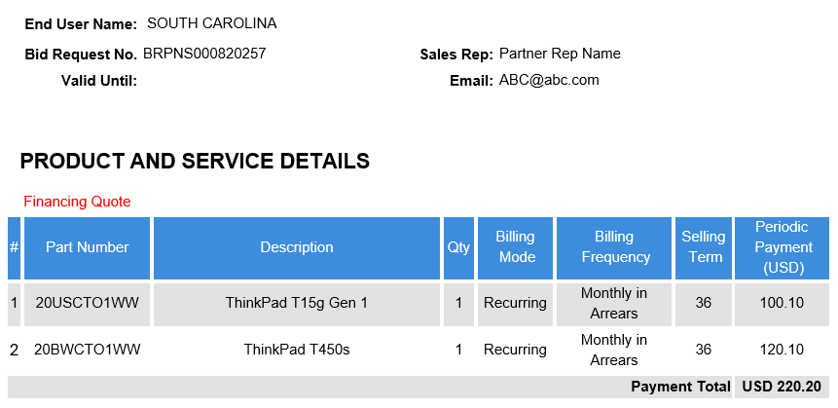
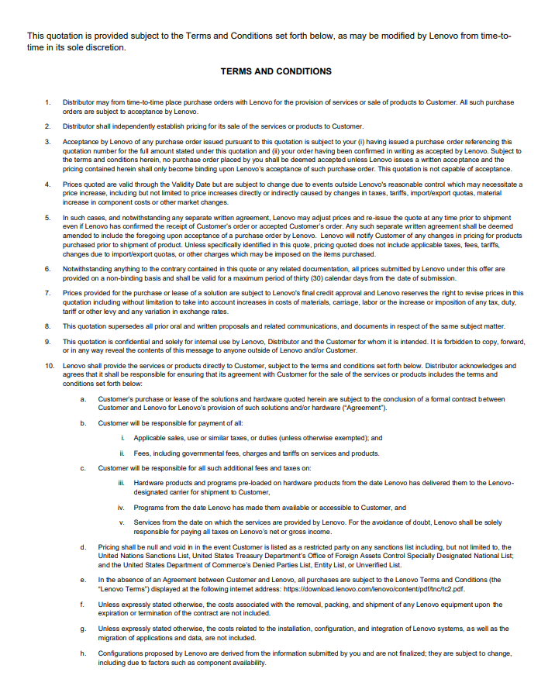
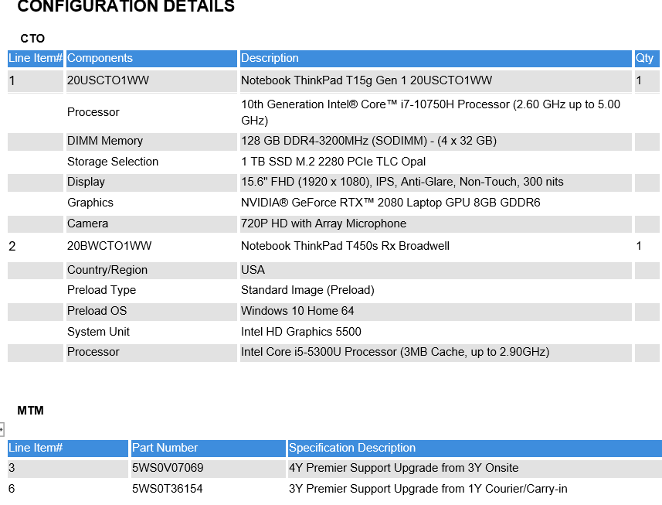
Financing Quote PDF Output
Financing Quote PDF Output can be generated by selecting option & click download button.

Slide 11
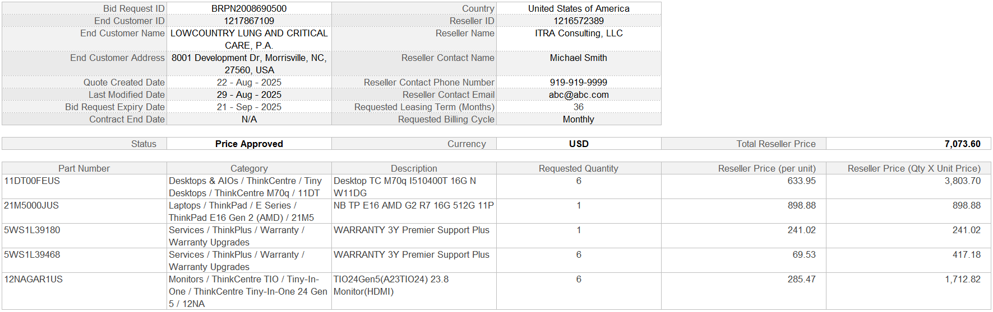
Export Template
Below export file is generated & attached to email sent out to LFS Funder.
Exported Data Elements
Exported Template Format
Bid Request ID
End Customer ID
End Customer Name
End Customer Address
Quote Created Date
Last Modified Date
Bid Request Expiry Date
Contract End Date
Country
Reseller ID
Reseller Name
Reseller Contact Name
Reseller Contact Phone Number
Reseller Contact Email
Requested Leasing Term (Months)
Requested Billing Cycle
Status
Currency
Total Reseller Price
Part Number
Category
Description
Requested Quantity
Reseller Price (per unit)
Reseller Price (Qty X Unit Price)
Link to Template

