Slide 1

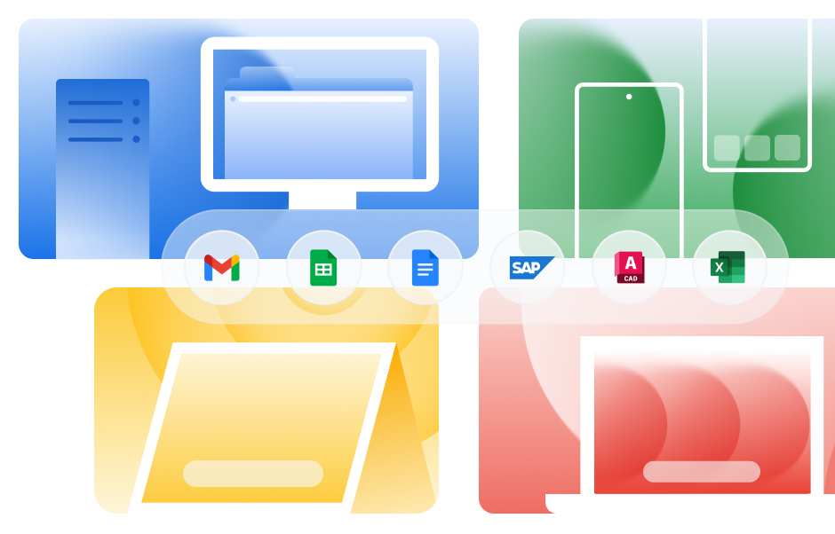
Partner logo
A flexible path to modern end-user computing with Cameyo by Google
Cameyo by Google is a modern alternative
to VDI designed specifically to solve the legacy app gap without the overhead of traditional virtual desktops. Instead of streaming a full, resource-heavy desktop, Cameyo’s Virtual App Delivery (VAD) technology delivers only the applications users need, securely to any device.
With Cameyo, legacy Windows or Linux apps can either be streamed in the browser or delivered as Progressive Web Apps (PWAs) to give users the feel of using a native app in its own window. Users can run legacy applications — such as ERP clients, AutoCAD, and the desktop version of Excel — alongside modern web apps, accessing them directly in the browser or as system-tray PWAs.
For the user, the experience is seamless and free from the context-switching of managing a separate virtual desktop environment. For IT, the complexity of VDI is eliminated.
The Modernization Paradox
90%
of IT leaders agree
the future of end user computing is web-based¹
With Cameyo by Google, our employees get web-based access to the same desktop version of the software that they’re used to with absolutely nothing new to learn, so it’s a seamless user experience. Also, Cameyo dramatically simplifies both the initial deployment and the ongoing management of applications. We’ve experienced at least an 80% reduction in time required for installation and ongoing maintenance.”
Christian Ahlin, Group Head of IT at Nordward
50%
of the enterprise app stack is still client-based¹
While IT departments almost unanimously
believe the future of end user computing
at their organization is web-based, half of their applications still remain client-based today.¹
¹ Forrester Consulting: A commissioned study conducted by Forrester Consulting on behalf of Google, Deliver a Next-Generation Endpoint, 2024
© 2025 Google LLC 1600 Amphitheatre Parkway, Mountain View, CA 94043.

Slide 2

Unlock secure, collaborative web-first computing
Moving apps to the web with Cameyo by Google not only unifies the user experience but also empowers IT with significantly greater flexibility and security. Compared to traditional virtualization technologies that take weeks or months to deploy, IT can publish their first apps within hours, and be fully deployed in days. All while taking advantage of Cameyo’s embedded Zero Trust security model for ultra-secure app delivery.
And that added simplicity, flexibility, and security opens up other opportunities for IT, too.
After years of security incidents, outages, and forced upgrades, organizations are increasingly seeking a more secure alternative to Windows. Cameyo enables IT to finally migrate to ChromeOS — even converting existing PCs via ChromeOS Flex — while retaining access to all of their critical Windows applications.
Similarly, Cameyo allows organizations to fully embrace Google Workspace while retaining access to essential client apps that previously kept them tethered to Microsoft,™ such as legacy Excel versions with complex macros or specific ERP clients. Now, teams can move to a more modern, collaborative productivity suite that was built for the web, and they can still access any specialized Windows apps that their workflows depend on.
What Customers Are Saying
Customers consistently report that Cameyo by Google’s Virtual App Delivery (VAD) provides a simpler, more secure, more cost-effective solution while delivering a better end-user experience.
Simple Scalability
“We chose Cameyo over traditional VDI
and desktop as a service (DaaS) solutions
for one key reason: VDI and DaaS were
far too complex. We needed something
that could be deployed quickly — that wouldn’t require tons of resources to manage moving forward. That was Cameyo.”
Dan Morley, Head of IT Infrastructure and Service, Village Hotels
More Secure
“Cameyo has a zero-trust security
model baked in at its core which adds additional layers of security so we can confidently enable our employees to work from anywhere, on any device, with the utmost security,”
Mario Zúñiga, IT Director, Digital Workplace, Sanmina
A Secure Browsing First
The combination of Cameyo by Google and Chrome Enterprise Premium provides the only solution in the market that delivers and secures both modern web apps and legacy client-based apps within a single, secure enterprise browser environment.
Here’s how it works:
Chrome Enterprise Premium serves as the secure entry point, providing advanced threat protection, URL filtering, and granular Data Loss Prevention (DLP) controls for all sensitive data and web activity.
Cameyo takes your legacy client apps and publishes them within the managed Chrome Enterprise browser.
This unifies the digital workspace. Those legacy applications, which previously lived on a desktop, now run under the single security context of the secure browser.
This not only brings all your apps into a secure enterprise browser, but thanks to Gemini in Chrome, all of your legacy apps now have AI layered on top.
More Cost-Effective
“Right off the bat, Cameyo doesn’t
require any complex infrastructure and
you don’t need to hire a third-party engineer to set it up — so that’s a huge cost savings right there.”
Emir Saffar, CIO, Ur&Penn
Better User Experience
“The user experience is just seamless. They can easily access the full desktop version of all of their apps just as if they were installed locally on the device, but instead, the apps are running from Cameyo. All of the feedback from our users has been incredibly positive.”
Dan Morley, Head of IT Infrastructure and Service, Village Hotels
“It was a breath of fresh air to see how
easy it was to deploy apps to ChromeOS via Cameyo, and to see how simple it is
to manage long-term. With Cameyo,
we were able to go all-in with Google.”
Dan Morley, Head of IT Infrastructure and Service, Village Hotels
To learn more, reach out to our sales team
© 2025 Google LLC 1600 Amphitheatre Parkway, Mountain View, CA 94043.

