Slide 1
Notes for Presenters
(Hidden Slide, Internal Use Only – Delete Before Presenting)
Hidden Slide, Internal Use Only – Delete Before Presenting
Target audience:
Business Decision Makers | Executives
Speaker notes are for internal use only
If you require more product information and customer-ready content, please refer to these resources:
  Storage Knowledge Center
  Data Protection Knowledge Center
  Networking Knowledge Center
  Storage Networking Knowledge Center
  Customer Stores & Sales Wins
This is a fully scripted deck that has been designed to help you position yourself as a thought leader and deliver a compelling customer EBC.
Only share slides externally in PDF format, without speaker notes.
This deck includes animation, including a few click-to-build slides. Look for a green flag above slides to easily identify which are animated, or that are “morph builds” which should not be altered.
Objectives of this deck
This deck is intended to introduce and simplify our Dell storage portfolio (inclusive of primary, unstructured, and data protection). It’s meant to:
Start a conversation about what leaders must focus on to modernize their data-centers with smarter storage.
Ask the customer questions about their challenges, data needs, and workload disposition strategy.
Introduce 3 lead franchise products for key customer outcomes: PowerStore for Hybrid cloud, PowerScale for AI, and PowerProtect Data Domain for Data Protection.
This deck is modular; Feel free to customize the deck with the additional slides in backup tailored to your customer’s needs.
Show how Dell Technologies is uniquely positioned to advance customers’ modern data center initiatives.
Create interest in more detailed follow-up conversations:
  Storage and Data Protection
  Professional Services, including Lifecycle Extension program
  Next steps for getting started (assessments, workshops)
Notes:
// NOTES FOR PRESENTER
(Hidden Slide, Internal Use Only – Delete Before Presenting)
Speaker notes contain:
Script section which supplies a detailed talk track
Because the speaker notes have a lot of internal information and guidance to you as presenters, please only share the slides externally in PDF format without speaker notes.

Slide 2


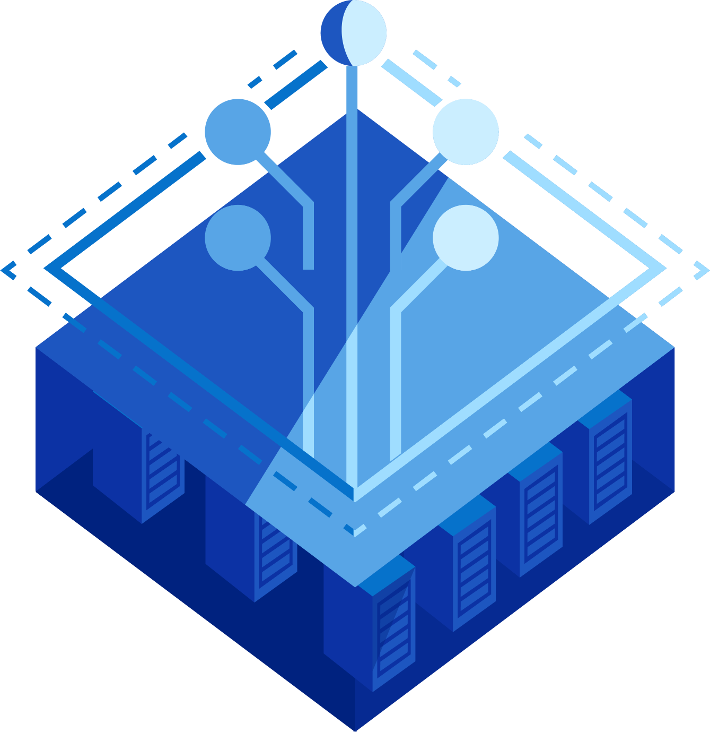
Dell’s Enterprise
Storage Portfolio
Gaining control of your data strategy with efficient, resilient, and future-ready storage systems
Updated February 24, 2026

Slide 3




Data is at the heart of everything we do
It powers innovation, drives decisions, and unlocks new possibilities.
Drive
growth
Enhance
experiences
Optimize
productivity
Accelerate
innovation
3
Copyright © Dell Inc. All Rights Reserved.
Notes:
Data is the backbone of progress—it drives innovation, informs smarter decisions, and unlocks limitless possibilities. It fuels growth, enhances user experiences, boosts productivity, and propels innovation forward.
At Dell, we recognize the transformative potential of data. That’s why we’re committed to helping organizations like yours unlock its full value with purpose-built storage solutions designed to meet your unique needs.

Slide 4

Today’s IT landscape is more complex than ever
In an unpredictable world, enterprises seek to regain control of their data
say their overall IT environment has become more complex the past two years¹
Of organizations say usage/evaluation of multiple hypervisor options is a strategic imperative³
Of data will remain on-prem, rather than in the cloud²
of ransomware attacks included attempts to compromise the backup (57% success rate)⁴
1 Enterprise Strategy Group Complete Survey Results, 2024 Technology Spending Intentions Survey, February 2024
² https://www.datacenterdynamics.com/en/news/michael-dell-ai-to-drive-data-center-demand-up-100-fold-over-next-10-years/, March 18, 2024.
³ Enterprise Strategy Group Complete Survey Results, Navigating the Cloud and AI Revolution: The State of Enterprise Storage and HCI, February 2024.
4. Sophos, https://news.sophos.com/en-us/2024/03/26/the-impact-of-compromised-backups-on-ransomware-outcomes/
Notes:
We live in a time where the digital landscape is more dynamic and unpredictable than ever. For organizations, this means navigating the complex challenges of managing and securing vast amounts of data, all while driving innovation and business growth. But challenges also bring opportunities. Enterprises around the globe are taking bold steps to regain control of their data environments, ensuring they’re well-prepared for what lies ahead.
On this slide, we see a clear picture of what’s on the minds of IT leaders and decision-makers when it comes to cloud strategies and data management priorities.
Key Data Point 1 (83% of enterprises plan to move workloads back to private cloud from public cloud)
The first statistic here is striking. This movement, also known as ‘cloud repatriation,’ signals a growing realization among businesses. The public cloud, while flexible, often falls short when enterprises need cost predictability, reliability, and, most critically, control over their data. Enterprises are recognizing that private cloud environments offer greater stability and control, helping them optimize their operations while avoiding unexpected costs.
Key Data Point 2 (75% of CISOs say gaining control over their cloud data footprint is the top priority for managing risk)
This second statistic reinforces what many of us know to be true. The rapidly increasing scale of cybersecurity threats, coupled with stricter regulatory requirements, has made visibility and control of data more essential than ever. If an organization lacks a secure and well-structured system for managing its data, it risks operational inefficiency, compliance issues, and security vulnerabilities.
In today’s environment, businesses are prioritizing control, security, and efficiency within their digital infrastructures. Why? Because managing data isn’t just about where it’s stored—it’s about how it’s accessed, secured, and leveraged to fuel innovation. Organizations need the flexibility to adapt quickly to changing priorities, run diverse workloads where and how their business demands, and view IT as a strategic driver for growth.

Slide 5
Organizations are rethinking their IT architectures to lower costs, complexity, and risk
Optimize
diverse workloads
Increase
agility
Simplify IT operations
Secure critical assets everywhere
Legacy and modern
Multiple locations
Varied performance requirements
Avoid vendor lock-in
Improve scalability, efficiency and adaptability
Lower costs
Automate and integrate processes
Leverage AIOps tools for management
Protect all data
Prevent outages
Defend against cyber threats
Meeting today’s challenges requires more than just a storage vendor;
it demands a trusted, strategic infrastructure partner.
Copyright © Dell Inc. All Rights Reserved.
Notes:
As organizations seek greater control over their data, they are rethinking IT architectures to address evolving needs. Key areas of focus include:
Support diverse workloads: Modern businesses manage a wide variety of workloads, from legacy systems to cutting-edge applications. These span on-premises and cloud environments, requiring flexible performance solutions tailored to different locations and demands.
Shift towards disaggregated infrastructure: To enhance scalability, efficiency, and cost-effectiveness, many are moving away from vendor lock-in. Disaggregated infrastructure allows businesses to deploy resources strategically and efficiently, aligning with specific workload needs.
Simplify IT operations: As IT environments grow more complex, the need for simplicity becomes all the more apparent. Overly complex systems can lead to inefficiencies, increased costs, and slower innovation. Automation and integration are essential in simplifying operations, and this is where we see the power of AIOps, or Artificial Intelligence for IT Operations, stepping in.
Secure critical assets everywhere: Of course, none of this matters if your data and assets aren’t secure. Organizations are facing increasing pressures to protect against outages, cyberattacks, and other security risks. The need for comprehensive data protection has never been greater.
Infrastructure agility keeps your business moving forward. As technology evolves rapidly, organizations must future-proof their storage infrastructure to keep up with changing demands. This means investing in smart solutions that can scale, integrate with emerging technologies, and provide maximum resiliency in case of disruptions or disasters. This is why it’s crucial to go beyond a simple storage provider. You need a trusted partner who offers flexible infrastructure, seamless management, robust security, and support for long-term growth.

Slide 6



Not all data workloads are created equal
Right-size your workload mix with purpose-built infrastructure to meet your evolving business needs
Hot | Cold | Archive
High-performance
High speed, low latency, NVMe, all-flash, high IOPS
Capacity-intensive
Large-scale capacity, cost-efficiency, and scalability
AI/ML
High throughput, parallel processing, and support for large datasets
Backup and archiving
Robust data encryption, backup and recovery capabilities, and compliance
Virtualization
High availability, cloud integration, and support for virtualized workloads
Data mobility
Facilitating easy data movement across different environments
Cost optimization
Balance of performance and cost efficiency, offering reliability an affordable price
Disaster recovery
High availability, redundancy, and fast recovery times for business continuity
Public Cloud
Unified | Block | File | Object | Software - Defined
Power any workload across the edge, data center & public cloud.
Private Cloud /
On Premises
Copyright © Dell Inc. All Rights Reserved.
Notes:
Let’s discuss a critical aspect of optimizing IT environments: workload-driven infrastructure. Every workload has unique requirements, so why settle for a one-size-fits-all storage platform? High-performance environments require high speed and low latency, while capacity-intensive tasks demand scalability and cost-efficiency. Universal solutions promise to do it all, but they often falter when it comes to the specific demands of modern enterprises. A single platform trying to fit every scenario risks diluting its efficiency.
At Dell Technologies, we provide best-of-breed, purpose-built infrastructure solutions tailored to each of these workload types. From block, file, to object storage, and spanning from private clouds to public clouds, Dell Technologies has the resources and expertise to right-size your workload mix. We emphasize a right-sized workload approach because the right storage foundation can significantly improve your business operations, making you more agile and responsive to changing demands.
By choosing specialized storage solutions, you gain:
Optimized Efficiency: Purpose-built solutions are designed to handle specific workloads, delivering faster response times and superior performance when compared to universal platforms.
Transparent Costs: Pay for exactly what you need, without unnecessary features dragging down your investment. Purpose-built solutions minimize waste and maximize ROI.
Scalability That Makes Sense: Specialized systems grow with your evolving needs, unlike generic platforms that may struggle to keep up when enterprise data demands change.
Reliable Integration: Built to seamlessly support your specific infrastructure, purpose-driven solutions reduce complexity and simplify management.
Your business deserves a storage system that works for you—not one that tries (and fails) to be everything for everyone. Trust solutions purpose-engineered for your environment to keep you ahead in a competitive landscape.

Slide 7
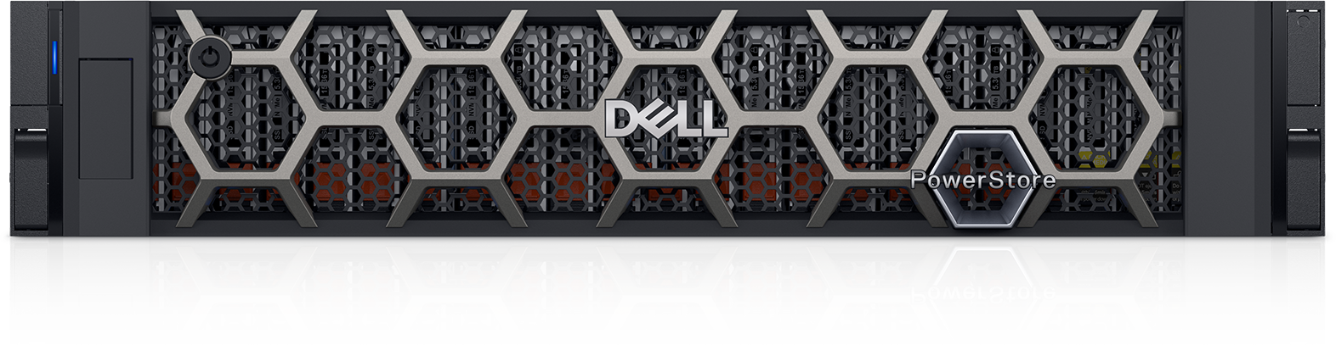

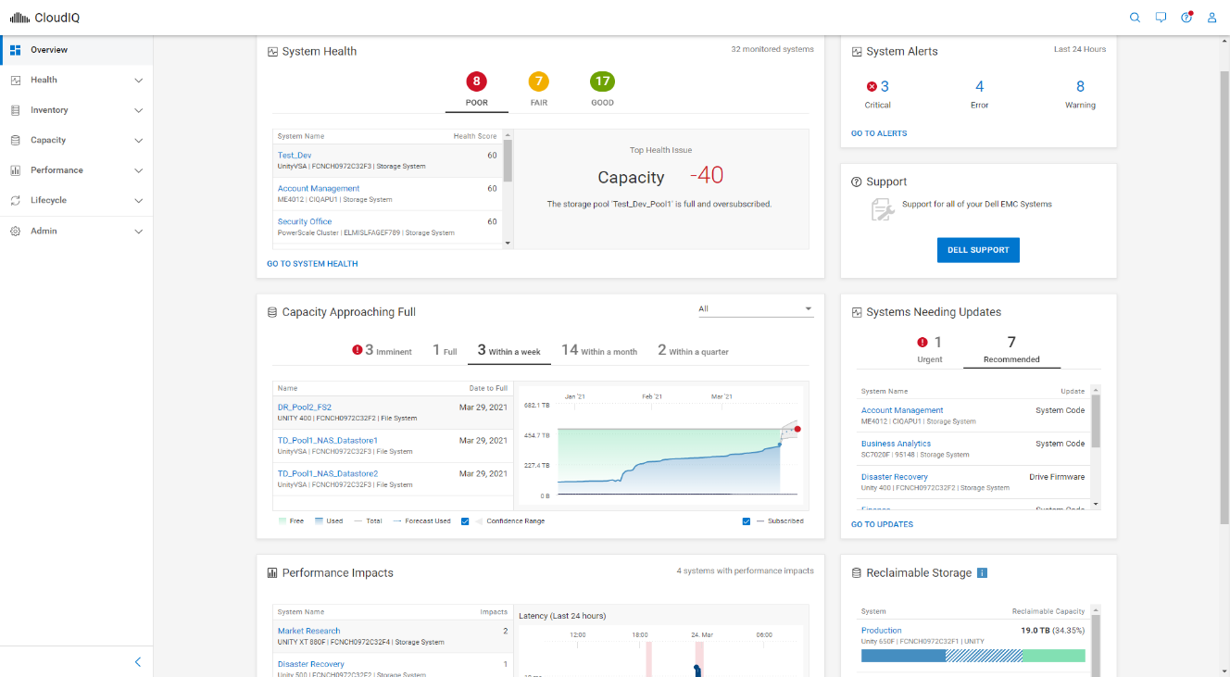

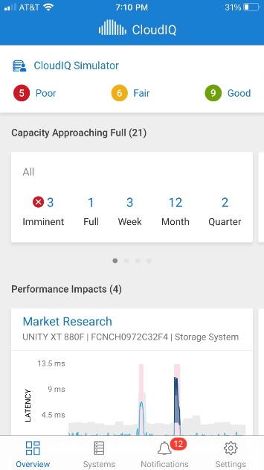
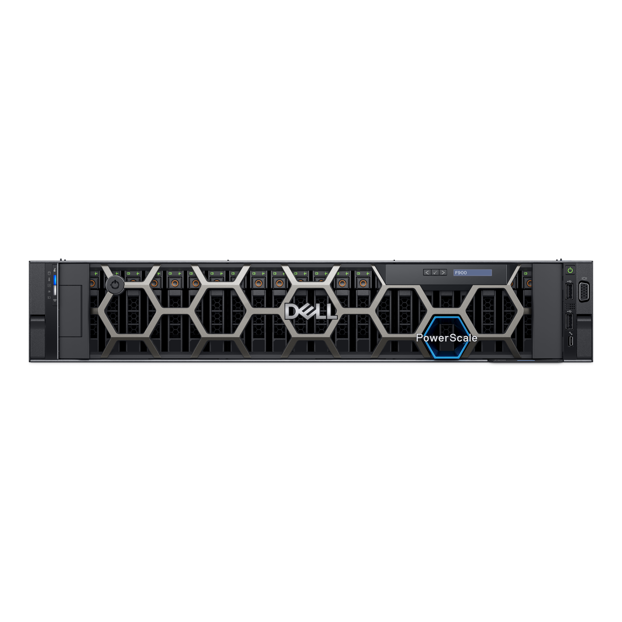
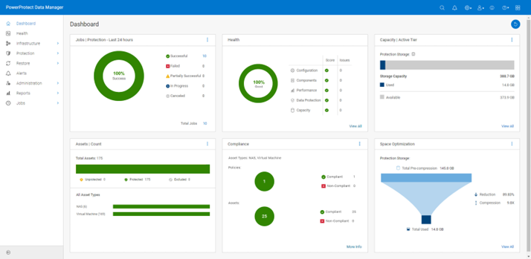

Dell simplifies your IT operations, so you can accelerate innovation.
Animated build slide
Delivering a consistent, predictable, and reliable experience.
Open and integrated ecosystem
ECS
Public cloud and SaaS flexibility
End-to-end solutions: We have tailored solutions to support your business outcomes
API-driven and open-source
Hypervisor agnostic
Efficient resources: Optimize diverse workloads and dynamically scale resources
Consistent management & operations
Dell AIOps
Reliable integrations: We support an open ecosystem with validated solutions
Dell AIOps
Simplified management: Centralized, consistent management and operations
Workload-driven infrastructure
Storage | Server | Networking
Reduced costs: Pay for exactly what you need, minimize waste and maximize ROI
Cyber resilience
Data protection, backup, and cyber recovery
Notes:
As IT demands grow, mixed vendor environments often lead to unnecessary complexity, inefficiencies, and costly integration challenges. Dell Technologies simplifies this with a unified, end-to-end approach, bridging gaps, streamlining operations, and aligning IT infrastructure with evolving business needs.
As a strategic partner—not just a storage vendor—we deliver consistent, reliable, and tailored solutions to help you simplify IT, drive innovation, and achieve impactful results through our:
End-to-end solutions: We provide tailored, end-to-end solutions that not only meet your immediate IT needs but also position your organization to thrive in an increasingly dynamic and competitive world. From storage to networking and servers, we provide seamless integration, centralized management, and solutions designed to optimize efficiency while maximizing your ROI.
Efficient resources: Our solutions optimize workloads and scale resources dynamically, so you only use what you need. This approach reduces waste, cuts costs, and ensures your infrastructure grows efficiently as your business evolves.
Reliable integrations: We support an open ecosystem that easily integrates with existing platforms, public clouds, and SaaS environments. With hypervisor-agnostic, API-driven technologies, we ensure seamless operations and reliable performance across your IT infrastructure.
Simplified management: Dell simplifies IT management with centralized tools that unify operations. Automation reduces manual tasks, letting your team focus on driving innovation instead of handling day-to-day complexities.
Reduced costs: Our solutions are designed to maximize ROI by eliminating redundant resources and helping you pay only for what you need. This means lower costs without sacrificing performance.

Slide 8

Animated build slide
Artificial Intelligence
What’s top of mind for your
CIO is top of mind for us
Power strategic innovation to transform your business
Optimize your AI investment with right-sized infrastructure
Cyber resilience
Private cloud
Blurry image
Power any workload across the edge, data center & public cloud
Deliver comprehensive cyber resilience everywhere
8
Copyright © Dell Inc. All Rights Reserved.
Notes:
The IT landscape is shaped by trends like hybrid cloud adoption, the AI-driven transformation of industries, and a growing demand for robust data resiliency. These trends require smarter, integrated storage solutions capable of supporting evolving workloads and delivering optimal performance and security. Organizations that align their strategies with these trends will strengthen their competitive edge and drive impactful innovation.
We share your priorities, and we’re here to support your vision.
Organizations are prioritizing three major strategic initiatives within their storage environments:
Private Cloud: With 91% of organizations facing challenges in building multicloud systems, Dell enables private and hybrid cloud solutions that are flexible and cost-effective. This avoids ecosystem lock-in and ensures optimized resource utilization.
AI: Seventy-five percent of organizations now say AI or GenAI is integral to their business strategy. These technologies are creating a massive demand for performance-intensive storage systems that can process structured and unstructured data seamlessly.
Cyber Resilience: With 89% of organizations identifying security as a critical focus, there’s an increasing need for advanced ransomware detection, zero-trust architecture, and air-gapped recovery solutions. Dell provides unparalleled cyber resilience strategies to ensure minimal downtime and secure data environments.
With 75% of data still stored on-premises, businesses need a trusted partner like Dell to move closer to their goals. We offer a one-stop shop for IT infrastructure to drive seamless integration and elevate organizational capabilities.
Sources:
1 Innovation Catalysts, Dell Technologies, February 2024
2 Source: Dell Technologies survey across 750 business and IT decision makers across US, UK, DE, FR and JP, all segments, Feb 2025.
3 Source: Michael Dell, AI to drive data center demand up 100x over next 10 years. (https://www.datacenterdynamics.com/en/news/michael-dell-ai-to-drive-data-center-demand-up-100-fold-over-next-10-years/)

Slide 9
The future of IT runs on smarter storage
And is backed by an end-to-end integrated and open ecosystem
Private cloud
Artificial Intelligence
Cyber resilience
Optimize for diverse workloads
with high-performant, unified storage solutions for modern, hybrid cloud applications
Adopt performant-intensive storage
to optimize performance and efficiency across data workflows at scale
Secure and reduce the attack surface
by minimizing vulnerabilities and entry points that can be exploited to compromise the environment.
Increased flexibility and resource utilization
by shifting towards open, disaggregated architectures for dynamic scaling
Break silos of data
with a modern data architecture and management platforms to unify access to all enterprise data
Detect and respond to threats
by actively identifying and addressing potential security incidents and malicious activities
Simplify IT operations
with unified management, automation, orchestration, and AIOps
Support AI workloads
with strategic partnerships for open-source models, LLMs, and GPUs
Recover from Cyberattacks
by restoring the organization as quickly as possible while minimizing disruption
Strengthen security and control
with secure-by-design storage and integrated backup and recovery
Enable secure, compliant operations backed by built-in data protection and cyber resilience
Notes:
We recognize the challenges organizations face when navigating rapidly evolving IT landscapes. That’s why we are committed to delivering more than just infrastructure—we provide an integrated, open ecosystem that empowers businesses to achieve their goals.
Dell’s solutions are trusted, proven, and fully integrated to work across hybrid cloud, AI environments, and intrinsic security frameworks. Our open ecosystem supports a range of platforms, hypervisors, public clouds, and SaaS infrastructures. With end-to-end solutions and reliable integrations, Dell Technologies ensures you have the systems you need to succeed.
We believe that purpose-built storage is key to helping organizations achieve greater control, flexibility, availability, and security for their data. From hybrid cloud to AI workloads, Dell empowers businesses to power any workload with tailored solutions.
Private cloud: Our hybrid cloud solutions empower you to seamlessly manage workloads across the edge, data center, and public cloud. With reliable performance, dynamic resource allocation, and customizable integrations, your IT environment will stay modern and adaptable to your needs.
Artificial intelligence: For organizations leveraging AI, Dell provides high-performance, scalable infrastructure to optimize your investments. With advanced data management platforms and built-in security, your AI projects can operate securely and efficiently.
Cyber resilience: Data security is more crucial than ever. Our cyber resilience solutions ensure comprehensive protection, so your data stays secure and compliant. We offer advanced recovery options and supply chain security to safeguard your operations from potential threats.
Our constant innovation keeps your enterprise ahead of the curve while ensuring secure, scalable, and efficient operations.

Slide 10


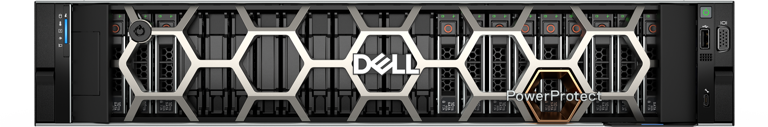
Purpose-built storage. Confidence to handle any workload.
Dell Storage Solutions
Private
cloud
Artificial intelligence
Cyber Resilience
Cloud agility and simplicity with full control over cost, data sovereignty, and security – in your environment, on your terms.
Storage that maximizes
GPU utilization and ensures data is intelligently managed, available, and accessible.
Comprehensive, integrated prevention, detection and
rapid recovery across every
layer of infrastructure
Public Cloud
Private Cloud /
On Premises
Open, integrated ecosystem
1 IDC quarterly enterprise storage systems tracker, 2024Q4 final historical release, March 13, 2025 – Vendor Revenue.
Notes:
At the foundation of everything we do is our infrastructure and our best in class storage portfolio. Dell Technologies' storage and data protection portfolios are crafted to empower organizations by meeting their unique data needs with efficient, resilient, and future-ready solutions. Designed to handle the demands of evolving workloads, these products deliver the flexibility and resilience businesses require to succeed, whether you're a small startup or a global enterprise. We believe the future of the data center is being shaped by three strategic imperatives—and Dell is aligning our storage and cyber resilience portfolio to lead in each of these areas.
First, Private Cloud. Customers want cloud agility and simplicity, but without losing control over cost, data sovereignty, and security. Our private cloud solutions deliver just that—cloud operating models on your terms, in your environment.
Second, Artificial Intelligence. As AI use cases grow, infrastructure needs to keep up. We’re focused on delivering high-performance storage that maximizes GPU utilization and ensures data is intelligently managed and accessible, so organizations can train, tune, and deploy models efficiently.
Third, Cyber Resilience. With increasing threats, protection alone isn’t enough. Our strategy is built on comprehensive prevention, detection, and rapid recovery—delivered across every layer of infrastructure, from production to backup to isolated cyber vaults.
And tying it all together is our platform vision—AI Ops and multi-system management—helping customers simplify operations, gain actionable insights, and prepare for a future where infrastructure is increasingly autonomous, integrated, and intelligent.

Slide 11
Purpose-built storage. Confidence to handle any workload.
Dell Storage Solutions
Future-proof
private cloud
Unleash AI
at scale
Strengthen
cyber resilience
PowerStore
PowerScale
PowerProtect
Unified, all-flash enterprise storage for diverse workloads
Unified file and object storage, built for modern apps
Build a cyber resilience foundation on the most trusted protection platform
Power any workload across the edge, data center & public cloud.
Achieve your data needs with efficient, resilient, and future-ready solutions from the #1 provider of external enterprise storage.¹
1 IDC quarterly enterprise storage systems tracker, 2024Q4 final historical release, March 13, 2025 – Vendor Revenue.
11
Copyright © Dell Inc. All Rights Reserved.
Copyright © Dell Inc. All Rights Reserved.
Notes:
Dell Technologies' storage and data protection portfolios are crafted to empower organizations by meeting their unique data needs with efficient, resilient, and future-ready solutions. Designed to handle the demands of evolving workloads, these products deliver the flexibility and resilience businesses require to succeed, whether you're a small startup or a global enterprise.
Dell offers purpose-built solutions tailored for your most critical workloads.
PowerStore is designed for private cloud and is highly programmable with end-to-end ecosystem integrations, allowing you to provision advanced storage services directly from your preferred management or orchestration platform. Unified and all-flash, it offers future-proof flexibility, ease of use, and unmatched efficiency through AI-driven automation—perfect for diverse workloads like databases , virtual machines and containers.
PowerScale is your go-to for scalable AI-ready storage, built for handling breakthroughs in data. Unified file and object enterprise storage with speed, scale and security to power modern apps and AI. Accelerate performance and optimize data-intensive workloads. Adapt seamlessly and scale effortlessly across all environments. Ensure data is always secure and readily accessible, anywhere.
And PowerProtect Data Domain delivers unmatched data protection with industry-leading functionality for backup and recovery. PowerProtect Data Domain and PowerProtect Data Manager for end-to-end backup solutions, integration with multicloud platforms, and industry-leading data reduction guarantees to optimize costs.
Critical to maintaining business agility without vendor lock-in, Dell supports an open ecosystem that easily integrates with existing platforms, public clouds, and SaaS environments. With hypervisor-agnostic, API-driven technologies, we ensure seamless operations and reliable performance across your IT infrastructure.
At the center of Dell's storage ecosystem lies AIOps for AI-powered IT insights. Infrastructure Observability enhances performance monitoring and resolves infrastructure issues 10x faster. With AIOps, managing IT environments becomes simpler and more proactive. It’s a crucial part of Dell being your trusted technology partner.
By combining advanced technology with scalable options, Dell Technologies ensures that organizations of all sizes can confidently manage, protect, and leverage their data for lasting success.

Slide 12
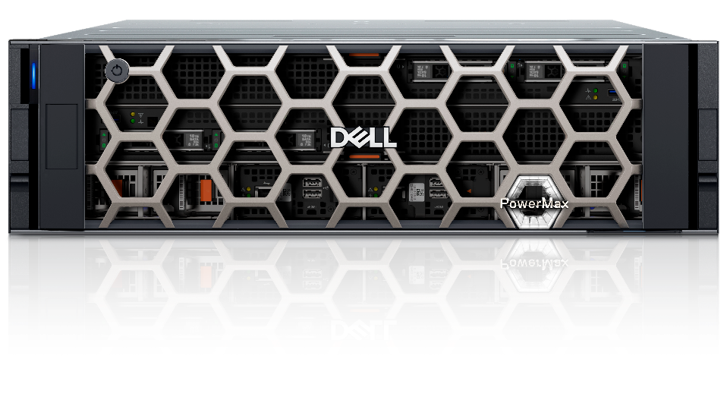
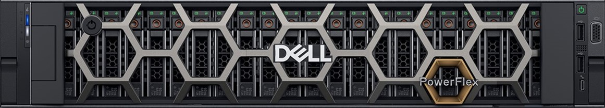
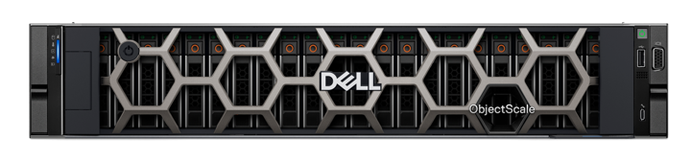
Purpose-built storage. Confidence to handle any workload.
Dell Storage Solutions
Future-proof
private cloud
Unleash AI
at scale
Strengthen
cyber resilience
PowerStore
Unified, all-flash enterprise storage
PowerScale
Unified file and object storage
PowerMax
World’s most secure mission-critical storage
PowerFlex
Powerful, flexible software-defined infrastructure
PowerProtect
The ultimate protection for any workload
ObjectScale
Object storage at scale
Power any workload across the edge, data center & public cloud.
Achieve your data needs with efficient, resilient, and future-ready solutions from the #1 provider of external enterprise storage.¹
1 IDC quarterly enterprise storage systems tracker, 2024Q4 final historical release, March 13, 2025 – Vendor Revenue.
Copyright © Dell Inc. All Rights Reserved.
12
Copyright © Dell Inc. All Rights Reserved.
Notes:
Dell Technologies' storage and data protection portfolios are crafted to empower organizations by meeting their unique data needs with smart, flexible, and resilient solutions. Designed to handle the demands of evolving workloads, these products deliver the flexibility and resilience businesses require to succeed, whether you're a small startup or a global enterprise.
First, let's look at primary storage, purpose-built for private cloud environments, where speed, reliability, and scalability are crucial. Our offerings include:
PowerStore: Unified and all-flash, it offers future-proof flexibility, ease of use, and unmatched efficiency through AI-driven automation—perfect for diverse workloads like databases , virtual machines and containers.
PowerMax: Designed for mission-critical applications requiring extraordinary performance and resiliency. With its scale-out architecture, AI delegation, and industry-leading cyber resiliency, PowerMax delivers peace of mind for critical data environments.
PowerFlex: Ideal for software-defined infrastructure. It provides extreme scalability, enabling independent scaling of compute and storage, and supports mixed workloads on a universal platform.
These products ensure that transactional data operations run seamlessly, efficiently, and securely.
Next, let’s look at Unstructured data storage solutions, purpose-built for AI/GenAI use cases, like files, images, and videos, requires flexible yet scalable storage solutions. Here’s how Dell delivers:
PowerScale: Unified file storage built for modern apps and AI. Enterprise storage with power, scale and security to drive modern apps and AI – from anywhere. Uncompromised performance, from NVMe all flash to feed GPUs, and the densest storage enclosures. Unprecedented scale, single file system, intelligent tiering, multi-protocol access, including S3. Unmatched safeguards, layered security and resilience, with compliance across industries.
ObjectScale: The ultimate choice for cloud-native applications and secured archival. It excels in handling high volumes of unstructured data with unmatched efficiency and elasticity at lower TCO.
Whether you're building AI models or managing large multimedia archives, Dell's unstructured storage systems offer consistency and speed.
Cyber Resiliency underpins modern IT strategy, and Dell's comprehensive solutions ensure your business continuity:
PowerProtect Data Domain and PowerProtect Data Manager for end-to-end backup solutions, integration with multicloud platforms, and industry-leading data reduction guarantees to optimize costs.
PowerProtect Backup Services enhance cyber resiliency with immutability, AI-based threat detection, and secure recovery through a cyber vault architecture.
From traditional on-prem storage to multicloud ecosystems, Dell offers modern data defense mechanisms to keep your systems resilient against evolving threats.
At the center of Dell's storage ecosystem lies AIOps, our AI-powered IT operations system that simplifies infrastructure management.
Infrastructure Observability enhances performance monitoring and resolves infrastructure issues 10x faster.
With AIOps, managing IT environments becomes simpler and more proactive. It’s a crucial part of Dell being your trusted technology partner.
Critical to maintaining business agility without vendor lock-in, Dell supports an open ecosystem that easily integrates with existing platforms, public clouds, and SaaS environments. With hypervisor-agnostic, API-driven technologies, we ensure seamless operations and reliable performance across your IT infrastructure. By combining advanced technology with scalable options, Dell Technologies ensures that organizations of all sizes can confidently manage, protect, and leverage their data for lasting success.

Slide 13
Unified, all-flash enterprise storage. Future-ready for diverse workloads and private cloud.
Dell PowerStore
Future Proof
Endlessly adaptable
Scale-up/Scale-out flexibility
Built-in data resiliency
Lifecycle Extension with ProSupport – “Never outgrow”
Efficient
Automatically lowers costs
Always on data reduction, no performance impact
Autonomous active/active
Energy efficient design
Easy to use
Simple across any ecosystem
Self-optimizing platform
Powerful AIOps tools
End-to-end ecosystem automations
Industry’s most flexible upgrade program¹
Industry’s best data reduction guarantee²
Better data efficiency vs competitor³
Average three-year ROI⁴
in ease of use⁵
#1
5:1
2x
463%
#1
1 – Based on Dell industry analysis, November 2024
2 – 5:1 average rate guaranteed for reducible data across customer applications. Rates for individual applications may vary. See Future-Proof Program terms and conditions for details.
3 – Based on a Prowess report commissioned by Dell Technologies, “Choose High Data-Efficiency Technology for Lower Storage TCO”, May 2024. Actual results may vary
4 – IDC: The Business Value of PowerStore, March 2023
5 – Based on Dell Technologies analysis in October 2023 using double-blinded, competitive benchmark Net Promoter Score (NPS) data gathered by third-party commissioned by Dell for 1H FY24
13
Copyright © Dell Inc. All Rights Reserved.
Notes:
Dell PowerStore is the flagship storage solution from the industry’s #1 external storage provider for a reason – and I’m excited to share how it can help your business adapt to challenges, reduce costs, and simplify infrastructure for the long term.
PowerStore offers unified, all-flash enterprise storage to handle diverse workloads with agility and efficiency. With Scale-Up and Scale-Out architecture and AIOps integration, organizations can achieve automation-driven performance, reduced cost, and flexible scalability, enabling seamless operations across edge, core, and cloud environments.
It’s built on a
FUTURE-PROOF design – including the industry’s most flexible modernization program
Guaranteed EFFICIENCY – that helps you save cost predictably over time
#1-ranked EASE OF USE – with built-in intelligence and automation so you can accomplish more with less effort
PowerStore is unlike any other storage platform, architecturally and programmatically. That “PowerStore difference” is the reason it’s the go-to all-flash solution for thousands of enterprises worldwide – backed by over 8 exabytes of capacity shipped, millions of run hours, and deployments across more than 90% of the Fortune 500 sectors.
These businesses know PowerStore is more than just a smart choice – it’s today’s BEST value in enterprise storage.
----------------------------------------------------------------------------
Sources:
1 – Based on Dell industry analysis, November 2024
2 – 5:1 average rate guaranteed for reducible data across customer applications. Rates for individual applications may vary. See Future-Proof Program terms and conditions for details.
3 – Based on a Prowess report commissioned by Dell Technologies, “Choose High Data-Efficiency Technology for Lower Storage TCO”, May 2024. Actual results may vary
4 – IDC: The Business Value of PowerStore, March 2023
5 – Based on Dell Technologies analysis in October 2023 using double-blinded, competitive benchmark Net Promoter Score (NPS) data gathered by third-party commissioned by Dell for 1H FY24

Slide 14

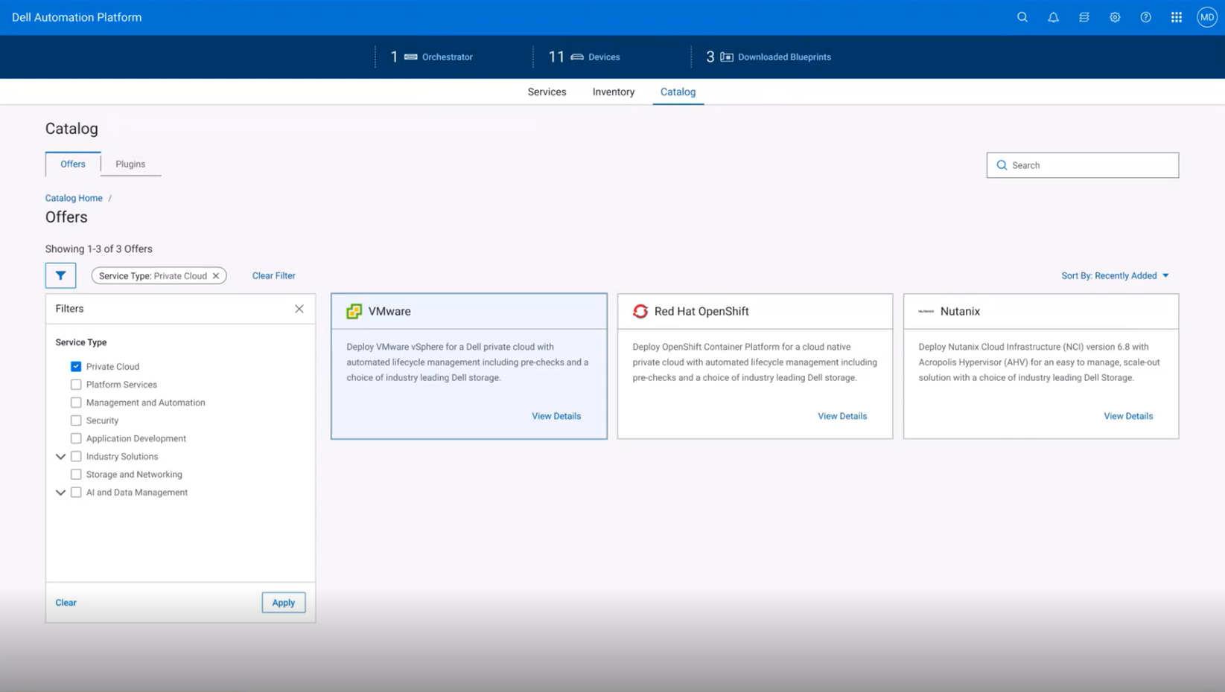
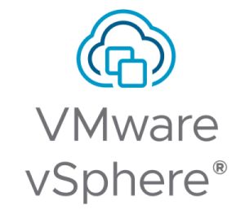


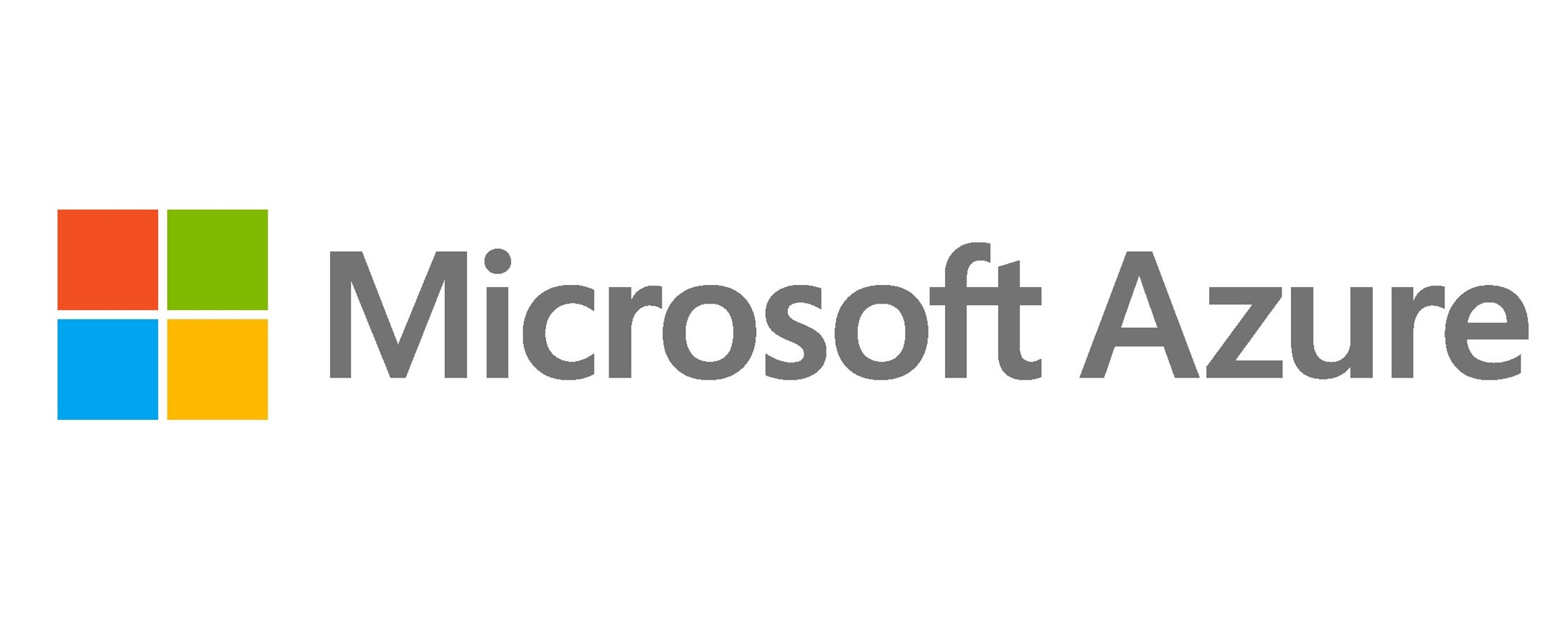
Dell Private Cloud
Fully transferable and reusable infrastructure
Freedom and flexibility to evolve on your terms
Dell Automation Platform
Protect investments with disaggregated and adaptable infrastructure
Bring your own cloud OS licenses for ultimate flexibility
Simplify operations with full lifecycle management and automated integration with Dell PowerStore
Ensure continuity by leveraging existing skills and access to familiar tools
Rely on Dell as the primary source of system-level support for hardware and system software
Private Cloud Catalog
Dell Automation Platform
Delivers
44%
cost savings
compared to HCI¹
Validated with
45,000+
hours of testing²
Over
90%
fewer steps to provision vs.
manual deployment³
Workload-ready
clusters in
2.5
hours, zero manual effort⁴
Compute
Networking
Storage
¹ Based on internal Dell testing. Dell Private Cloud deploying VMware vSphere and Red Hat. August 2025. Actual results may vary. CLM-014261.
² Based on internal Dell testing. Manual steps automated through a single Dell Private Cloud blueprint. May 2025. Actual results may vary. CLM-014260.
³ Based on internal Dell testing. After hardware installation, configuration and platform onboarding. No manual interaction required after initiation. Actual results may vary. CLM-014262.
⁴ Additional storage support coming 2H 2025.
Notes:
Dell Private Cloud – built on Dell’s disaggregated infrastructure – is designed with freedom and flexibility in mind and based on direct feedback from customers like you.
That means Dell Private Cloud offers investment protection through its open infrastructure that can be wiped and re-imaged as workloads and business needs change. Dell Private Cloud is not an appliance, but it provides an easy-to-use, simple appliance-like experience with adaptability. [This is really important based on everything we’ve heard: Anything you're investing in from an infrastructure standpoint, both the hardware and the software, has to be able to support what you have today, but also where you’re going in the future. That means being able to reuse the hardware and making sure that any software you’re investing in is as flexible as possible.]
Dell Private Cloud provides flexibility allowing you to bring your own 3rd party cloud OS licenses. [That means if you have an ELA with VMware, you can use that on this platform. You procure the licenses you want and use it on this infrastructure. And we’re offering flexibility with our own software license as well. So after you purchases a Dell Private Cloud subscription, you can use it for a VMware environment for 1, 2, 3 years and then when you’re ready to transition, you can keep using that same Dell Private Cloud license and hardware when you pivot to a different software ecosystem. This is another example of how Dell Private Cloud infrastructure is built to be reusable across the board.]
You will also benefit from simplified day-to-day operations with full lifecycle management, continuously validated states and automated integration with Dell PowerStore.
Additionally, Dell Private Cloud ensures continuity and is easy-to-use. You can leverage your existing skill set and access familiar tools. [The way you manage Dell Private Cloud in a VMware environment for example, is through the vCenter plug-in. So it’s going to look identical to how you’ve been managing VxRail, your teams don’t need to be re-trained.]
And lastly, you can be confident knowing that Dell provides solution-level support for both hardware and system software. Dell resolves the vast majority of third part system software issues and will collaborate with the customer and third-party support teams on the infrequent occasions when their help is required.

Slide 15
Get more for less with Dell Private Cloud
Hyperconverged
3-Tier
3-Tier
Simple to order, onboard and deploy
Automated lifecycle management
Streamlined, single stack support
Flexibility to BYO 3rd party cloud OS
Protect hardware investment
Reduce storage footprint
44%
Disaggregated Infrastructure
Fewer storage needs
Lower $/GB with 5:1 DRR²
Higher utilization
Fewer compute nodes
Fewer servers required
Lower licensing costs
cost savings compared to HCI¹
Dell Private Cloud combines the best of HCI and 3-Tier for
more simplicity, automation and flexibility to lower OPEX costs
¹ Source: Arcilla, Alex. Dell Private Cloud: Dynamic and Flexible IT Architecture for an Ever-changing Business Landscape. Omdia, January 2026. Actual results may vary. CLM-015607.
² 5:1 average rate guaranteed across customer applications. Rates for individual applications may vary. See Future-Proof program terms and conditions for details.
Notes:
Let’s focus on what makes Dell Private Cloud the clear choice for organizations. It combines the simplicity and convenience you expect with unmatched value—offering 44% lower costs at the point of sale compared to traditional hyperconverged (HCI) appliances.
With Dell Private Cloud, customers get unmatched flexibility—supporting both VMware and non-VMware environments—while avoiding the lock-in of HCI. You can scale compute and storage independently, reducing your hardware footprint, lowering software licensing costs, and cutting infrastructure.
On top of that, Dell Private Cloud ensures better storage utilization, thanks to centralized storage and a 5:1 data reduction ratio with PowerStore, driving down the cost per GB. And with streamlined lifecycle management, patching is faster, simpler, and minimizes downtime—keeping operations running smoothly.
In short, Dell Private Cloud offers greater simplicity, enhanced automation, and the flexibility to adapt to evolving needs—all while protecting your investments and delivering significant cost savings.

Slide 16
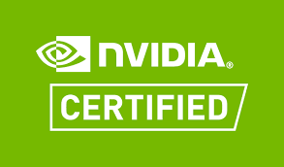
Unified file and object storage built for modern apps and artificial intelligence.
Dell PowerScale
Uncompromised performance
Move faster
High throughput
Ultra-low latency
Elastic scale
Unbound intelligence
Think bigger
Reliable data integrity
Effortless pipeline integration
Cost efficient at scale
Unmatched safeguards
Stay stronger
End-to-end security
Built-in compliance
Seamless orchestration
Up to 8x
The World’s
Most Secure NAS²
350+ integrations
greater cluster throughput than traditional flash-only competition¹
And certifications for industry applications
1 Based on Dell analysis. Performance is based on PowerScale F710 maximum throughput per cluster running NFS 4.2, September 2024. Actual results many vary.
2 Based on Dell analysis of cybersecurity software capabilities
16
Copyright © Dell Inc. All Rights Reserved.
Notes:
Dell PowerScale unified file and object enterprise storage with speed, scale and security to power modern apps and AI.
PowerScale is engineered for performance and scalability, delivering optimized solutions for modern apps, including AI, machine learning, big data. Its unified global namespace and smart scale-out architecture ensures seamless expansion, making it ideal for processing vast datasets while providing unmatched efficiency and reliability for innovation-driven workloads.
Our PowerScale lineup enables our customers to right-size their environment by balancing cost to performance requirements. From all-flash to hybrid and archive, PowerScale is fit to handle a diverse set of customer workload requirements. ​
Powerful to move faster – accelerate performance and optimize data-intensive workloads. Uncompromised performance, from NVMe all flash to feed GPUs, and the densest storage enclosures.
Scalable to think bigger – adapt seamlessly and scale effortlessly across all environments. Unprecedented scale, single file system, intelligent tiering, multi-protocol access, including S3.
Secure to deepen trust – Ensure data is always secure and readily accessible, anywhere. Unmatched safeguards, layered security and resilience, with compliance across industries.
----------------------------------------------------------------------------
Sources:
1 Based on preliminary internal analysis comparing F600p running OneFS 9.5 versus F710 running OneFS 9.9 using 200GbE. December 2024. CLM-012804
2 Based on preliminary internal analysis of streaming read figures comparing F600p running OneFS 9.5 versus F710 running OneFS 9.9 using 200GbE. December 2024. CLM-012803
3 Dell PowerScale/PowerScale F710 accelerates AI workloads with up to 3x the sustained throughput per rack unit vs. traditional flash-only scale-out NAS/file competitors. Based on Dell analysis. Dell performance is based on PowerScale F710 maximum sustained write throughput running NFS 4.2. February 2025. Actual results may vary. CLM-012698.
4 Based on 61TB SSD availability vs previously max availability of 30TB SSDs. October 2024. CLM-012793

Slide 17









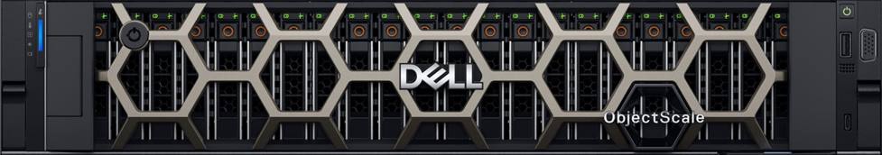


AI Data Platform
Composable approach - - -
---- modular, reusable, design to operate as part of a larger solution
Data Sources
Dell AI Data Platform
Consumers
Business Intelligence
Data Engines
Cyber Resilience
Provide universal, unified access to all enterprise data.
Access Control
Query
Extract
Streaming
Batch
Data Query
Engine
Data Processing
Engine
Data Search Engine (coming soon)
Data Engineers
Data Masking
Storage Engines
Data Scientist
Store, retrieve, manage and protect complex data at scale for AI.
Data Encryption
PowerScale
ObjectScale
GEN AI / ML
Unified File / Object
Performance at scale with operational simplicity
Real-time Threat Detection
Cloud Native S3 / Object
Purpose built with global reach & access
On-premises |
Hybrid-cloud | Edge
Outcomes
Notes:
"To bring the Dell AI Data Platform to life, we take a composable approach—using specialized engines for data, storage, and protection. Each plays a unique role, but together, they form a powerful foundation for AI success.
<CR>
Let’s start with data engines—the brain of the platform. They help organizations access, prepare, and manage data from apps, devices, and other sources. These engines clean, organize, and enhance data, making it ready for analytics, AI model training, and real-time decision-making.
Dell’s data engines are powered by trusted partners like Starburst for data queries, Apache Spark for batch and streaming data processing, and, coming soon, Elastic for unstructured data search.
Key takeaway? Embrace the role of data engines—and rely on Dell presales specialists to help position them with customers.
<CR>
Next, let’s talk about storage engines—critical for managing data in today’s AI-driven world. Storage is no longer passive. It’s an active enabler of performance, scalability, and flexibility.
These engines handle all types of data—structured, semi-structured, and unstructured—and ensure it’s always available, secure, and high-performing. Dell offers Unified File and Object Storage to simplify hybrid environments, and S3 Object Storage for scalable, cloud-native data handling.
Together, they help customers move faster and scale smarter.
<CR>
SHORT PAUSE
And finally, being cyber resilent. In today’s environment, security is essential. Dell builds protection into the platform from the ground up—with access controls, data masking, and encryption to safeguard sensitive information.
To defend against modern threats, Dell includes cyber-resilient features like data isolation and air-gapped architecture—ensuring data stays protected, even during a cyberattack.
<CR>
In summary: Data, Storage, and Protection Engines work together to support the full data lifecycle—helping customers unlock insights, drive innovation, and scale with confidence."

Slide 18
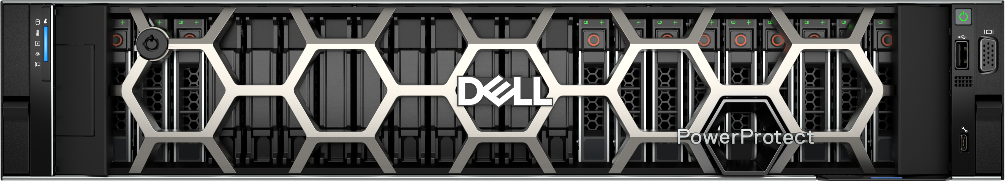
Achieve cyber resilience. And peace of mind.
Dell PowerProtect
Modern multicloud protection
Innovate faster
End-to-end protection
Rich automation
Operational consistency
Simple, flexible consumption
Innovate efficiently
Ease of deployment
Self-service operations
Streamline operations
Intelligent cyber resilience
Innovate securely
Secure by design
Built in immutability
Cyber vault with AI-based threat detection and recovery
Purpose-Built Backup Appliance¹
In customer satisfaction²
In total cost of ownership³
#1
#1
#1
Up to 4X
Up to 80%
Typically 75:1
Faster restores⁴
Less power⁴
Data reduction⁵
1 Based on revenue from the IDC 3Q25 Purpose-Built Backup Appliance (PBBA) Tracker.
2 Based on Dell Technologies analysis. Compared to VAST, Pure Storage, NetApp, and HPE backup appliances. Compared to Veeam, Cohesity, Rubrik, and Commvault data protection software. Using double-blind, competitive benchmark Net Promoter Score (NPS) data gathered by third-party commissioned by Dell. August 2025.
3 Based on Dell internal testing comparing a PowerProtect Data Domain DD9910 appliance vs a PowerProtect Data Domain All-Flash DD9910F appliance, both configured at similar capacity. April 2025. Actual results may vary..​
4 Based on Dell internal testing comparing a PowerProtect Data Domain DD9910 appliance vs a PowerProtect Data Domain All-Flash DD9910Fappliance, both configured at similar capacity. April 2025.
5 Based on Dell internal testing and field telemetry data, December 2025. Actual results may vary.
18
Copyright © Dell Inc. All Rights Reserved.
Notes:
Dell doesn’t just protect data. We protect our customers’ ability to adapt, evolve, and excel by helping them build their cyber resilient foundation with PowerProtect.
The Dell PowerProtect portfolio empowers your business to secure, detect, and recover against cyber threats. Features like immutable backups, end-to-end encryption, and automated cyber recovery enhance data resiliency, safeguard against cyber threats, and minimize downtime, providing peace of mind in an unpredictable landscape.
Dell PowerProtect is #1 in customer satisfaction and PowerProtect Data Domain is the number 1 purpose-built backup appliance for a reason. It has the performance, efficiency, security and scale our customers require- supporting both traditional and modern cloud-based workloads.
The high-performance Data Domain All-Flash appliance delivers unmatched speed, efficiency, and security, empowering organizations to modernize their cyber resilience strategies with measurable benefits: up to 4x faster restores and 2x faster replication, occupying 40% less rack space and provides up to 80% power savings.
We have 55 to 1 data reduction guaranteed, and customers typically see 75 to 1 data reduction across our install base. We have over 2700 customers using PowerProtect Data Domain as a cyber recovery vault - a key component to a modern cyber resiliency strategy.
----------------------------------------------------------------------------
Sources:
1 Based on revenue from the IDC 3Q25 Purpose-Built Backup Appliance (PBBA) Tracker.
2 Based on Dell Technologies analysis. Compared to VAST, Pure Storage, NetApp, and HPE backup appliances. Compared to Veeam, Cohesity, Rubrik, and Commvault data protection software. Using double-blind, competitive benchmark Net Promoter Score (NPS) data gathered by third-party commissioned by Dell. August 2025.
3 Based on Dell Technologies analysis. Compared to VAST, Pure Storage, NetApp and HPE backup appliances using double-blind, competitive benchmark Net Promoter Score (NPS) data gathered by a third-party commissioned by Dell. August 2025.
4 Based on Dell internal testing comparing a PowerProtect Data Domain DD9910 appliance vs a PowerProtect Data Domain All-Flash DD9910F appliance, both configured at similar capacity. April 2025. Actual results may vary..​
5 Based on Dell internal testing and field telemetry data, December 2025. Actual results may vary.

Slide 19

Dell Technologies
Cyber Resilience
Through the lens of the threat funnel
Reduce the Attack Surface:
Minimize the vulnerabilities and entry points that can be exploited to compromise the environment.
Secure
Detect and Respond to Threats:
Actively identify and address potential security incidents and malicious activities.
Detect
Recover from Cyberattacks:
Restore the organization as quickly as possible while minimizing disruption.
Recover
Notes:
To build a strong foundation for cyber resilience, Dell emphasizes three critical practice areas or pillars: Secure, Detect, and Recover. These use cases work together to create a comprehensive approach to protecting, monitoring, and restoring your organization’s digital environment.
Secure:
The first pillar, Secure, is all about fortifying your defenses. This includes implementing robust access controls, encrypting sensitive data, and ensuring your systems are protected against vulnerabilities. The goal here is to minimize the attack surface and make it as difficult as possible for threat actors to breach your environment.
Detect:
The second pillar, Detect, focuses on identifying threats early and in real time. This involves leveraging advanced monitoring tools, threat intelligence, and analytics to quickly spot suspicious activity. Early detection is critical to minimizing the impact of an attack and preventing it from spreading further.
Recover:
The third pillar, Recover, is where we focus on bouncing back after an incident. Even with the best security and detection measures, breaches can still happen. The Recover pillar ensures that your organization can restore operations quickly and effectively, minimizing downtime and data loss. This includes having robust backup and recovery solutions, as well as a well-defined incident response plan.
Together, these three pillars form a holistic approach to cyber resilience, ensuring your organization is prepared to withstand and recover from cyber threats. The PowerProtect portfolio is designed with these pillars in mind to help organizations continue business operations.

Slide 20


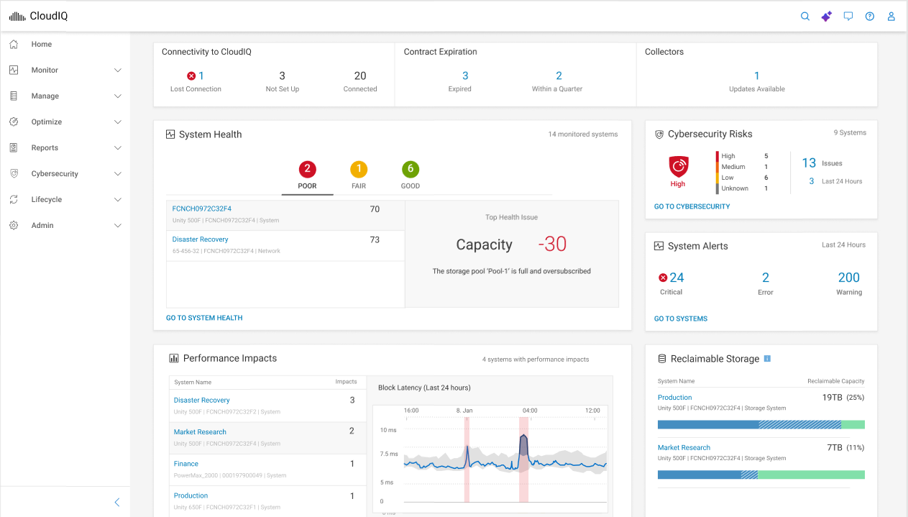
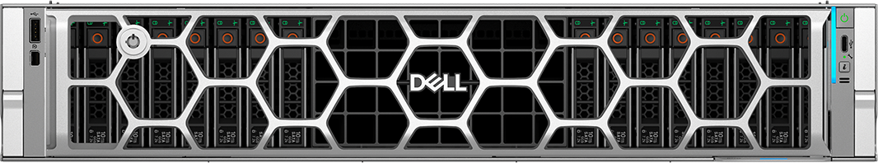
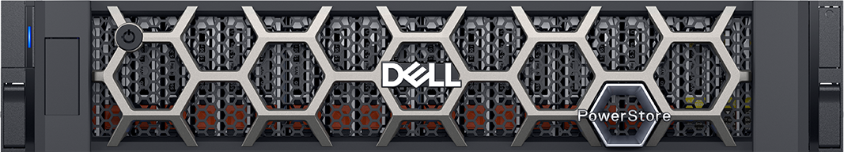

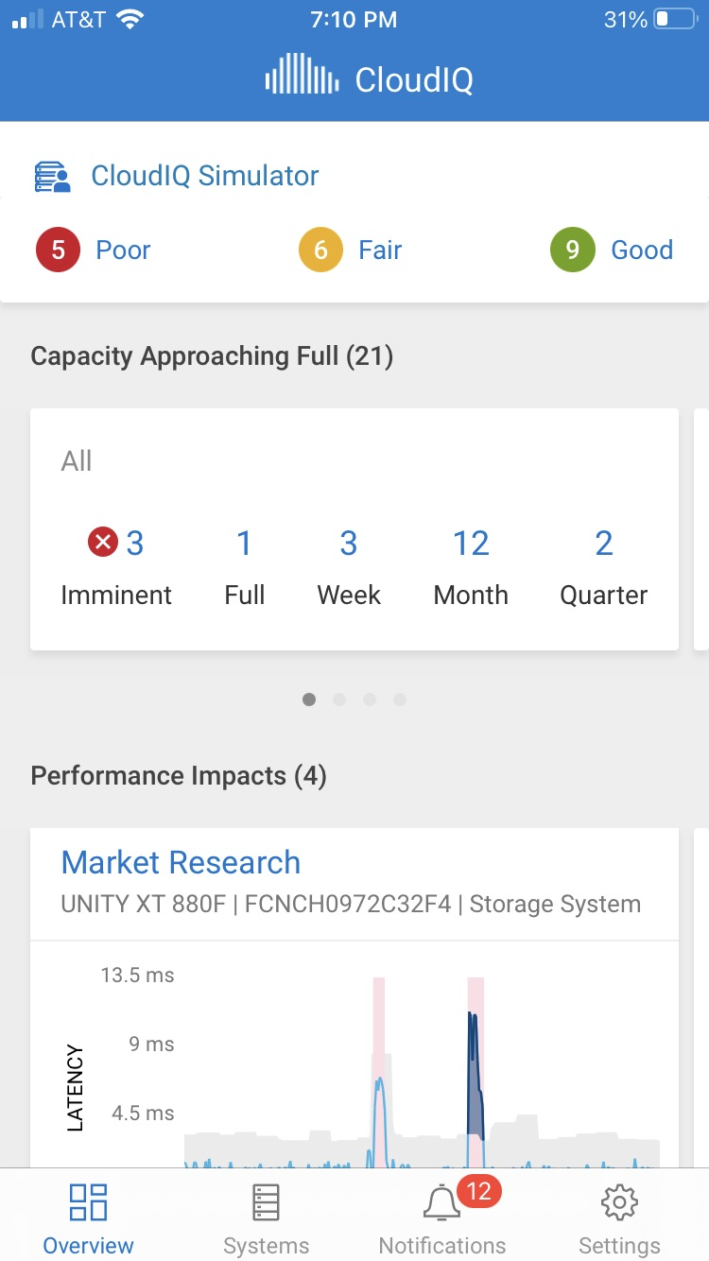
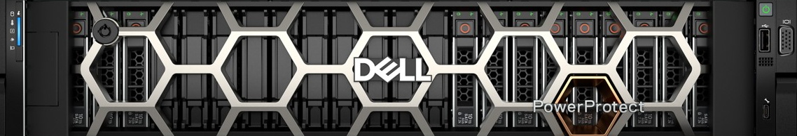
Smarter infrastructure. Fewer disruptions.
Dell AIOps
Gain visibility instantly
Across your infrastructure
Proactively resolve issues
Predict and act before impact
Automate everything
With AI-powered intelligence
>950,000
Up to 10x
Up to 8hrs
systems monitored¹
faster issue resolution²
saved per week²
Dell AIOps
New AI assistant
Supports Dell infrastructure: storage, cyber resilience, server and networking infrastructure*
AI-driven observability and automation.
Cloud-based simplicity. Included with ProSupport agreements.
AIOps Assistant: streamlines research and resolves issues faster.
¹ Based on Dell analysis of all systems ever connected as of January 2026
² Dell AIOps user survey, Dell Technologies, January 2026. Actual results may vary.
* PowerStore, PowerMax, PowerFlex, Unity XT HFA, PowerVault, PowerScale, VxRail, PowerProtect Data Domain, PowerEdge, PowerSwitch, Connectrix, and older systems and cloud versions.
20
Copyright © Dell Inc. All Rights Reserved.
Notes:
Dell AIOps gives storage admins the clarity, control, and confidence to run faster, safer, and smarter—all from a single, cloud-based platform. By using predictive analytics and real-time insights, AIOps minimizes disruptions, reduces manual intervention, and enables IT teams to maintain resilient and optimized environments with confidence and ease.
Dell AIOps empowers storage administrators to optimize system performance with a user-friendly, cloud-based platform. Achieve real-time visibility across your entire Dell infrastructure and utilize AI-driven predictions to identify and proactively resolve issues up to ten times faster. Included with your ProSupport agreement, Dell AIOps frees up valuable time with automated smart alerts and our new AI Assistant, saving your storage administrators up to eight hours per week. With advanced insights into health, cybersecurity, and sustainability, Dell AIOps minimizes downtime, boosts efficiency, and enables you to concentrate on strategic initiatives.
----------------------------------------------------------------------------
Sources:
1 Based on Dell analysis of all systems ever connected as of January 2026.
2 Dell AIOps user survey, Dell Technologies, January 2026. Actual results may vary.
* PowerStore, PowerMax, PowerFlex, Unity XT HFA, PowerVault, PowerScale, VxRail, PowerProtect Data Domain, PowerEdge, PowerSwitch, Connectrix, and older systems and cloud versions.

Slide 21
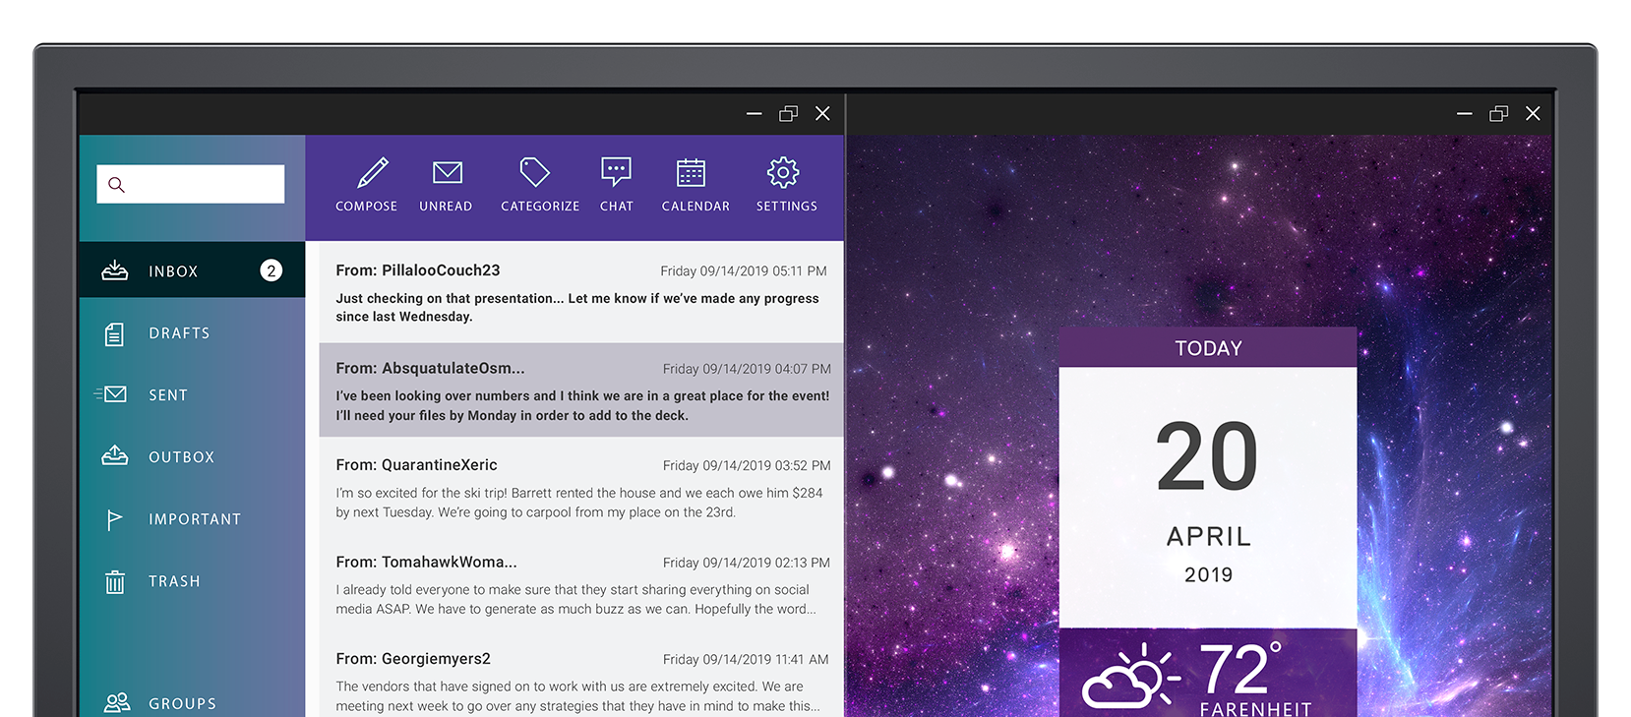
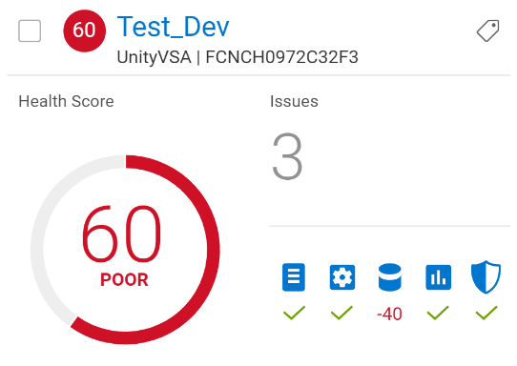

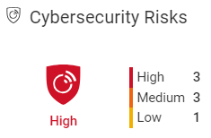






AIOps: a game-changer for IT operations
Simplify your Dell fleet management with smarter insights
Health
Cybersecurity
Sustainability
System Health
Carbon Footprint
Carbon Emissions
Energy Trend
Evolution from simple metrics to actionable insights
Copyright © Dell Inc. All Rights Reserved.
21
Copyright © Dell Inc. All Rights Reserved.
21
Notes:
IT monitoring has evolved in a similar way – from simple key performance indicators that you’d have to interpret yourself to Dell AIOps, which uses machine learning and other AI algorithms to analyze IT telemetry and give you actionable insights.
Dell AIOps (formerly CloudIQ) uses the power of AI to simplify IT management, assure infrastructure integrity and optimize the health, cybersecurity and sustainability of your enterprise-wide Dell infrastructure.
Health
Dell AIOps analyzes a lot of telemetry to evaluate system health for you.
The blue icons represent the different types of metrics that go into health calculation to tell you:
If there are component outages
If there’s a configuration issue
If there’s capacity issue
If there’s a performance issue
if there’s a data protection issue.
It does the heavy lifting -- the time-consuming analysis of telemetry -- for you and recommends how to resolve issues before they impact your business.
Cybersecurity
Dell AIOps also keeps you aware of cybersecurity risks and vulnerabilities – something that older monitoring tools didn’t do at all.
First there’s security configuration monitoring:
Every system has a several to dozens of security settings that have to be unlocked to perform system administration.
Dell AIOps lets you know when they have been left unlocked or misconfigured – and how to restore them.
Next there are intelligent security advisories:
These are more efficient than traditional email-based advisories because they warn you and recommend actions directly in your dashboard. No more email advisories filter through.
Sustainability and Energy Efficiency
Dell AIOps analyzes power telemetry to track and forecast energy consumption as well as emissions (also called Use Phase Carbon Footprint).
It does this at the organization, system and workload levels – which would be too time-consuming to do manually.
This gives you actionable insights about how to reduce carbon footprint and lower energy costs.

Slide 22
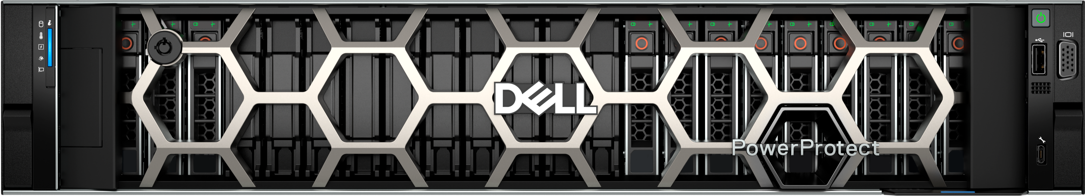
Great individually. Better together.
Get efficient with Dell infrastructure.
7:1
Consolidation
Latest PowerEdge does the work of up to 7 previous gen servers.
72%
Less power
& cooling
5:1
Capacity
data
reduction
55:1
Capacity
deduplication
guarantee
Built-in intelligent automation software to manage infrastructure
Dell AIOps
Define/resolve issues
OME Power Manager
Power/energy management
Dell software innovation
Lifecycle management
PowerEdge
A single vendor for server, storage and cyber resilience delivers a Consistent, Predictable, Reliable customer experience
PowerStore, PowerScale,
PowerMax, PowerFlex
PowerProtect
22
Copyright © Dell Inc. All Rights Reserved.
Notes:
Dell aligns innovation with sustainability, offering solutions that reduce energy consumption and optimize operational footprints. By choosing Dell’s storage solutions, businesses advance environmental goals while maintaining top-tier performance and cost efficiency.
We know aging systems are less performant, offer poorer data density, run hotter and contribute more to your carbon footprint as well as total-cost-of-ownership.
Dell’s infrastructure products are powerful on their own, but even stronger when combined. By refreshing existing servers and storage with newer Dell infrastructure you get immediate efficiency gains to pave the way for funding your AI initiative. Here’s how:
A single current generation PowerEdge server can do the same amount of work as up to seven servers of previous generations. By improving performance per watt, you can do more processing with less power.
With our design breakthroughs in thermals, variable speed fans and liquid cooling – you can reduce power and cooling by up to 72%.
With Dell’s data reduction guarantees and higher capacity systems, you can reduce the infrastructure it takes to support workloads, resulting in lower space requirements and overhead. Our enterprise storage products deliver up to 5:1 data reduction guarantees while our PowerProtect solutions achieve typically 75:1 data reduction, with a guaranteed 55:1 reduction.
And then there’s our built-in intelligent automation software to manage Dell infrastructure. From Dell AIOps to OME Power Manager to our overall software innovation – each provides the capabilities required to make your people and your operations more efficient.
Ultimately, choosing Dell infrastructure means more efficiency, reduced waste, and a better return on investment for your business. By working with Dell Technologies as a single vendor, you get the consistent, predictable and reliable customer experience you need to run the most efficient data center.

Slide 23

Dell technologies strategy and operating model
Our purpose
To create technologies that drive human progress
Our strategy
Leverage our strengths to extend our leadership and capture new growth
Our vision
Be the most essential technology partner
Leading end-to-end solutions
Industry’s largest GTM engine
Client Business
Workstations
PC Monitors
Servers
External Storage
Storage Software
Purpose-Built Backup Appliances
HCI
Extensive direct salesforce
A broad global technology ecosystem of partners
Modern online and consumption experiences
Unique operating model
Industry-leading supply chain
Unmatched global services
Automated
& AI-driven
Resilient, agile, sustainable at global scale
Global distribution & logistics centers
AI-driven support & experiences
Global footprint of direct services & support
Service centers around the world
Innovation + culture + customer-centricity
Client PC & upsell revenue statistic calculated by Dell Technologies primarily by utilizing other PC OEMs’ financial public filings, as of Q2 FY25; Workstations (Units) - IDC WW Quarterly Workstation Tracker CY24Q2 using data for 2Q24; PC Monitors (Units) - IDC WW Quarterly Monitor Tracker CY24Q2 using data for 2Q24; Server (Units) - IDC WW Quarterly Server Tracker CY24Q1 using data for 1Q24; External Storage (Revenue) - IDC WW Quarterly Enterprise Storage Systems Tracker CY24Q1 using data for 1Q24; Storage Software – IDC WW Storage Software and Cloud Services Tracker CY24Q1 using data for 1Q24 and includes archiving software, data replication and protection software, software-defined storage controller software, and storage infrastructure and device management software; PBBA – IDC WW Purpose-Built Backup Appliance (PBBA) (Revenue) CY24Q1 using data for 1Q24; Hyperconverged Systems (HCI) (Revenue) - IDC WW Quarterly Converged Systems Tracker CY24Q1 using data for 1Q24.
Notes:
Key Takeaways:
A clear strategy coupled with operational excellence and an underlying culture that can adapt, improvise and overcome nearly anything we encounter is what makes Dell special.
It’s also the foundation of why we are best positioned to be the catalyst to accelerate ideas to innovation.
Script:
We’ve just discussed our how Dell’s storage solutions can help advance your strategic priorities. Here’s why are a trusted industry leader and what sets us apart:
Leading End-to-End Solutions
We hold roughly 20 #1 positions across the technology landscape, showcasing our leadership in a wide range of solutions.
This success is fueled by continuous innovation, significant R&D investments, and one of the most talented technology workforces in the industry.
Industry’s Largest GTM (Go-To-Market) Engine
Our extensive direct sales team, complemented by 240,000 global channel partners, provides unparalleled customer reach and insight.
Combined with a modern online consumption model, our omnichannel approach ensures every customer can choose how they prefer to learn, buy, and interact with us.
Industry-Leading Supply Chain
Our supply chain is the strongest and most resilient in the industry, powered by automation and AI-driven processes.
Operating at a global scale, it is built to prioritize sustainability, agility, and resiliency, with industry-best inventory to meet customer needs.
Unmatched Global Services
We offer one of the largest footprints for direct services and support, delivering unmatched scale and expertise.
AI-driven experiences paired with end-to-end lifecycle services—spanning deployment to professional and managed services—ensure consistently high industry CSAT scores.
What Sets Us Apart
These unique capabilities are backed by our globally diverse team operating in a culture rooted in innovation and an unwavering dedication to our customers.
This is why Dell Technologies is perfectly positioned to act as a catalyst for your innovation. With us, you can unlock the full potential of your data, enhance experiences, improve efficiency, optimize productivity, and fuel growth.
----------------------------------------------------------------------------
Sources:
Client PC & upsell revenue statistic calculated by Dell Technologies primarily by utilizing other PC OEMs’ financial public filings, as of Q2 FY25; Workstations (Units) - IDC WW Quarterly Workstation Tracker CY24Q2 using data for 2Q24; PC Monitors (Units) - IDC WW Quarterly Monitor Tracker CY24Q2 using data for 2Q24; Server (Units) - IDC WW Quarterly Server Tracker CY24Q1 using data for 1Q24; External Storage (Revenue) - IDC WW Quarterly Enterprise Storage Systems Tracker CY24Q1 using data for 1Q24; Storage Software – IDC WW Storage Software and Cloud Services Tracker CY24Q1 using data for 1Q24 and includes archiving software, data replication and protection software, software-defined storage controller software, and storage infrastructure and device management software; PBBA – IDC WW Purpose-Built Backup Appliance (PBBA) (Revenue) CY24Q1 using data for 1Q24; Hyperconverged Systems (HCI) (Revenue) - IDC WW Quarterly Converged Systems Tracker CY24Q1 using data for 1Q24.

Slide 24
Power your data future with Dell Technologies
Create a roadmap from your current to future state of IT
Private cloud
Artificial Intelligence
Cyber resilience
Get Efficient
Assessment
GenAI Accelerator Workshop
Cyber Resiliency
Assessment
Understand the efficiency gains you
can get with Dell systems
Address your readiness in leveraging
GenAI across business and IT
dimensions
Self-guided approach to assess your vulnerabilities and get actionable recommendations
Cloud Smart
Discovery
ProConsult Advisory Engagement
Cybersecurity
Workshops
Optimize and right-size your cloud
environment
Define a winning strategy and outline
a roadmap to achieve your objectives
Expert-driven, interactive workshop to improve security and resilience strategies
Notes:
At Dell, we believe in empowering businesses with the right technology to accelerate their success. Our Storage Portfolio is designed to not only meet your current storage needs but also pave the way for future innovations and growth. With our powerful solutions and dedicated support, you can confidently navigate through any challenges and achieve your business goals. Let us be your partner on this journey towards success.
Now that you’ve seen what Dell’s storage portfolio can offer, we invite you to take the next step toward enhancing your IT environment. Connect with us today to discuss your storage challenges, and learn more about Dell’s solutions for:
Private Cloud:
Get Efficient Assessment: Identify opportunities to gain efficiency with Dell systems.
Cloud Smart Discovery: Develop a roadmap for adopting smarter cloud strategies.
Artificial Intelligence:
GenAI Accelerator Workshop: Address your readiness in leveraging GenAI across business and IT dimensions
ProConsult Advisory Engagement: Define a winning strategy and outline a roadmap to achieve your objectives
Cyber Resilience:
Cyber Resiliency Assessment: Evaluate and strengthen your cybersecurity posture.
Cyber Security Workshops: Expert-driven, interactive workshop to improve security and resilience strategies
These assessments are easy to start and provide actionable insights to accelerate your business success. Together, we’ll pave the way for your innovative data-driven future.

Slide 25

Closing slide
Are you ready to take control of your data strategy?
25
Copyright © Dell Inc. All Rights Reserved.
Notes:
Thanks so much for your time today! We look forward to working together to fuel your strategic priorities!

Slide 27
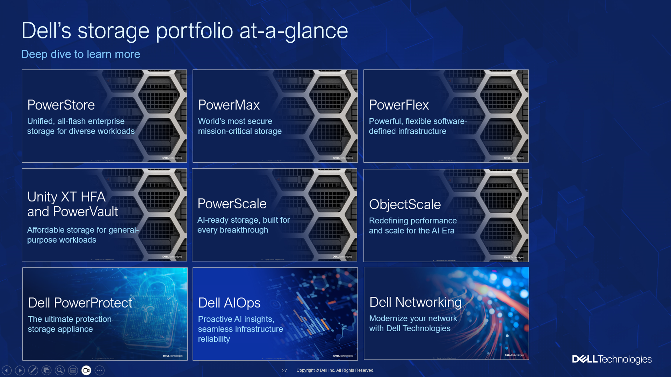
Notes for Presenters
(Hidden Slide, Internal Use Only – Delete Before Presenting)
Hidden Slide, Internal Use Only – Delete Before Presenting
Product Deep Dive (Zoom slide functionality)
In presentation mode, click on a product tile to present the slides within that section. Once you’ve reached the end of that section, it will bring you back to this menu. If you’d rather, you can just click next to present in sequential order as usual.
If you don’t want to present specific slides, just ‘hide’. If you want to remove an entire product tile, right click on all the tiles > Edit Summary > Select/Unselect the sections you want to present.
Objectives of this deck
This deck is intended to introduce and simplify our Dell storage portfolio (inclusive of primary, unstructured, and data protection). It’s meant to:
Start a conversation about what leaders must focus on to modernize their data-centers with smarter storage.
Ask the customer questions about their challenges, data needs, and workload disposition strategy.
Introduce 3 lead franchise products for key customer outcomes: PowerStore for Hybrid cloud, PowerScale for AI, and PowerProtect Data Domain for Data Protection.
This deck is modular; Feel free to customize the deck with the additional slides in backup tailored to your customer’s needs.
If you require more product information and customer-ready content, please refer to these resources:
  Storage Knowledge Center
  Data Protection Knowledge Center
  Networking Knowledge Center
  Storage Networking Knowledge Center
  Customer Stores & Sales Wins
Notes:
// NOTES FOR PRESENTER
(Hidden Slide, Internal Use Only – Delete Before Presenting)
Speaker notes contain:
Script section which supplies a detailed talk track
A Sources section, which supplies details of any quotes or stats used
Because the speaker notes have a lot of internal information and guidance to you as presenters, please only share the slides externally in PDF format without speaker notes.

Slide 28
Why settle for mixed-vendor complexity?
Simplify your infrastructure strategy with a single, strategic IT partner and integrated platform solutions.
Private cloud
Artificial Intelligence
Cyber resilience
Power any workload across the
edge, data center & public cloud
Optimize your AI investment with
right-sized infrastructure
Deliver comprehensive data
protection everywhere
Industry-leading infrastructure
Storage | Server | Networking
Industry-leading infrastructure
Storage | Server | Networking | Client
Industry-leading infrastructure
Data protection | Backup | Archive
Software
Data management | Monitoring | Analytics
Data security
Data protection | Cyber recovery
Data security
Data protection | Cyber recovery
Consistent management & ops
AI Ops | Automation | Orchestration
Professional services
Strategy | Data | Deployment | Implementation
Backup services
Backup | Disaster and Cyber Recovery
Open ecosystem
Hypervisors | Public Cloud | SaaS
Open ecosystem
Open-source models | LLMs | Silicon
Open ecosystem
Backup solutions | Multicloud enabled
Notes:
We recognize the challenges organizations face when navigating rapidly evolving IT landscapes. That’s why we are committed to delivering more than just infrastructure—we provide an integrated, open ecosystem that empowers businesses to achieve their goals.
Dell’s solutions are trusted, proven, and fully integrated to work across hybrid cloud, AI environments, and intrinsic security frameworks. Our open ecosystem supports a range of platforms, hypervisors, public clouds, and SaaS infrastructures. With end-to-end solutions and reliable integrations, Dell Technologies ensures you have the systems you need to succeed.
We believe that purpose-built storage is key to helping organizations achieve greater control, flexibility, availability, and security for their data. From hybrid cloud to AI workloads, Dell empowers businesses to power any workload with tailored solutions.
Hybrid cloud: Our hybrid cloud solutions empower you to seamlessly manage workloads across the edge, data center, and public cloud. With reliable performance, dynamic resource allocation, and customizable integrations, your IT environment will stay modern and adaptable to your needs.
Artificial intelligence: For organizations leveraging AI, Dell provides high-performance, scalable infrastructure to optimize your investments. With advanced data management platforms and built-in security, your AI projects can operate securely and efficiently.
Cyber resilience: Data security is more crucial than ever. Our cyber resilience solutions ensure comprehensive protection, so your data stays secure and compliant. We offer advanced recovery options and supply chain security to safeguard your operations from potential threats.
Our constant innovation keeps your enterprise ahead of the curve while ensuring secure, scalable, and efficient operations.

Slide 29
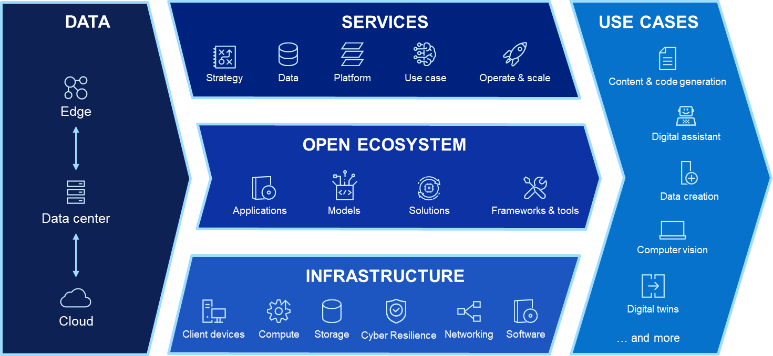
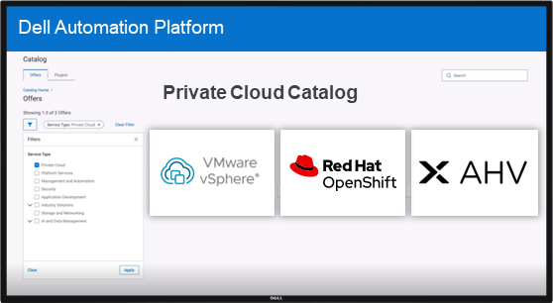
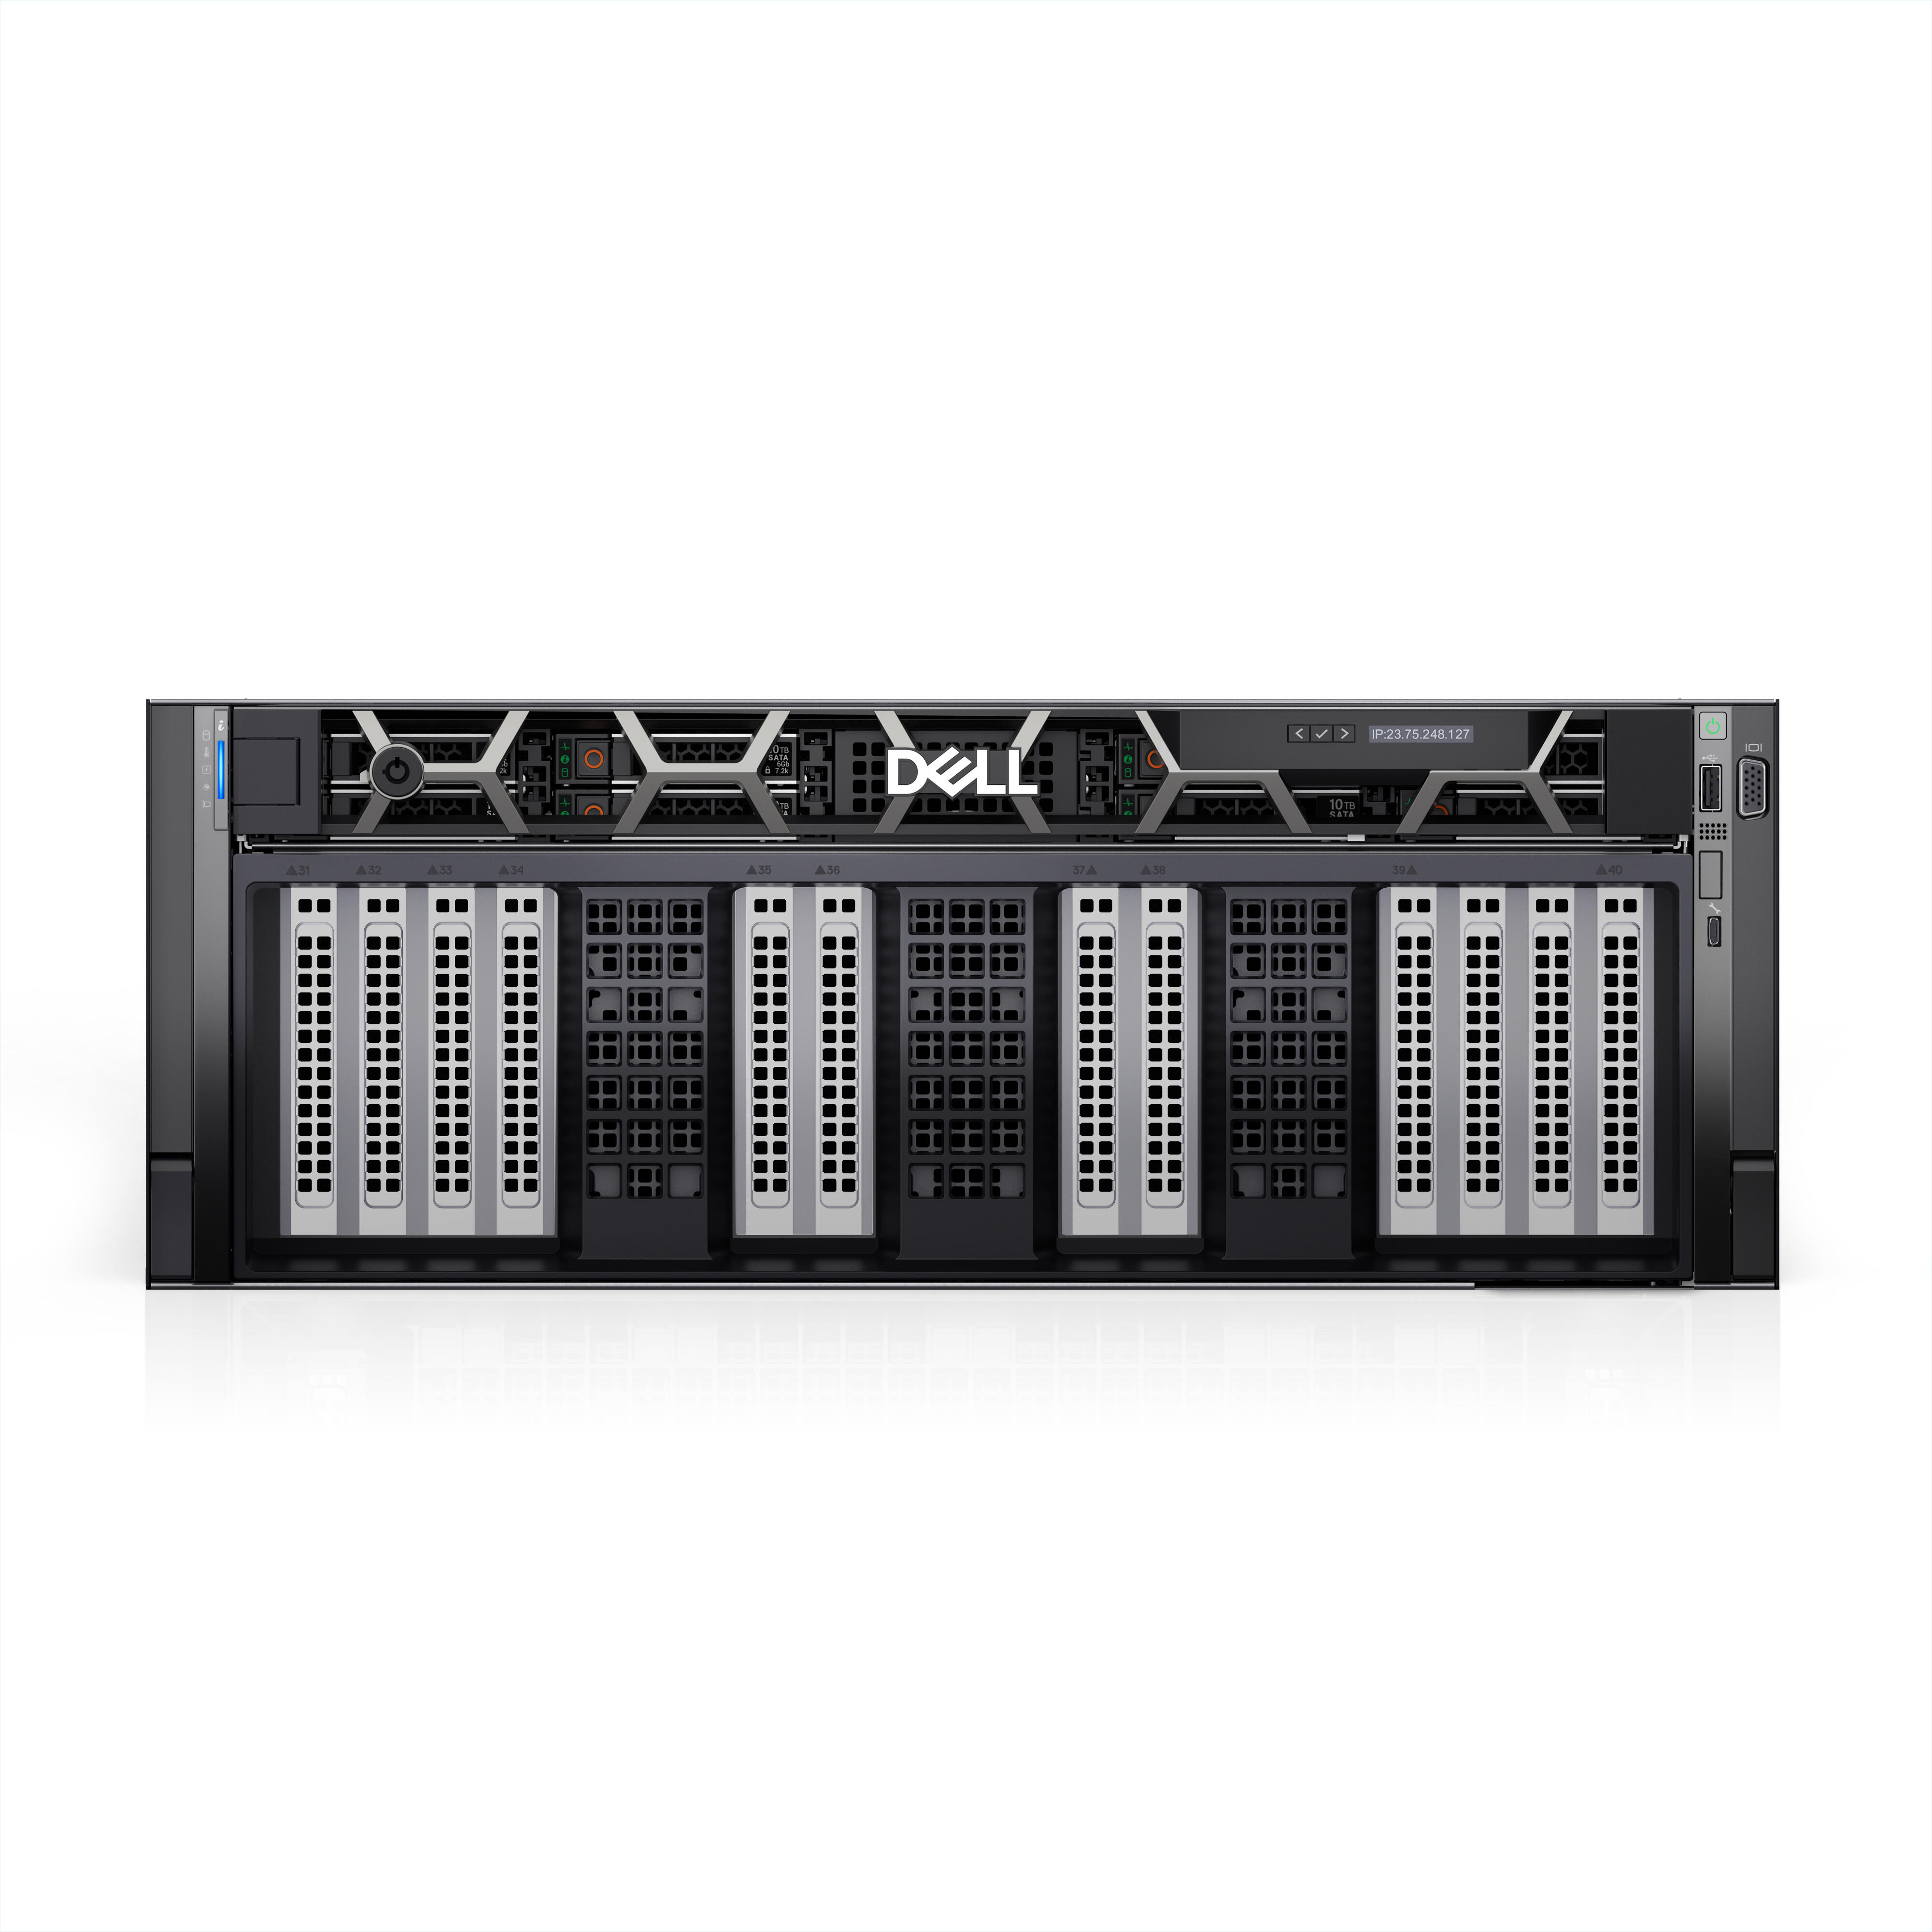
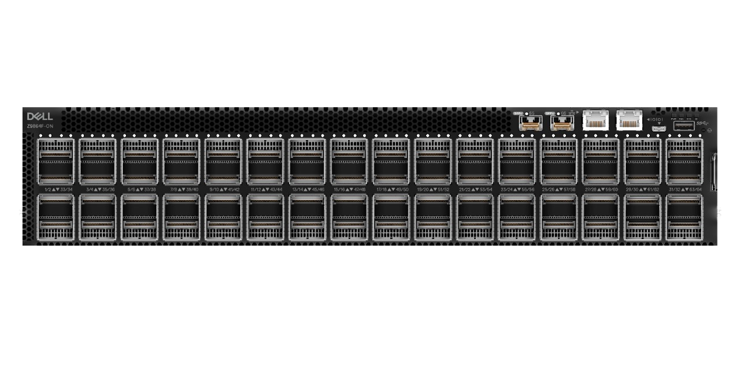
Dell Infrastructure Solutions
Powering strategic innovation with the #1 provider of enterprise infrastructure¹
Private/Hybrid Cloud
Artificial Intelligence
Cyber Resilience & Security
Easily deploy and manage your clouds without lock-in
Accelerate enterprise AI adoption with the Dell AI Factory
Build end-to-end resilience for any workload in any location
Secure
Detect
Recover
PowerStore | PowerEdge
Private Cloud | NativeEdge
PowerScale | PowerEdge XE | PowerSwitch
Integrated Rack Scalable Systems
PowerProtect
Appliances | Software | Services
¹ IDC Quarterly Enterprise Infrastructure Tracker: Buyer & Cloud Deployment, 2024Q4, March 27, 2025, Vendor Revenue
29
Copyright © Dell Inc. All Rights Reserved.
Notes:
Dell Technologies' storage and data protection portfolios are crafted to empower organizations by meeting their unique data needs with efficient, resilient, and future-ready solutions. Designed to handle the demands of evolving workloads, these products deliver the flexibility and resilience businesses require to succeed, whether you're a small startup or a global enterprise.
Dell offers purpose-built solutions tailored for your most critical workloads.
PowerStore is designed for private cloud and is highly programmable with end-to-end ecosystem integrations, allowing you to provision advanced storage services directly from your preferred management or orchestration platform. Unified and all-flash, it offers future-proof flexibility, ease of use, and unmatched efficiency through AI-driven automation—perfect for diverse workloads like databases , virtual machines and containers.
PowerScale is your go-to for scalable AI-ready storage, built for handling breakthroughs in data. Unified file and object enterprise storage with speed, scale and security to power modern apps and AI. Accelerate performance and optimize data-intensive workloads. Adapt seamlessly and scale effortlessly across all environments. Ensure data is always secure and readily accessible, anywhere.
And PowerProtect Data Domain delivers unmatched data protection with industry-leading functionality for backup and recovery. PowerProtect Data Domain and PowerProtect Data Manager for end-to-end backup solutions, integration with multicloud platforms, and industry-leading data reduction guarantees to optimize costs.
Critical to maintaining business agility without vendor lock-in, Dell supports an open ecosystem that easily integrates with existing platforms, public clouds, and SaaS environments. With hypervisor-agnostic, API-driven technologies, we ensure seamless operations and reliable performance across your IT infrastructure.
At the center of Dell's storage ecosystem lies AIOps for AI-powered IT insights. Infrastructure Observability enhances performance monitoring and resolves infrastructure issues 10x faster. With AIOps, managing IT environments becomes simpler and more proactive. It’s a crucial part of Dell being your trusted technology partner.
By combining advanced technology with scalable options, Dell Technologies ensures that organizations of all sizes can confidently manage, protect, and leverage their data for lasting success.

Slide 30
Purpose-built storage. Confidence to handle any workload.
Dell Storage Solutions
Future-proof
private cloud
Unleash AI
at scale
Strengthen
cyber resilience
PowerStore
Unified, all-flash enterprise storage
PowerScale
Unified file and object storage
PowerMax
World’s most secure mission-critical storage
PowerFlex
Powerful, flexible software-defined infrastructure
PowerProtect
The ultimate protection for any workload
ObjectScale
Object storage at scale
Power any workload across the edge, data center & public cloud.
Achieve your data needs with efficient, resilient, and future-ready solutions from the #1 provider of external enterprise storage.¹
1 IDC quarterly enterprise storage systems tracker, 2024Q4 final historical release, March 13, 2025 – Vendor Revenue.
30
Copyright © Dell Inc. All Rights Reserved.
Notes:
Dell Technologies' storage and data protection portfolios are crafted to empower organizations by meeting their unique data needs with smart, flexible, and resilient solutions. Designed to handle the demands of evolving workloads, these products deliver the flexibility and resilience businesses require to succeed, whether you're a small startup or a global enterprise.
First, let's look at primary storage, purpose-built for private cloud environments, where speed, reliability, and scalability are crucial. Our offerings include:
PowerStore: Unified and all-flash, it offers future-proof flexibility, ease of use, and unmatched efficiency through AI-driven automation—perfect for diverse workloads like databases , virtual machines and containers.
PowerMax: Designed for mission-critical applications requiring extraordinary performance and resiliency. With its scale-out architecture, AI delegation, and industry-leading cyber resiliency, PowerMax delivers peace of mind for critical data environments.
PowerFlex: Ideal for software-defined infrastructure. It provides extreme scalability, enabling independent scaling of compute and storage, and supports mixed workloads on a universal platform.
These products ensure that transactional data operations run seamlessly, efficiently, and securely.
Next, let’s look at Unstructured data storage solutions, purpose-built for AI/GenAI use cases, like files, images, and videos, requires flexible yet scalable storage solutions. Here’s how Dell delivers:
PowerScale: Unified file storage built for modern apps and AI. Enterprise storage with power, scale and security to drive modern apps and AI – from anywhere. Uncompromised performance, from NVMe all flash to feed GPUs, and the densest storage enclosures. Unprecedented scale, single file system, intelligent tiering, multi-protocol access, including S3. Unmatched safeguards, layered security and resilience, with compliance across industries.
ObjectScale: The ultimate choice for cloud-native applications and secured archival. It excels in handling high volumes of unstructured data with unmatched efficiency and elasticity at lower TCO.
Whether you're building AI models or managing large multimedia archives, Dell's unstructured storage systems offer consistency and speed.
Cyber Resiliency underpins modern IT strategy, and Dell's comprehensive solutions ensure your business continuity:
PowerProtect Data Domain and PowerProtect Data Manager for end-to-end backup solutions, integration with multicloud platforms, and industry-leading data reduction guarantees to optimize costs.
PowerProtect Backup Services enhance cyber resiliency with immutability, AI-based threat detection, and secure recovery through a cyber vault architecture.
From traditional on-prem storage to multicloud ecosystems, Dell offers modern data defense mechanisms to keep your systems resilient against evolving threats.
At the center of Dell's storage ecosystem lies AIOps, our AI-powered IT operations system that simplifies infrastructure management.
Infrastructure Observability enhances performance monitoring and resolves infrastructure issues 10x faster.
With AIOps, managing IT environments becomes simpler and more proactive. It’s a crucial part of Dell being your trusted technology partner.
Critical to maintaining business agility without vendor lock-in, Dell supports an open ecosystem that easily integrates with existing platforms, public clouds, and SaaS environments. With hypervisor-agnostic, API-driven technologies, we ensure seamless operations and reliable performance across your IT infrastructure. By combining advanced technology with scalable options, Dell Technologies ensures that organizations of all sizes can confidently manage, protect, and leverage their data for lasting success.

Slide 31


Future-proof your infrastructure for evolving workloads with Dell’s flexible, scalable, and future-ready storage solutions
Animated build slide
ERP/CRM
Databases
Virtual machines
Containers
Cloud native
AI / ML
Primary
Unstructured
Best for: Block and unified consolidation, databases and VMs, containerized apps
Best for: File and object-intensive
apps, data analytics and AI/ML
PowerStore
Unified, all-flash enterprise storage for diverse workloads
PowerMax
World’s most secure mission-critical storage
PowerFlex
Powerful, flexible software-defined infrastructure
PowerScale
Unified file and object storage built for modern apps and AI
Unity XT Hybrid
Hybrid flash storage for general purpose workloads
PowerVault
Optimized SAN/DAS for small and medium businesses
ObjectScale
Object storage at scale, built for the AI era
Dell PowerProtect data protection and cyber resiliency solutions
Notes:
Dell Technologies' storage and data protection portfolios are crafted to empower organizations by meeting their unique data needs with smart, flexible, and resilient solutions. Designed to handle the demands of evolving workloads, these products deliver the flexibility and resilience businesses require to succeed, whether you're a small startup or a global enterprise.
First, let's look at primary data storage, where speed, reliability, and scalability are crucial. Our offerings include:
PowerStore: Unified and all-flash, it offers future-proof flexibility, ease of use, and unmatched efficiency through AI-driven automation—perfect for diverse workloads like databases and virtual machines.
PowerMax: Designed for mission-critical applications requiring extraordinary performance and resiliency. With its scale-out architecture, AI delegation, and industry-leading cyber resiliency, PowerMax delivers peace of mind for critical data environments.
PowerFlex: Ideal for software-defined infrastructure. It provides extreme scalability, enabling independent scaling of compute and storage, and supports mixed workloads on a universal platform.
These products ensure that transactional data operations run seamlessly, efficiently, and securely.
Unstructured data, like files, images, and videos, requires flexible yet scalable storage solutions. Here’s how Dell delivers:
PowerScale: Unified file storage built for modern apps and AI. Enterprise storage with power, scale and security to drive modern apps and AI – from anywhere. Uncompromised performance, from NVMe all flash to feed GPUs, and the densest storage enclosures. Unprecedented scale, single file system, intelligent tiering, multi-protocol access, including S3. Unmatched safeguards, layered security and resilience, with compliance across industries.
ObjectScale: The ultimate choice for cloud-native applications and secured archival. It excels in handling high volumes of unstructured data with unmatched efficiency and elasticity at lower TCO.
Whether you're building AI models or managing large multimedia archives, Dell's unstructured storage systems offer consistency and speed.
Data protection and cyber resiliency underpins modern IT strategy, and Dell's comprehensive solutions ensure your business continuity:
PowerProtect Data Domain and PowerProtect Data Manager for end-to-end backup solutions, integration with multicloud platforms, and industry-leading data reduction guarantees to optimize costs.
PowerProtect Backup Services enhance cyber resiliency with immutability, AI-based threat detection, and secure recovery through a cyber vault architecture.
From traditional on-prem storage to multicloud ecosystems, Dell offers modern data defense mechanisms to keep your systems resilient against evolving threats.
At the center of Dell's storage ecosystem lies AIOps, our AI-powered IT operations system that simplifies infrastructure management.
Infrastructure Observability enhances performance monitoring and resolves infrastructure issues 10x faster.
With AIOps, managing IT environments becomes simpler and more proactive. It’s a crucial part of Dell being your trusted technology partner.
Critical to maintaining business agility without vendor lock-in, Dell supports an open ecosystem that easily integrates with existing platforms, public clouds, and SaaS environments. With hypervisor-agnostic, API-driven technologies, we ensure seamless operations and reliable performance across your IT infrastructure. By combining advanced technology with scalable options, Dell Technologies ensures that organizations of all sizes can confidently manage, protect, and leverage their data for lasting success.

Slide 32

Dell enterprise storage for Kubernetes
Best-of-breed storage for Kubernetes-based virtualization, AI/ML and cloud-native modern apps
Manage cloud native and modern apps
Supporting AI/ML workloads at scale
Migration to Kubernetes virtualization (KubeVirt)
Best-of-breed storage solutions for containers and modern apps
Scalable and high-performance file and object storage for virtualized workloads
Scalable and high-performance block storage for virtualized workloads
Power any workload with Dell’s purpose-built storage:
Kubernetes virtualized workloads
AI/ML workloads
Backup/DR workloads
PowerStore
Unified, all-flash enterprise storage
PowerFlex
Powerful, flexible software-defined infrastructure
PowerMax
The gold-standard in mission-critical storage
ObjectScale
Object storage at scale
PowerScale
Unified file and object storage
PowerProtect
The ultimate protection for any workload
Enabled by Dell CSI/CSM
Open Source and available at no additional licensing cost
Any Kubernetes
Any
Dell Storage
Observe
Replicate
Authorize
Resilient
Protect
Notes:
Production use of Kubernetes is on the rise. According to a recent CTO guide published by Gartner, they anticipate that more than 95% of organizations will be using containers in production by 2029, a significant increase from less than half of companies in 2023. And the reasoning is clear; Enterprises are seeing direct benefits from using Kubernetes, including improvements in agility, workload placement, and cost optimization.
However, scaling isn’t simple. You're running diverse, demanding workloads: Virtual machines on KubeVirt, Intensive AI and Machine Learning workloads at scale, and critical cloud-native, microservices, and modern applications. Each has unique storage needs, where you need enterprise-grade performance, reliability, and data services without adding complexity or vendor lock-in.
With Dell, you get the best of both worlds:
Best-of-breed hardware designed for performance and scale.
Intelligent, integrated software that simplifies operations and lowers your total cost of ownership.
You don't have to compromise between powerful storage and a simple developer experience. We empower you to run any workload on Kubernetes, backed by the enterprise-class storage you already trust.
Dell offers best-of breed, purpose-built storage solutions for any of your Kubernetes and non-Kubernetes workloads too.
For Kubernetes Virtualization, think high-performance, scalable block storage.
PowerStore & PowerFlex: Deliver the consistent, low-latency performance VMs demand.
For AI/ML, you need massive data throughput for file and object data.
PowerScale: Unmatched scalability to power your most demanding analytics.
For Backup and Disaster Recovery, you need robust data protection and cyber resilience.
PowerProtect: Integrated protection, right where your applications live.
This isn't a one-size-fits-all approach. It's about using the right tool for the right job, built on proven, trusted enterprise platforms.
So, how do we bring it all together?
Our Container Storage Interface (CSI) drivers and Container Storage Modules (CSM) are the key. Together, they empower Kubernetes environments to deliver high availability, fault tolerance, and seamless failover capabilities, ensuring business continuity and operational resilience.
Available for Dell’s entire storage portfolio:
Container Storage Interface (CSI) drivers expose block, file and unstructured storage systems to containerized workloads on Container Orchestration Systems (COs) like Kubernetes.
Container Storage Modules (CSM) enhances the Container Storage Interface (CSI) to provide advanced enterprise storage features for Kubernetes clusters. It includes software modules that extend beyond CSI, offering enterprise storage capabilities to Kubernetes users:
Observability: Full visibility into storage health and performance.
Replication: Automated disaster recovery for stateful apps.
Resiliency & Protection: High availability and robust data protection.
Authorization: Secure multi-tenancy.
Crucially, these are available at no additional licensing cost to plug and play with our storage solutions. Other solutions often require you to buy and manage a separate, complex software layer, which can lead to costly license fees and risk potential vendor lock-in. We build it in, giving you access to the latest open-source features at your fingertips faster and cheaper than other competitors.

Slide 33
Dell’s integrated storage solutions for superior outcomes
Better together
Infrastructure
Delivering end-to-end solutions to reduce cost, improve security, simplify operations and accelerate your business goals
Simplify IT operations
Dell AIOps
Integrated infrastructure optimized for all use cases:
Dell PowerEdge Servers
Best for Multicloud (private/hybrid cloud)
Best for Artificial Intelligence/GenAI
ESX
Multi-HV
Linux
K8’s
XE-AI
XE-AI
Container Storage Management (CSM)
GPUs
GPUs
Hybrid Cloud
AI
Security
Transparent Snapshots
PowerProtect Data Manager
Dell PowerStore
Dell Networking
Dell PowerStore
Dell PowerStore
Dell PowerScale
Dell PowerProtect
Storage Direct Protection
Dell PowerMax
Dell ObjectScale
75:1 DRR
Dell PowerFlex
Maximize investments
Transformational License Agreements
Dell Financial Services Utility & Flex on Demand

Slide 34
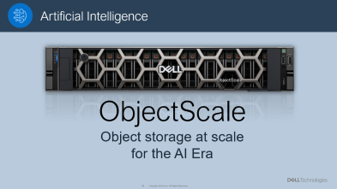
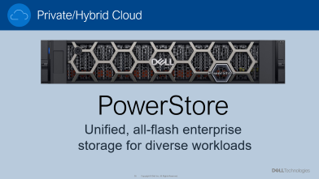
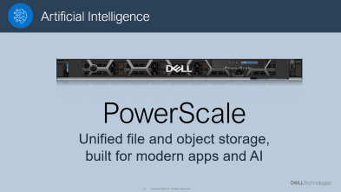
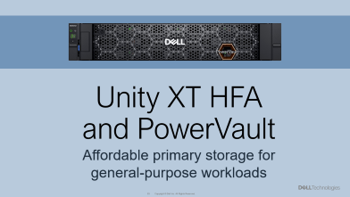
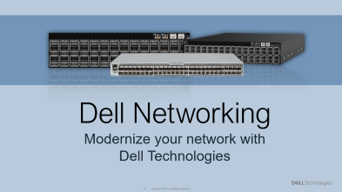
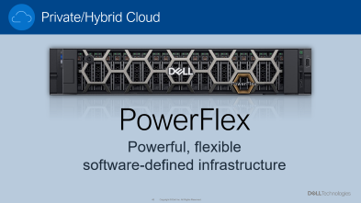
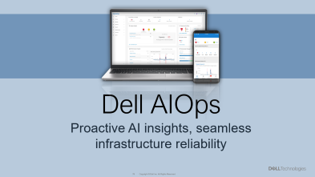
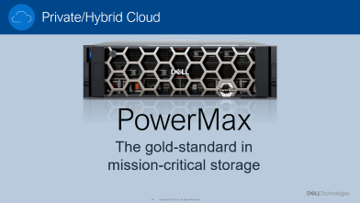
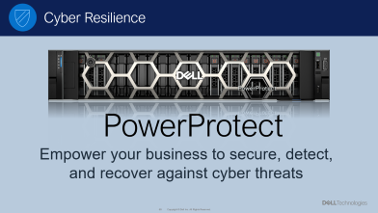
Dell’s storage portfolio at-a-glance
Note to presenter:
In presentation mode, click on a product tile to present the slides within that section. Once you’ve reached the end of that section, it will bring you back to this menu. If you’d rather, you can just click next to present in sequential order as usual.
Deep dive to learn more

Slide 35
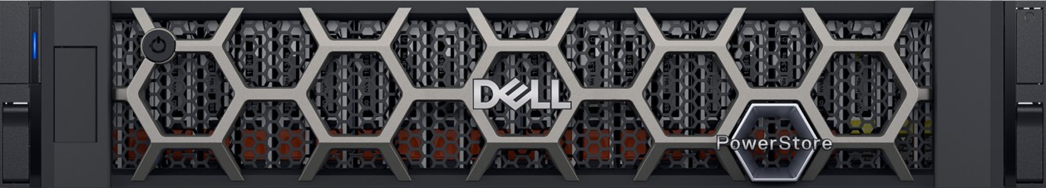
Private/Hybrid Cloud
PowerStore
Unified, all-flash enterprise
storage for diverse workloads

Slide 36
Unified, all-flash enterprise storage. Future-ready for diverse workloads and private cloud.
Dell PowerStore
Future Proof
Endlessly adaptable
Scale-up/Scale-out flexibility
Built-in data resiliency
Lifecycle Extension with ProSupport – “Never outgrow”
Efficient
Automatically lowers costs
Always on data reduction, no performance impact
Autonomous active/active
Energy efficient design
Easy to use
Simple across any ecosystem
Self-optimizing platform
Powerful AIOps tools
End-to-end ecosystem automations
Industry’s most flexible upgrade program¹
Industry’s best data reduction guarantee²
Better data efficiency vs competitor³
Average three-year ROI⁴
in ease of use⁵
#1
5:1
2x
463%
#1
1 – Based on Dell industry analysis, November 2024
2 – 5:1 average rate guaranteed for reducible data across customer applications. Rates for individual applications may vary. See Future-Proof Program terms and conditions for details.
3 – Based on a Prowess report commissioned by Dell Technologies, “Choose High Data-Efficiency Technology for Lower Storage TCO”, May 2024. Actual results may vary
4 – IDC: The Business Value of PowerStore, March 2023
5 – Based on Dell Technologies analysis in October 2023 using double-blinded, competitive benchmark Net Promoter Score (NPS) data gathered by third-party commissioned by Dell for 1H FY24
36
Copyright © Dell Inc. All Rights Reserved.
Notes:
Dell PowerStore is the flagship storage solution from the industry’s #1 external storage provider for a reason – and I’m excited to share how it can help your business adapt to challenges, reduce costs, and simplify infrastructure for the long term.
PowerStore offers unified, all-flash enterprise storage to handle diverse workloads with agility and efficiency. With Scale-Up and Scale-Out architecture and AIOps integration, organizations can achieve automation-driven performance, reduced cost, and flexible scalability, enabling seamless operations across edge, core, and cloud environments.
It’s built on a
FUTURE-PROOF design – including the industry’s most flexible modernization program
Guaranteed EFFICIENCY – that helps you save cost predictably over time
#1-ranked EASE OF USE – with built-in intelligence and automation so you can accomplish more with less effort
PowerStore is unlike any other storage platform, architecturally and programmatically. That “PowerStore difference” is the reason it’s the go-to all-flash solution for thousands of enterprises worldwide – backed by over 8 exabytes of capacity shipped, millions of run hours, and deployments across more than 90% of the Fortune 500 sectors.
These businesses know PowerStore is more than just a smart choice – it’s today’s BEST value in enterprise storage.
----------------------------------------------------------------------------
Sources:
1 – Based on Dell industry analysis, November 2024
2 – 5:1 average rate guaranteed for reducible data across customer applications. Rates for individual applications may vary. See Future-Proof Program terms and conditions for details.
3 – Based on a Prowess report commissioned by Dell Technologies, “Choose High Data-Efficiency Technology for Lower Storage TCO”, May 2024. Actual results may vary
4 – IDC: The Business Value of PowerStore, March 2023
5 – Based on Dell Technologies analysis in October 2023 using double-blinded, competitive benchmark Net Promoter Score (NPS) data gathered by third-party commissioned by Dell for 1H FY24

Slide 37
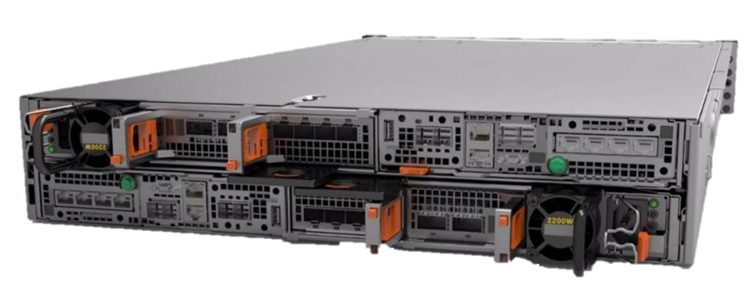
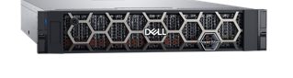
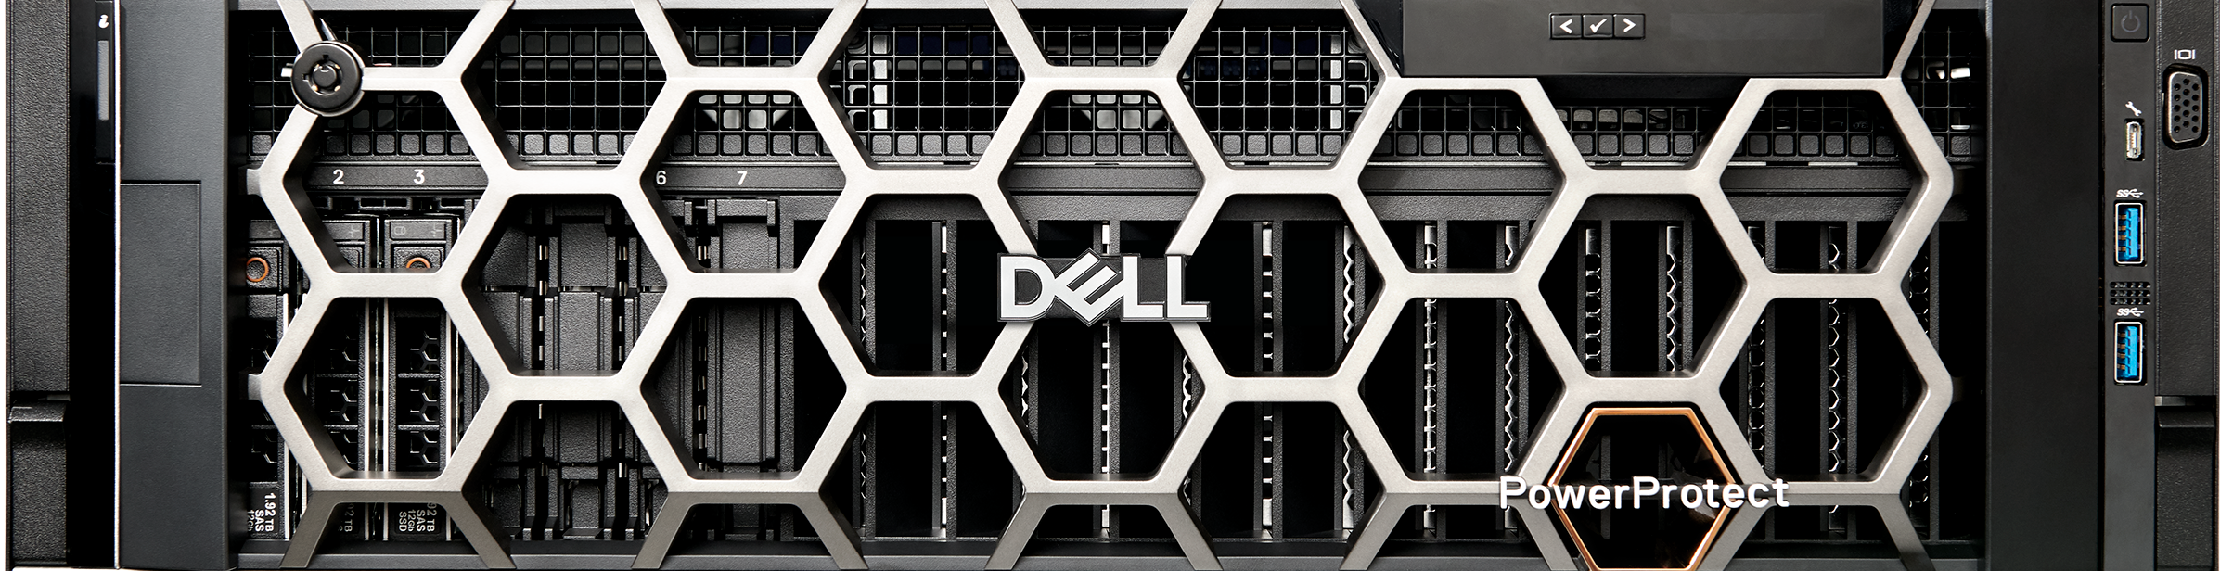
Future-proof: Never outgrow your storage
Is your infrastructure ready for anything?
Put modernization on autopilot
Lifecycle Extension with ProSupport
Modular hardware
All-inclusive software
Industry’s most flexible upgrade program
Non-disruptive Next-Gen, Higher Model, Scale-out upgrades
Up to 25% hardware savings
Node deployment included
25% credit on drive refreshes
Keep your existing drives!
Plus…
World-class proactive support
Appointed technical advisor
3-year money back guarantee
Trade-in credit
Flexible configurations
Rock solid resiliency
Federal-grade security
Start anywhere — grow anywhere
Any workload: Block, file, vVols, containers
Policy-based protection for every workload
Stay ahead of today’s threats…and tomorrow’s
ZERO RTO/RPO
Secure snapshots
Sync/async replication
Native metro w/witness
Intelligent cybersecurity
Secure enough for the US DoD – and your Zero Trust business solution
Scale up
All services
auto-configured
Single-drive granularity
No expensive drive packs
All models
scale equally
No need to upgrade for capacity
Local
Remote
Cloud
Integrated backup and recovery
Hardware Root of Trust
Multifactor authentication
STIG/APL, USGv6-R1
Ransomware detection
Data-at-rest encryption
File level retention
AIOps cybersecurity assessment
PowerStore
PowerProtect DD
Storage
Direct
Protection
Scale out with intelligent load balancing
Control backups directly from PowerStore
37
Copyright © Dell Inc. All Rights Reserved.
Notes:
First and foremost, PowerStore is a Future-proof platform designed to ensure you never outgrow your storage, no matter how your business evolves. Think of it as the last array you’ll need – ending the expensive and disruptive cycle of platform upgrades. Future-readiness has been PowerStore's defining principle since Day 1, and it drives everything we’ll discuss today.
[CLICK – FLEXIBLE CONFIGURATIONS]
It starts with a high-performance unified architecture that supports block, file, vVols, and containers – all in one appliance. This flexibility gives you headroom to handle changing demands
Scale-up and scale-out expansion means you can add performance or capacity seamlessly and independently, with easy load balancing between arrays
Unlike some competitors, you can scale one drive at a time to manage growth economically. No need to purchase expensive drive packs!
All PowerStore models scale equally, so you’ll never need to upgrade models just to get more storage space.
[CLICK – RESILIENCY]
Future-readiness also means resiliency – the ability to recover quickly from data loss or disruptions. With PowerStore, no matter how you grow, your data stays safe and protected. Key features include
Secure & immutable snapshots, that can’t be deleted, even by an administrator
Synchronous and asynchronous replication, including native metro sync with auto-failover -- so your workloads never stop running, even during an outage.
Intuitive Protection Policies, that let you customize and combine multiple kinds of local, remote, or cloud-based protection into reusable policies you can apply with just a few clicks
You can even control backup and recovery directly from PowerStore, thanks to PowerStore’s Storage Direct integration with Dell PowerProtect Data Domain – the industry’s #1 backup solution. It’s a great “better together” solution you can have up and running in just 90 seconds.
[CLICK – FEDERAL-GRADE SECURITY]
PowerStore also delivers advanced security to combat today’s AI-accelerated threats. From Hardware Root of Trust to multi-factor authentication, encryption and more, PowerStore is designed to meet the toughest compliance standards. It’s even listed on the US Department of Defense Approved Products List—unlike competitors like Pure Storage.
[CLICK – LIFECYCLE EXTENSION WITH PROSUPPORT]
But the real game-changer is Lifecycle Extension with ProSupport. This industry-leading program leverages PowerStore’s modular hardware and all-inclusive software to put modernization on autopilot. You get seamless technology transitions, cost-saving capacity refresh credits, an appointed technical advisor and more.
Lifecycle Extension simplifies every aspect of storage ownership – ensuring your workloads are always running on the latest technology for the lowest cost – so your business stays ready for anything.

Slide 38
Efficient: Maximize ROI and cost savings
PowerStore’s smart technology helps you get the most out of every resource
Software-optimized performance & scalability
Autonomous
active/active architecture
Store MORE data on fewer drives
Dynamic Node Affinity
Reassigns host path dynamically
Real-time IOPS/latency optimization
Advanced data reduction
Software + integrated hardware
Zero performance impact
Global Data Reduction Base
Not limited to volume or aggregate
Always on – nothing to manage!
Controller
1
Controller
2
Dynamic Resiliency Engine
No need to create RAID groups
Faster rebuilds with distributed sparing
LUN
Industry’s best DRR guarantee
Covers all reducible data
No assessment required
Up to 6 years coverage
Transparent remediation process
Access any drive
5:1
Single virtualized storage pool
Add drives one at a time
Mix and match sizes
468%
Average
3-year ROI¹
2x
better data efficiency²
54%
lower energy use³
1 IDC: The Business Value of PowerStore
2 vs. a leading competitor
3 vs. a leading competitor
38
Copyright © Dell Inc. All Rights Reserved.
Notes:
Now, let’s talk Efficiency – another of PowerStore’s core strengths. Storage efficiency is primarily about cost savings, but it’s also about optimizing performance and management so you get the most from every resource.
It’s important to realize there are fundamental differences among storage solutions – and this is an area where architecture really matters.
Traditional storage often requires constant manual tuning…but PowerStore’s built to work smarter.
Its unique “Autonomous Active/Active” architecture drives incredible efficiency without any intervention on your part.
[CLICK]
Let’s explore two software-driven ways this happens.
First, Dynamic Node Affinity auto-tunes performance by dynamically switching host paths between controllers.
When you create a volume on PowerStore, it’s NOT pinned to one controller.
PowerStore selects a preferred path initially, but from a host perspective, both controllers have an active multipath connection.
This makes it easy to swap paths in software – no HA failover is required, it’s just a simple multipathing cutover.
PowerStore distributes paths among volumes automatically – and reassigns them as performance and capacity needs change over time.
Unlike other arrays, there’s absolutely nothing you have to do to load balance or reconfigure complex failover scenarios.
You simply create your volume, and PowerStore works in the background to keep the system optimized.
[NOTE TO SALES: For more background on Dynamic Node Affinity, watch this lightboard video: https://www.youtube.com/playlist?list=PL2nlzNk2-VME2yEe4qmpYdeuCo21d3iph]
[CLICK]
Next, our Dynamic Resiliency Engine extends this simplicity to drive redundancy, eliminating the need to manage RAID groups.
Again, nothing is pinned – both controllers have access to ALL the drives in a single virtualized pool.
You can add drives one at a time, and even mix-and-match drive sizes.
Each new resource is simply absorbed into the pool, with all services (including sparing) configured and rebuilt automatically.
[CLICK]
PowerStore also drives HUGE cost savings with advanced data reduction – and again, this flows directly from the architecture.
Unlike basic software-only approaches that can degrade performance, PowerStore data reduction combines smart software and hardware to deliver predictable efficiency with zero impact on workloads.
Intel QuickAssist Technology built directly into the system, not an add-on module, offloads compression processing.
Variable block compression and granular global deduplication leverage the single pool architecture to maximize utilization.
PowerStore data reduction is “always-on.” There’s nothing to manage, configure, or decide – it just works. And the results are well-documented. Independent testing has shown PowerStore delivers up to 2x better data efficiency and 54% lower energy use compared to leading competitors.
Best of all, Dell backs this superior technology with the industry’s best guarantee – 5:1 on reducible data. Your 5:1 results will continue through your entire pre-paid maintenance term, or we’ll ship you actual free drives (up to 50% of your purchased capacity) – not just a “discount toward future purchase.”
NO assessment required
Valid for up to 6 years
We even give you industry-leading data reduction visibility and analytics so you can confirm your guarantee status.
It all adds up to an unprecedented ability to lock in long term savings for simplified planning and purchasing. And it makes owning the world’s best storage platform much more affordable than you might think…

Slide 39
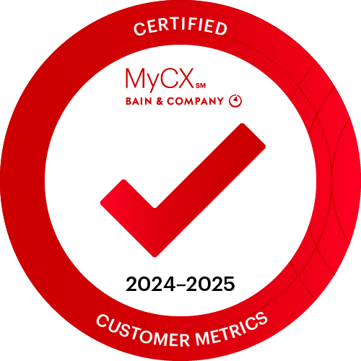
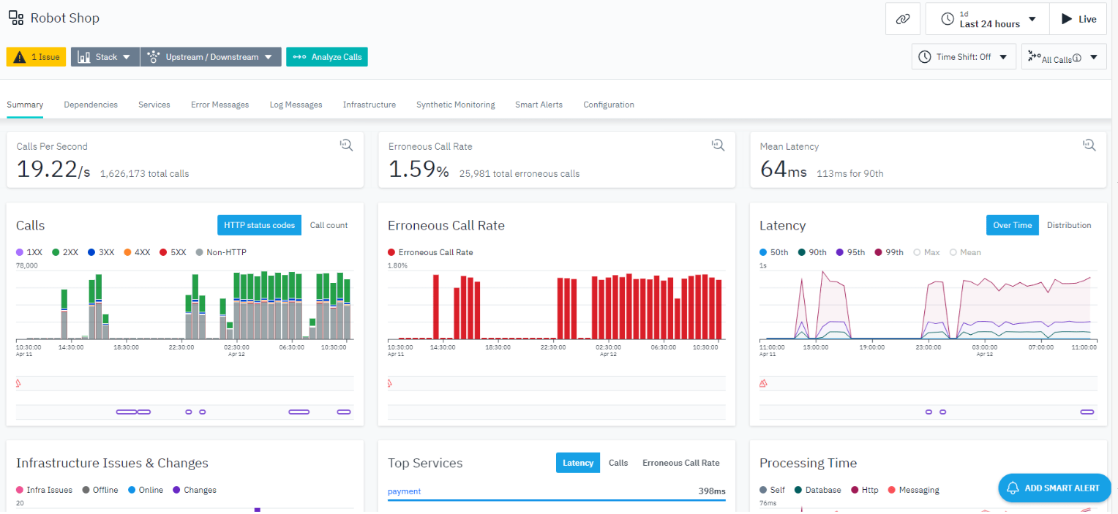
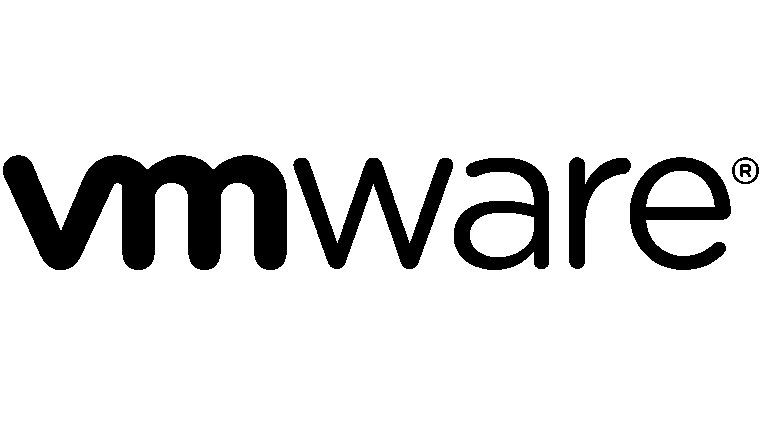
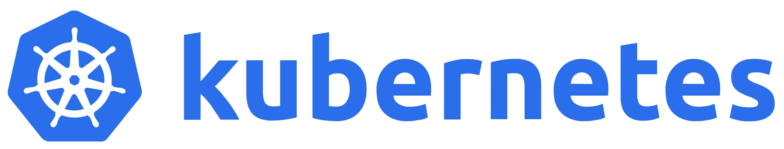


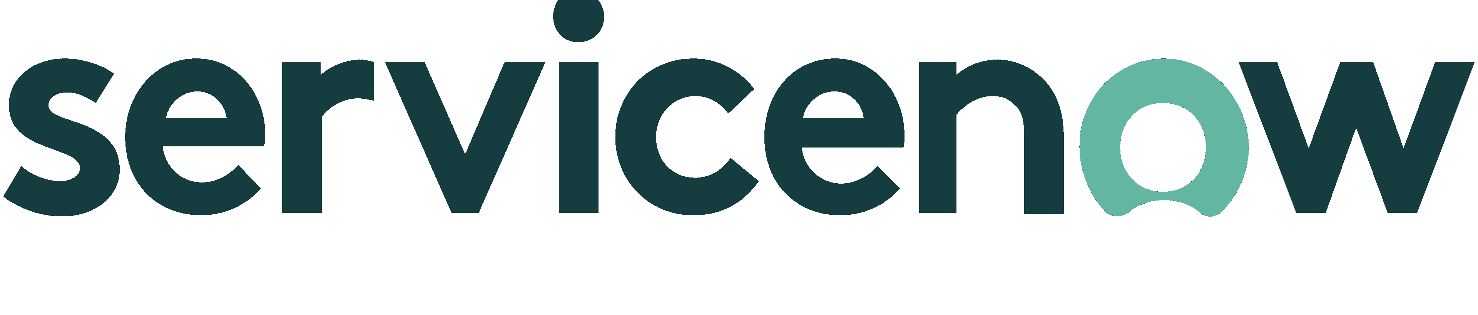

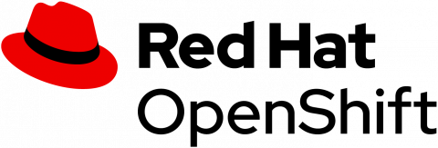
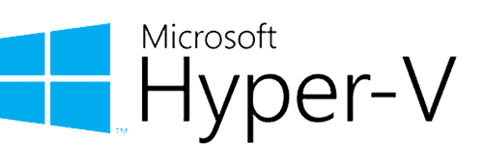

















Easy to use: Put more time back in your day
PowerStore’s AI-powered simplicity helps you deliver fast, consistent results under pressure
Self-optimizing platform
Powerful AIOps tools
End-to-end ecosystem integrations
Built-in intelligence automates dozens of manual tasks and decisions
Resolve issues up to 10x faster with connected AI insights across
Empower your users with self-service storage!
Provision PowerStore from your management or orchestration platform of choice
Deployment
Parity/sparing
Data placement
Node optimization
Load balancing
Data reduction
Network configuration
Performance tuning
Server
Storage
Network
Cloud
Voted #1 in ease of use
Independent 3rd-party survey
Bain-certified methodology
Health scoreboards
Predictive analytics
Smart alerts with root cause and suggested remediation
61%
quicker storage
deployment¹
New AI assistant
Custom, natural language answers in seconds
Save hours of research
Create volumes, snapshot policies, replication rules
Business value assessment
26%
more time for
innovation²
Streamline workloads – get results in seconds, not days
1, 2 – Source: IDC paper: “The Business Value of PowerStore”
39
Copyright © Dell Inc. All Rights Reserved.
Notes:
The final topic is Ease of Use -- we’ll finish by looking at how PowerStore can help you achieve better outcomes with less effort.
[CLICK – SELF-OPTIMIZING PLATFORM]
Again, PowerStore is a self-optimizing platform that auto-tunes your storage for peak performance, efficiency and availability, no matter how the environment evolves.
With PowerStore, what starts simple, stays simple -- and independent NPS surveys show customers rank PowerStore #1 in ease of use, ahead of Pure, HPE and NetApp.
[CLICK – POWERFUL AIOPS TOOLS]
But it’s not ONLY about “plug and dust” simplicity. When you DO need to make a change, PowerStore puts AI on your side. Intelligent analysis and connected insights across multiple Dell infrastructure categories – including servers, storage, networking and cloud – help you move forward quickly, improving productivity and resolving issues up to 10x faster.
You get health scorecards, predictive analytics – and even a new AI assistant that provides instant, personalized answers synthesizing insights from over 100,000 Dell-approved Knowledge Base articles.
[CLICK – END-TO-END ECOSYSTEM INTEGRATIONS]
And finally, PowerStore takes ease of use to the next level by integrating seamlessly with your IT ecosystem.
PowerStore is highly programmable and flexible, allowing you to provision advanced storage services directly from your preferred management or orchestration platform. Whether you operate in VMware vSphere, deploy Kubernetes workloads, integrate with ServiceNow, or use other Dell tools, PowerStore fits naturally into your workflows.
Need to empower users with self-service storage? PowerStore makes it possible with integrations that allow controlled access while maintaining enterprise-grade data services.
Automating IT tasks is a breeze. By embedding advanced storage functions within frameworks like vSphere or Azure, administrators can deploy new services in seconds rather than days.
From provisioning storage in your DevOps pipeline to managing large-scale virtualization environments, PowerStore streamlines end-to-end operations to help you deliver faster, more powerful results.

Slide 40




Trusted
Future Proof
Resilient
Customer adoption
Lifecycle Extension with ProSupport
Policy-based protection
Safeguard ANY workload
Federal-grade cybersecurity
STIG Hardened
Hardware Root of Trust
Secure Boot
Data-at-rest encryption
Multi-factor authentication
Secure snapshots
Ransomware protection
More…
9+
exabytes
shipped
90%
of F500 sectors
600M+
run hours clocked
30%
Industry’s most flexible upgrade program³
Stay cost-effective AND continuously modern
growth since Prime launch!¹
Next gen, higher-model, scale-out
Save up to 25% on non-disruptive upgrades⁴
Local
Remote
Cloud
6 Product of
the Year awards
Voted #1
Roadmap confidence²
Integrated backup
with Storage Direct Protection
All-inclusive software
3-year sat guarantee
Capacity refresh credit
PowerStore
PowerProtect
POWERSTORE
Superior architecture
Voted #1
Ease of use¹⁰
Autonomous Active/Active
Dynamic Node Affinity
Dynamic Resiliency Engine
End-to-End NVMe
Scale-Up/Scale-Out
Intelligent Load Balancing
Unified File/Block/vVols
Advanced Data Reduction
5:1
Data Reduction Guarantee⁶
2x
Better efficiency
than leading competitor⁷
Intelligent, self-optimizing platform
3x faster provisioning¹¹, 24% lower cost of operations¹²
Included AIOps tools
Resolve issues up to 10x faster¹³
End-to-end ecosystem automations
VMware, DevOps, Dell-on-Dell integrations
Track record of high-value software releases
Delivered non-disruptively, at no cost to existing customers
54%
lower energy use
than leading competitor⁸
463%
3-year ROI
(IDC BV assessment⁹)
Voted #1
Innovation⁵
Modern
Efficient
Easy to Use
Notes:
Slide opening (no clicks): Trusted
PowerStore is the go-to all-flash storage solution for thousands of enterprises worldwide. As the flagship array from the industry’s #1 storage provider, it’s trusted to enhance a wide variety of workloads – backed by over 5 exabytes of capacity shipped, millions of run hours, and deployments across more than 90% of Fortune 500 sectors.
Already the fastest-ramping new storage platform in Dell history, PowerStore’s momentum continues, with sales increasing an additional 30% year-over-year since last year’s PowerStore Prime announcement.
Industry recognition further validates this success—PowerStore has won six Product of the Year awards from TechTarget and CRN, highlighting a steady drumbeat of software and hardware innovation that delivers new value with every release.
Customers recognize this leadership, ranking PowerStore #1 in roadmap confidence over Pure, HPE, and NetApp.
Click #1: Future-Proof
These customers already understand the second key point we’ll cover today: PowerStore is a future-proof platform built to help you adapt to evolving business needs. Everything else on this slide ties back to that central idea – because future-readiness has been PowerStore’s defining principle since Day 1.
It starts with ample performance headroom to handle the most demanding workloads, and a scale-up/scale-out architecture for quick and easy expansion.
But the real game-changer is Lifecycle Extension with ProSupport. This industry-leading program leverages PowerStore’s modular hardware and all-inclusive software to put modernization on autopilot – offering seamless technology transitions with full deployment services, cost-saving capacity refresh credits, and more.
Simply put, with Lifecycle Extension with ProSupport, PowerStore may be the last storage platform you ever need to buy!
Click #2: Resilient
Security and resilience are mission-critical in today’s evolving threat landscape, and PowerStore is built to safeguard your data from corruption, loss, and cyber threats.
Protect any workload with a powerful combination of local, remote, and cloud-based methods, easily customized through reusable Protection Policies that reduce effort and minimize the risk of human error.
You also get PowerStore’s Storage Direct Protection integration with Dell PowerProtect Data Domain. This unique “better solution” lets you manage backups and restores directly from PowerStore – with setup in only 90 seconds!
And underpinning it all, PowerStore strengthens your Zero Trust cybersecurity initiatives with dozens of built-in safeguards. From Hardware Root of Trust to multi-factor authentication, encryption and more, PowerStore meets the stringent security requirements of the U.S. Department of Defense – and is listed on the DoD Approved Products List, unlike competitors such as Pure.
Click #3: Modern
PowerStore is built for the modern data era, delivering superior results by combining today’s best storage technologies with a unique autonomous active/active architecture that optimizes performance and resiliency in the background. Unlike traditional arrays, PowerStore continuously adapts to changing demands, making it smarter, faster, and more efficient.
Key innovations include:
Dynamic Node Affinity – which fine-tunes performance by dynamically switching host paths between controllers for maximum efficiency, and
Dynamic Resiliency Engine – A software-driven approach to redundancy that eliminates RAID group management, increasing availability while minimizing complexity. There’s no need for expensive drive packs either – you can add drives one at a time and even mix-and-match drive sizes for ultimate flexibility.
Best of all, PowerStore keeps evolving. The upcoming 4.1 release introduces even more AIOps advantages, enhanced resiliency, expanded file capabilities, and greater support for Unity customers transitioning to PowerStore – all delivered as a no-cost, non-disruptive upgrade.
Click #4: Efficient
PowerStore’s intelligent architecture delivers 2x better efficiency than a leading competitor. Advanced always-on data reduction reduces capacity and energy costs with zero performance impact, thanks to hardware offload via integrated Intel QuickAssist technology.
Industry-leading data reduction visibility and analytics provide long-term confidence in planning and purchasing. And it’s all backed by the industry’s best data reduction guarantee – 5:1 on reducible data. No assessments. No exceptions. Just guaranteed savings and a faster path to ROI.
Click #5: Easy to Use
And finally, despite its advanced capabilities, PowerStore remains incredibly simple to manage – earning yet another #1 NPS ranking for Ease of Use, ahead of Pure, HPE, and NetApp.
PowerStore’s AI-driven simplicity works in three key ways:
Self-optimizing platform – Automatically tunes performance, efficiency, and availability, offloading dozens of manual tasks for up to 3x faster provisioning and 24% lower operational costs.
Built-in AIOps tools – AI accelerates issue resolution by up to 10x, reducing administrative effort to give you more time back in your day.
End-to-end ecosystem automation – Seamless VMware and DevOps integrations let you provision PowerStore from your preferred management or orchestration platform – or even empower end users with self-service storage.
Conclusion
PowerStore is the #1 choice for modern enterprise storage, future-proofing your business with an intelligent, resilient, and easy-to-use solution. Backed by Dell’s industry-leading support and innovation, PowerStore is the smart, secure, and scalable choice for businesses that refuse to compromise on storage.
*******************************
1 – Source: Internal Dell data, 2025
2 – Based on Dell Technologies analysis in October 2023 using double-blinded, competitive benchmark Net Promoter Score (NPS) data gathered by third-party commissioned by Dell for 1H FY24
3 – Based on Dell industry analysis, November 2024
4 – Based on Dell internal analysis, March 2024
5 – Based on Dell Technologies analysis in October 2023 using double-blinded, competitive benchmark Net Promoter Score (NPS) data gathered by third-party commissioned by Dell for 1H FY24
6 – 5:1 average rate guaranteed for reducible data across customer applications. Rates for individual applications may vary. See Future-Proof Program terms and conditions for details.
7 – Based on a Prowess report commissioned by Dell Technologies, “Choose High Data-Efficiency Technology for Lower Storage TCO”, May 2024. Actual results may vary
8 – Based on a Prowess report commissioned by Dell Technologies, “Choose High Data-Efficiency Technology for Lower Storage TCO”, May 2024. Actual results may vary
9 – IDC: The Business Value of PowerStore, March 2023
10 – Based on Dell Technologies analysis in October 2023 using double-blinded, competitive benchmark Net Promoter Score (NPS) data gathered by third-party commissioned by Dell for 1H FY24
11 – Based on Prowess Consulting Report, May 2024, comparing Dell PowerStore 1200T to similarly configured storage platform from a major competitor. Actual results may var
12 – IDC: The Business Value of PowerStore, March 2023
13 – Based on an April 2020 Principled Technologies Report commissioned by Dell , “Dell Infrastructure Observability streamlined the user experience in five cloud-based storage preventive management tasks.

Slide 41
Trusted
Future Proof
Resilient
Customer adoption
Lifecycle Extension with ProSupport
Policy-based protection
Safeguard ANY workload
Federal-grade cybersecurity
STIG Hardened
Hardware Root of Trust
Secure Boot
Data-at-rest encryption
Multi-factor authentication
Secure snapshots
Ransomware protection
More…
9+
exabytes
shipped
90%
of F500 sectors
600M+
run hours clocked
30%
Industry’s most flexible upgrade program³
Stay cost-effective AND continuously modern
growth since Prime launch!¹
Next gen, higher-model, scale-out
Save up to 25% on non-disruptive upgrades⁴
Local
Remote
Cloud
6 Product of
the Year awards
Voted #1
Roadmap confidence²
Integrated backup
with Storage Direct Protection
All-inclusive software
3-year sat guarantee
Capacity refresh credit
PowerStore
PowerProtect
POWERSTORE
Superior architecture
Voted #1
Ease of use¹⁰
Autonomous Active/Active
Dynamic Node Affinity
Dynamic Resiliency Engine
End-to-End NVMe
Scale-Up/Scale-Out
Intelligent Load Balancing
Unified File/Block/vVols
Advanced Data Reduction
5:1
Data Reduction Guarantee⁶
2x
Better efficiency
than leading competitor⁷
Intelligent, self-optimizing platform
3x faster provisioning¹¹, 24% lower cost of operations¹²
Included AIOps tools
Resolve issues up to 10x faster¹³
End-to-end ecosystem automations
VMware, DevOps, Dell-on-Dell integrations
Track record of high-value software releases
Delivered non-disruptively, at no cost to existing customers
54%
lower energy use
than leading competitor⁸
463%
3-year ROI
(IDC BV assessment⁹)
Voted #1
Innovation⁵
Modern
Efficient
Easy to Use
Notes:
Slide opening (no clicks): Trusted
PowerStore is the go-to all-flash storage solution for thousands of enterprises worldwide. As the flagship array from the industry’s #1 storage provider, it’s trusted to enhance a wide variety of workloads – backed by over 5 exabytes of capacity shipped, millions of run hours, and deployments across more than 90% of Fortune 500 sectors.
Already the fastest-ramping new storage platform in Dell history, PowerStore’s momentum continues, with sales increasing an additional 30% year-over-year since last year’s PowerStore Prime announcement.
Industry recognition further validates this success—PowerStore has won six Product of the Year awards from TechTarget and CRN, highlighting a steady drumbeat of software and hardware innovation that delivers new value with every release.
Customers recognize this leadership, ranking PowerStore #1 in roadmap confidence over Pure, HPE, and NetApp.
Click #1: Future-Proof
These customers already understand the second key point we’ll cover today: PowerStore is a future-proof platform built to help you adapt to evolving business needs. Everything else on this slide ties back to that central idea – because future-readiness has been PowerStore’s defining principle since Day 1.
It starts with ample performance headroom to handle the most demanding workloads, and a scale-up/scale-out architecture for quick and easy expansion.
But the real game-changer is Lifecycle Extension with ProSupport. This industry-leading program leverages PowerStore’s modular hardware and all-inclusive software to put modernization on autopilot – offering seamless technology transitions with full deployment services, cost-saving capacity refresh credits, and more.
Simply put, with Lifecycle Extension with ProSupport, PowerStore may be the last storage platform you ever need to buy!
Click #2: Resilient
Security and resilience are mission-critical in today’s evolving threat landscape, and PowerStore is built to safeguard your data from corruption, loss, and cyber threats.
Protect any workload with a powerful combination of local, remote, and cloud-based methods, easily customized through reusable Protection Policies that reduce effort and minimize the risk of human error.
You also get PowerStore’s Storage Direct Protection integration with Dell PowerProtect Data Domain. This unique “better solution” lets you manage backups and restores directly from PowerStore – with setup in only 90 seconds!
And underpinning it all, PowerStore strengthens your Zero Trust cybersecurity initiatives with dozens of built-in safeguards. From Hardware Root of Trust to multi-factor authentication, encryption and more, PowerStore meets the stringent security requirements of the U.S. Department of Defense – and is listed on the DoD Approved Products List, unlike competitors such as Pure.
Click #3: Modern
PowerStore is built for the modern data era, delivering superior results by combining today’s best storage technologies with a unique autonomous active/active architecture that optimizes performance and resiliency in the background. Unlike traditional arrays, PowerStore continuously adapts to changing demands, making it smarter, faster, and more efficient.
Key innovations include:
Dynamic Node Affinity – which fine-tunes performance by dynamically switching host paths between controllers for maximum efficiency, and
Dynamic Resiliency Engine – A software-driven approach to redundancy that eliminates RAID group management, increasing availability while minimizing complexity. There’s no need for expensive drive packs either – you can add drives one at a time and even mix-and-match drive sizes for ultimate flexibility.
Best of all, PowerStore keeps evolving. The upcoming 4.1 release introduces even more AIOps advantages, enhanced resiliency, expanded file capabilities, and greater support for Unity customers transitioning to PowerStore – all delivered as a no-cost, non-disruptive upgrade.
Click #4: Efficient
PowerStore’s intelligent architecture delivers 2x better efficiency than a leading competitor. Advanced always-on data reduction reduces capacity and energy costs with zero performance impact, thanks to hardware offload via integrated Intel QuickAssist technology.
Industry-leading data reduction visibility and analytics provide long-term confidence in planning and purchasing. And it’s all backed by the industry’s best data reduction guarantee – 5:1 on reducible data. No assessments. No exceptions. Just guaranteed savings and a faster path to ROI.
Click #5: Easy to Use
And finally, despite its advanced capabilities, PowerStore remains incredibly simple to manage – earning yet another #1 NPS ranking for Ease of Use, ahead of Pure, HPE, and NetApp.
PowerStore’s AI-driven simplicity works in three key ways:
Self-optimizing platform – Automatically tunes performance, efficiency, and availability, offloading dozens of manual tasks for up to 3x faster provisioning and 24% lower operational costs.
Built-in AIOps tools – AI accelerates issue resolution by up to 10x, reducing administrative effort to give you more time back in your day.
End-to-end ecosystem automation – Seamless VMware and DevOps integrations let you provision PowerStore from your preferred management or orchestration platform – or even empower end users with self-service storage.
Conclusion
PowerStore is the #1 choice for modern enterprise storage, future-proofing your business with an intelligent, resilient, and easy-to-use solution. Backed by Dell’s industry-leading support and innovation, PowerStore is the smart, secure, and scalable choice for businesses that refuse to compromise on storage.
*******************************
1 – Source: Internal Dell data, 2025
2 – Based on Dell Technologies analysis in October 2023 using double-blinded, competitive benchmark Net Promoter Score (NPS) data gathered by third-party commissioned by Dell for 1H FY24
3 – Based on Dell industry analysis, November 2024
4 – Based on Dell internal analysis, March 2024
5 – Based on Dell Technologies analysis in October 2023 using double-blinded, competitive benchmark Net Promoter Score (NPS) data gathered by third-party commissioned by Dell for 1H FY24
6 – 5:1 average rate guaranteed for reducible data across customer applications. Rates for individual applications may vary. See Future-Proof Program terms and conditions for details.
7 – Based on a Prowess report commissioned by Dell Technologies, “Choose High Data-Efficiency Technology for Lower Storage TCO”, May 2024. Actual results may vary
8 – Based on a Prowess report commissioned by Dell Technologies, “Choose High Data-Efficiency Technology for Lower Storage TCO”, May 2024. Actual results may vary
9 – IDC: The Business Value of PowerStore, March 2023
10 – Based on Dell Technologies analysis in October 2023 using double-blinded, competitive benchmark Net Promoter Score (NPS) data gathered by third-party commissioned by Dell for 1H FY24
11 – Based on Prowess Consulting Report, May 2024, comparing Dell PowerStore 1200T to similarly configured storage platform from a major competitor. Actual results may var
12 – IDC: The Business Value of PowerStore, March 2023
13 – Based on an April 2020 Principled Technologies Report commissioned by Dell , “Dell Infrastructure Observability streamlined the user experience in five cloud-based storage preventive management tasks.

Slide 42


Nurturing community growth and economic advancement through strategic partnerships
Reduced storage costs by 50%.
Improved response and approval times by 300%.
Maximized savings and streamlined budgeting with Dell’s APEX subscriptions.
“By using PowerFlex and PowerStore, we’ve reduced heating and cooling costs while achieving efficiency in both architecture and energy use.”
Doug Oliveira
Chief Information Officer, Caliber Financial Services
Dell PowerFlex
Dell PowerStore
Dell APEX Subscriptions
Dell PowerProtect DD Appliances
Dell PowerProtect Cyber Recovery

Slide 43




Reliable and innovative data center transformation unlocks limitless potential
Accelerating test results
with AI-powered diagnostics
Reduced data center footprint by 67%, driving significant power and cost savings — from 17 racks to one.
Enhanced data access speed, decreasing latency by 10x.
Lowered monthly OpEx by over $200k with Dell APEX.
“Dell PowerStore has everything we need, including speed, low latency, data protection and DRR to run mission-critical workloads.”
Kevin Cossa
Senior Director, Engineering, Smarsh
Dell PowerMax
Dell PowerStore
Dell APEX Subscriptions
Dell PowerProtect Cyber Recovery
Dell AIOps
Notes:
Key Takeaway
Smarsh modernized its legacy data center infrastructure with Dell Technologies solutions to enhance scalability, reduce costs, optimize performance, and boost resilience, enabling innovation and operational efficiency.
Situation
Smarsh, a leader in communications data and intelligence, needed to modernize its legacy systems to handle rapid data growth. The existing setup hindered efficiency, compliance, and innovation. They required a high-performance, scalable, and secure solution to store 10–15TB of daily data and support compliance in highly regulated industries.
Challenges
Legacy Limitations: Outdated systems couldn't meet growing data demands.
High Costs: Inefficiencies led to high latency, increased expenses, and operational challenges.
Data Security Risks: Protecting sensitive data at scale while meeting compliance was critical.
Scaling Issues: Lacked flexibility to adapt to evolving workloads.
Solution
Smarsh partnered with Dell Technologies to implement a modern, scalable architecture, leveraging advanced solutions such as:
Dell PowerMax for performance, low latency, and intelligent optimizations.
Dell PowerStore for scalable, dense, all-flash storage.
Dell PowerProtect Cyber Recovery for secure backups and cyber resilience.
Dell APEX Subscriptions for flexible, on-demand scalability.
Dell AIOps for proactive monitoring and predictive maintenance.
Benefits
Reduced data center footprint by 67%, from 17 racks to 1.
Lowered operational costs by over $200k per month.
Improved latency by 10x for faster data access.
Automated IT operations through predictive analytics.
Secured critical workloads with immutable backups.
Scalable infrastructure and effortless resource adjustments with Dell APEX.
Reduced admin overhead, enabling the IT team to focus on innovation.
Significance of the Partnership
The partnership between Smarsh and Dell went beyond technology, ensuring smooth data center relocation and providing cutting-edge, AI-driven features for future innovation.

Slide 44
Private/Hybrid Cloud
PowerMax
The gold-standard in
mission-critical storage

Slide 45
World’s most secure mission-critical storage
Dell PowerMax
Powerful
architecture
Ultimate performance at scale
Scale-out architecture
Linear scalability (2 to16 nodes)
Massive consolidation
Intelligent
automation
Simplified management
AI-powered automation
Performance optimization
Proactive health checks
Trusted
operations
Always-on availability
Unmatched cyber resiliency
Gold standard replication
Highest data integrity
Faster performance
Up to
better response times¹
Greater density
More storage density²
Industry’s best
data reduction guarantee³
50%
14x
5:1
1 Based on Dell’s internal testing using the OLTP benchmark comparing the PowerMax 2500 against the PowerMax 2000, April 2025. Actual response times may vary.
2 Based on Dell’s internal analysis comparing the Effective Storage Capacity per rack unit (1.75”) of the PowerMax 2500 compared with the PowerMax 2000, April 2025. Actual storage capacities will vary.
3 Based on Dell‘s Future-Proof program which offers 5:1 data reduction guarantee based on PowerMax open systems storage, August 2025..
45
Copyright © Dell Inc. All Rights Reserved.
Notes:
Next, we’ll focus on how PowerMax is designed to address your mission-critical storage challenges by combining a powerful architecture, intelligent automation, and trusted innovation.
Let’s dive in.
PowerMax is built on three key pillars:
Powerful architecture for unmatched performance and scalability.
Intelligent automation to simplify management and improve efficiency.
Trusted innovation to ensure security, resiliency, and data availability.
PowerMax delivers optimized workloads, a future-proof infrastructure, and reliable performance for your most critical tasks. It’s purpose-built for enterprise leaders like you, providing the tools you need to grow, innovate, and stay secure at scale.
----------------------------------------------------------------------------
Sources:
Based on Dell’s internal testing using the OLTP benchmark comparing the PowerMax 2500 against the PowerMax 2000, April 2024. Actual response times may vary.
Based on Dell’s internal analysis of total CO2 emissions over 5 years for PowerMax 2500 8PBe vs. 2000 at 8PBe. April 2024.
Based on Dell‘s Future-Proof program which offers 5:1 data reduction guarantee based on PowerMax open systems storage, August 2024.

Slide 46








Storage Direct Protection
Accelerate backup performance and efficiency for Dell Storage
PowerStore
PowerMax and PowerStore
No backup software required
Backup directly to PowerProtect Data Domain
Enhanced backup orchestration
Crash and application consistent backup and recovery
Centralized management
Control path
Multiple
clusters
Data
path
Control
path
Data
path
Control path
Notes:
You have two great options with PowerProtect cyber resilience solutions to increase the backup performance and efficiency for Dell PowerStore and PowerMax
PowerStore Manager with PowerStore and PowerProtect does not require any additional backup software and still allows for protection of your data on PowerProtect Data Domain.
With PowerProtect Data Manager you can control PowerStore, PowerMax, and PowerProtect Data Domain. You now have enhanced backup orchestration, crash-consistent and application-consistent backup and recovery, and centralized management of all your data.
PowerProtect Data Manager offers PowerStore and PowerMax backups and restores, with centralized management and orchestration, incremental forever backups and end-to-end immutability. Data Manager allows you to recover snapshots with little to no impact to your applications or databases.
All of this enables immutability, flexibility, control and the best user experience for your data center, cloud and edge environments.

Slide 47
















Trusted
Powerful
Cyber Resilient
Customer adoption
Superior Architecture
Scale-up/Scale-out (2 – 16 nodes)
Global shared memory
Any node can access any drive
Consistent performance (no LUN ownership)
Independently scale compute & capacity
Open systems, mainframe, file, virtualization
18PBe Capacity
256
F/E ports
65M
Secure snaps
World’s most secure mission-critical storage
9500+
petabytes
shipped
95%
of Fortune 500 sectors¹
90+
countries
shipped
Zero Trust³
Secure Boot
HW Root of Trust
Multi-factor Authentication
Ransomware Anomaly Detection
Cyber Recovery Services (air-gap vault)
Fed FIPS, STIG, US DoD APL, USGv6 certifications
Always-on data availability
Gold standard in disaster recovery (Pioneered replication)
2-site, 3-site, 4-site remote replication with SmartDR
Tech Innovator of the Year
Product of the Year²
#1
”PowerMax is the crown jewel of our data center.”
— Steven Kouvo, Boston Scientific
POWERMAX
Open ecosystem connecting to any IT infrastructure
DevOps, ITOps, Dell-on-Dell integrations
OpenShift integration, VMW-to-OpenShift migration tools
Amazon EKS Hybrid Nodes Support (EKS)
Cloud-based backup and restore (PowerProtect)
Up to
8x⁴
Faster time to resolve SAN network congestion
Up to
96%⁵
Up to
10x⁶
5:1⁸
Data Reduction Guarantee
Up to
2.8x⁹
More performance per watt
Reduction in time to access performance insights
Faster time to resolve issues via AIOps tools
Industry-leading
AI-powered automation
Dynamic cache performance optimization
Autonomous health checks, self-healing
Industry’s best power monitoring & alerting⁷
Integrated backup with Storage Direct Protection
Up to
14x¹⁰
Higher storage density
1-click¹¹
PowerMaxOS
Software updates
Intelligent
Efficient
Broad Ecosystem
Notes:
Slide opening (no clicks): World’s Most Trusted Enterprise Storage
I'm excited to speak with you about PowerMax, the world's most trusted enterprise storage solution. PowerMax has been shipped to over 90 countries and has delivered more than 9500 petabytes of storage. It's deployed in over 95% of Fortune 500 sectors, making it the gold standard in data availability and disaster recovery. With always-on data availability and pioneering replication technology, PowerMax ensures your data is always safe and accessible.
Click #1: Powerful Architecture Designed for High Performance at Scale
PowerMax incorporate a superior architecture designed for high performance at scale. It features a scale-up/scale-out design with up to 16 nodes and global shared memory, allowing any node to access any drive. This means consistent performance without the need for LUN ownership. You can independently scale compute and capacity, supporting open systems, mainframe, file, and virtualization. With a capacity of up to 18 petabytes and 256 front-end ports, PowerMax is built to handle the most demanding workloads at scale.
Click #2: Industry’s Most Secure Mission-Critical Storage
Security is paramount in any organization, and PowerMax is the industry’s most secure mission-critical storage solution. It’s designed to accelerate Zero Trust deployments with secure boot and hardware root of trust. Multi-factor authentication, ransomware anomaly detection, and cyber recovery services with an air-gap vault ensure your data is protected against cyber threats. PowerMax also meets stringent certifications like Federal FIPS, STIG compliance, US DoD Approved Products List, and USGv6, providing peace of mind for your mission-critical data.
Click #3: AI-Driven Automation Simplifies Management
Managing storage can be complex, but PowerMax simplifies it with AI-driven automation. Our industry-leading AI-powered tools offer dynamic cache performance optimization, autonomous health checks, self-healing capabilities, and a Digital Assistant to help you quickly optimize your IT infrastructure. This means you can resolve issues up to 10 times faster and reduce SAN network congestion up to 8 times quicker.
Click #4: Operational Efficiency that lower cost
Efficiency is key to reducing costs and environmental impact. PowerMax offers a 5:1 data reduction guarantee, up to 2.8 times more performance per watt, and up to 14 times higher storage density compared to previous versions. This translates to an 82% reduction in greenhouse gas emissions, making PowerMax not only powerful but also environmentally friendly. And PowerMax provides the best power monitoring and alerting in the industry so you can keep track of power usage in real-time.
Click #5: Broad Ecosystem Support
PowerMax integrates seamlessly into your existing IT infrastructure. It supports DevOps, ITOps, and Dell-on-Dell integrations, along with Dell private cloud and cloud-based backup and restore through Dell PowerProtect. Tight integration with Red Hat OpenShift speeds up VMware to OpenShift migrations and accelerates storage provisioning. This broad ecosystem ensures that PowerMax can connect to and enhance your current systems, providing a comprehensive and flexible storage solution.
Closing:
In summary, PowerMax is the ultimate enterprise storage for mission-critical workloads, offering unmatched trust, power, security, intelligence, efficiency, and ecosystem integration. Imagine a storage solution that not only meets your current needs but also scales effortlessly with your future growth. PowerMax is not just a storage solution; it's a strategic asset that will drive your business forward. Let's discuss how PowerMax can transform your IT infrastructure and give your organization a competitive edge.
-------------------------------------
Claim Footnotes
Based on vertical industry categories as of June 2024 from the Fortune 500 company rankings.
CRN Product of the Year, December 2022
Based on Dell’s internal analysis of Dell PowerMax's cybersecurity capabilities, April 2025.
Based on Dell’s internal analysis comparing time to resolve SAN network congestion for PowerMax, August 2025.
Based on Dell’s internal testing of time to access performance statistics using PowerMaxOS 10.2 bulk API Automation, August 2025.
Based on Dell’s CloudIQ user survey, 2021.
Based on Dell's internal analysis of the power monitoring capabilities of Dell PowerMax versus competitive mainstream arrays, August 2025.
Based on Dell‘s Future-Proof program which offers 5:1 data reduction guarantee based on PowerMax open systems storage, August 2025.
Based on Dell’s internal testing comparing IOPS per watt for PowerMax 2500 compared with PowerMax 2000, August 2025.
Based on Dell’s internal analysis comparing the Effective Storage Capacity per rack unit (1.75”) of the PowerMax 2500 vs. 2000, April 2025.
Based on Dell’s internal analysis of updating PowerMaxOS 10.3 software with a single click to upgrade PowerMaxOS software without disruption for PowerMax 2500/8500, July 2025.

Slide 48


INDUSTRY | BANKING & FINANCIAL SERVICES
Empowering Dubai’s leading bank with modern infrastructure
50% faster processing speeds, reducing data response to up to 1 millisecond.
70-80% reduction in energy consumption from smaller
footprint.
30% decrease in data center costs by using PowerMax.
“PowerMax very much runs the bank. It’s reliable, it’s flexible, it’s very fast.”
Ali Rey
Group Head of Technology Platforms, Emirates NBD
Powered by:
Dell PowerMax
Dell ObjectScale
PowerProtect DD Appliances
PowerProtect Cyber Recovery with CyberSense
Notes:
[Emirates Customer Story ft PowerMax]

Slide 49
Private/Hybrid Cloud
PowerFlex
Powerful, flexible
software-defined infrastructure

Slide 50
Powerful, flexible software-defined infrastructure
Dell PowerFlex
Adaptability — Evolved
Software-first flexibility across on-prem, hybrid, and cloud
Smarter automation and LCM with optimized data
Same agility. Greater intelligence
Efficiency
— Redefined
Scale-out architecture meets breakthrough efficiency
Over 50% storage footprint reduction
Up to 80% storage efficiency
Trust
— Reinforced
Built for any workload, any hypervisor
Now delivering up to 10x9s data availability
Industry’s most resilient software-defined block storage
3rd party storage integrated with Nutanix Cloud Platform⁴
over 80%
Up to 276%
up to10x9s
1st
Storage efficiency¹
ROI within three years²
1 IDC white paper commissioned by Dell Technologies and Intel. "The Business Value of Dell PowerFlex", December 2023. Results derived from interviews with 7 companies worldwide. Estimates and savings calculated over 3-years, in U.S. Dollars.
3 Internal Dell testing, 2024
4 Based on Dell and Nutanix analysis, July 2024. PowerFlex is the 1st third-party storage supported and integrated with the Nutanix Cloud Platform.
Availability³
50
Copyright © Dell Inc. All Rights Reserved.
Notes:
To wrap up, PowerFlex redefines enterprise storage by delivering unmatched efficiency, adaptability, and trust. It’s built for any workload—whether on-premises, hybrid, or cloud—enabling seamless consolidation and flexibility across environments. With smarter automation, PowerFlex simplifies operations and optimizes performance, allowing businesses to focus on innovation. The platform delivers breakthrough claims, including up to 50% footprint reduction, over 80% storage efficiency, and up to 10x9s data availability. PowerFlex empowers organizations to scale intelligently, securely, and with confidence, setting a new standard for software-defined storage.
----------------------------------------------------------------------------
Sources:
1 Source: Based on Dell internal testing, using 11 node PowerFlex 5.0 cluster versus previous generation PowerFlex software. May, 2025
2 Source: IDC white paper commissioned by Dell Technologies and Intel. "The Business Value of Dell PowerFlex", December 2023. Results derived from interviews with 7 companies worldwide. Estimates and savings calculated over 3-years, in U.S. Dollars. (https://www.delltechnologies.com/asset/en-us/products/storage/industry-market/idc-the-business-value-of-dell-powerflex.pdf)
3 CLM-014304: Based on Dell internal testing, May, 2025
4 Based on Dell and Nutanix analysis, July 2024. PowerFlex is the 1st third-party storage supported and integrated with the Nutanix Cloud Platform.

Slide 51










Trusted
Hybrid Cloud
Scale and Resilience
Customer adoption:
The world’s most scalable cloud block storage
Disaggregated scale
150k+
Nodes deployed globally¹
$13.9M
Additional revenue granted²
8 mths
To payback²
Storage
Storage
Improve TCO and leverage pre-committed cloud spend
Power demanding workloads with high performance
Move data seamlessly between multicloud environments
Efficiently place data across multi-AZ without extra copies
Unify fragmented resources and diverse workloads
Compute
Storage
Compute
Storage
Compute
Compute
Akbar Khan:
“With PowerFlex, we’ve reduced the time spent on routine tasks by around 40% — decreasing operational costs and allowing our IT team to focus on strategic initiatives.”
Integrated system
Enables independent storage/compute scaling
99.99999999%³ availability for always-on performance
Advanced encryption to protect data
Multi-factor authentication for enhanced security
POWERFLEX
POWERFLEX
Revolutionary Scalable Availability Engine (SAE)
Broad support for multiple hypervisors
80%
more efficient⁴
up to 50%
footprint reduction⁵
Why It Matters?
SAE eliminates the trade-offs of traditional storage, empowering enterprises to consolidate workloads, reduce costs, and scale with confidence.
SAE
88%
reduced unplanned downtimes²
276%
3-year ROI
(IDC BV assessment)²
built on
Erasure Coding
designed for
Native Block
Implemented as
Distributed Scale-Out
Modern
Efficient
Open Ecosystem
Notes:
1. Opening
Let’s talk about the versatility, performance, and reliability of Dell PowerFlex, including its trusted global adoption, robust hybrid cloud capabilities, high efficiency, and hypervisor-agnostic approach—all designed to empower businesses to innovate and scale with confidence.
2. Key Messages to Highlight
Trusted Adoption
Over 150,000 nodes have been deployed globally, delivering consistent value with an average payback period of 8 months and generating $13.9M in additional revenue for customers. Customers such as Akbar Khan with F1Soft speak highly of the product showcasing the real-world impact PowerFlex has on businesses.
*Click* Hybrid Cloud Power
PowerFlex is the world’s most scalable cloud block storage, powering demanding workloads, optimizing TCO, and enabling seamless data mobility across multicloud environments. You can reap the benefits of PowerFlex on-premises and in public cloud.
*Click* Scale and Resilience
Always-on functionality with 10 9s of availability along with advanced encryption, multi-factor authentication, and robust backup and disaster recovery support across multiple availability zones gives our data center operators the peace of mind that’s needed. Support independent scaling of compute and storage to thousands of nodes.
*Click* Cutting-Edge Features
The Scalable Availability Engine (SAE) is a next-generation storage architecture that removes the long-standing tradeoffs between scale, performance, efficiency, and availability. Its design combines distributed erasure coding, advanced metadata management, and new distributed caching services to create a foundation that is both highly resilient and highly efficient.
*Click* Efficiency Gains
PowerFlex is proven to increase storage efficiency by up to 80%, reduce storage footprint by up to 50%, and reduce unplanned downtimes by 88%. With such improvements in efficiencies, IT managers are able to dedicate more time that are crucial to their strategic plans. PowerFlex delivers a remarkable 276% ROI over three years reinforces its value proposition.
*Click* Open Ecosystem
PowerFlex integrates effortlessly with your current IT ecosystem and it capable of supporting hypervisor, physical and container-based workloads simultanteously. Its broad support for multiple hypervisors, including VMware and Nutanix, allows it to enhance and unify diverse environments. This flexibility ensures PowerFlex can meet your unique infrastructure needs while delivering a seamless, comprehensive storage solution.
CLOSE
PowerFlex delivers consistent, predictable outcomes at large scale for the most demanding mission-critical environments, with the ability to combine block storage and compute in a singularly-managed integrated platform. PowerFlex supports a broad range of hypervisors and operating environments.
*******************************
1 – Source: Internal Dell data, 2024
2 - Source: IDC Business Value of PowerFlex Paper – 2024 (https://www.delltechnologies.com/asset/en-us/products/storage/industry-market/idc-the-business-value-of-dell-powerflex.pdf)
3 – Source: Based on Dell internal analysis. May, 2025
4 - Source: Based on Dell internal testing, using 11 node PowerFlex 5.0 cluster versus previous generation PowerFlex software. May, 2025
5 - Source: Effective storage capacity savings using erasure coding compared to mirroring in PowerFlex 4.x and earlier. Comparison made using identical node capacity of 154TB. To obtain an effective capacity of 2.54PB, PowerFlex 5.0 (8+2 EC) requires 11 nodes

Slide 52



F1 Soft case study
Providing innovative digital access to a range of services for financial well-being
  Reduces response times on database queries to mere milliseconds for faster insights
Handles massive workloads with up to 30 million journal entries daily
Leverages automation
  to streamline routine tasks by 40%
"With PowerFlex, we’ve reduced the time spent on routine tasks by around 40% — decreasing operational costs and allowing our IT team to focus on strategic initiatives.”
  Akbar Khan,
  Chief Information Officer,
  F1Soft Group
Powered by:
Dell PowerFlex
Notes:
F1Soft is a leader in Nepal’s fintech industry. The company deployed Dell PowerFlex software-defined infrastructure across its five data centers to optimize performance, agility, scalability and reliability.

Slide 53

Unity XT HFA and PowerVault
Affordable primary storage for general-purpose workloads

Slide 54

Unified hybrid storage affordably balances cost and performance
Dell Unity XT HFA
Consistent Performance
Unified storage with predictable workload speed
Rapid data access
Powerful processors
Dual-active controllers
Balanced Efficiency
Performance and cost in perfect harmony and balance
DRR for hybrid & AF pools
DIP controller upgrades
Easy to use; simple to manage
Multicloud Enabled
Simplified access to private and public clouds
Supports file and block
Multiple S3 clouds
Virtual Cloud Edition
Up to 2:1
Up to 3:1
1 Unity XT HFA hybrid pools up to 2:1 DRR is based on internal Performance Engineering testing that includes mixed SSD and HDD pools. Actual DRR may vary. April 2025
2 Unity XT HFA all-flash pools up to 3:1 DRR is based on Performance Engineering testing that compared improved results of 2.7:1 (Unity OE 4.5) to 3:1 with Unity XT OE 5.x. Actual DRR may vary. April 2025
DRR in HFA pools¹
DRR in AFA pools²
54
Copyright © Dell Inc. All Rights Reserved.
Notes:
Unity XT Hybrid Flash Arrays (HFAs) are innovative storage solutions designed to meet the dynamic needs of businesses, from small operations to large enterprises.
Built for consistent performance, Unity XT HFAs ensure high-speed data access and smooth operation across workloads such as virtualization, databases, and file sharing. With balanced efficiency at their core, these arrays optimize storage costs by combining the speed of flash with the affordability of disk, making them an economical choice for data-intensive environments.
Their effortless multicloud capabilities enable organizations to seamlessly integrate on-premises storage with cloud environments, unlocking flexibility and scalability for modern IT strategies.
Unity XT HFAs also feature intuitive management tools and automation, enabling IT teams to deploy and operate them with ease.
For businesses seeking a reliable, efficient, and versatile storage solution, Unity XT HFAs provide the ideal combination of performance, simplicity, and adaptability.

Slide 55
Affordable SAN/DAS storage that’s built for growth
Dell PowerVault
Simple
Effortless storage with maximum efficiency
Easy to install/configure
Simple to manage
Predictive storage analytics
Fast
Accelerates storage for peak performance
Powerful IOPs performance
Fast host connectivity
12Gb SAS backend
Affordable
Cost-effective storage without compromise
Low-cost configurations
All-inclusive software
Pay-as-you-grow model
Up to 25%
Up to 8PB
Up to 16%
Up to 10%
more performance IOps¹
raw capacity²
more sequential reads³
more sequential writes⁴
1 Performance benchmarking of the updated ME52XX systems from the PowerVault 50XX models. Actual performance may vary. April 2025
2 Testing of the PowerVault ME5 firmware design has validated raw storage capacity of up to 8PB. April 2025 ​
3 Based on Dell internal analysis of ME52XX systems from the PowerVault 50XX models. Actual performance may vary. April 2025
4 Based on Dell internal analysis of ME52XX systems from the PowerVault 50XX models. Actual performance may vary. April 2025
55
Copyright © Dell Inc. All Rights Reserved.
Notes:
PowerVault ME5: Simple. Fast. Scalable. Affordable.
PowerVault is designed to give businesses the storage they need—without the complexity they don’t. With intuitive management and plug-and-play deployment, it's simple to set up and maintain. High-performance architecture with SSD caching. Auto-tiering and dual-active controllers makes it fast, ensuring seamless operations for critical workloads. As businesses grow, PowerVault scales effortlessly up to 8 Petabytes, adapting to evolving data needs. And with a cost-effective design, it delivers enterprise-class storage at an ‘SMB’-friendly price.
With PowerVault, businesses get a storage solution that works as hard as they do—reliable, powerful, and built for the future.
----------------------------------------------------------------------------
Claims:
1 (Claim #: CLM-014179​) Performance benchmarking of the updated ME52XX systems has validated performance capabilities of up to 800,000 IOPS under controlled testing conditions, utilizing 100% 16K Sequential Read operations within an R5 (Virtual) configuration representing a 25% performance increase from the PowerVault 50XX models. Actual performance may vary. April 2025
2 (Claim #: CLM-003819​) Testing of the PowerVault ME5 firmware design has validated raw storage capacity of up to 8PB. April 2025 ​
3 (Claim #: CLM-014180​) Performance benchmarking of the updated ME52XX systems has demonstrated throughput of up to 14 GB/s under controlled testing conditions, utilizing 100% Read Throughput with 256K block sizes in an R5 (Linear) configuration representing a 16% increase from the PowerVault 50XX models. Actual performance may vary. April 2025
4 (Claim #: CLM-014182​) Performance benchmarking of the updated ME52XX systems has demonstrated throughput of up to 12 GB/s under controlled testing conditions, utilizing 100% Write Throughput with 256K block sizes in an R5 (Linear) configuration representing a 10% increase from the PowerVault 50XX models. Actual performance may vary. April 2025

Slide 56












Trusted
Simple
Fast and Affordable
Customer adoption:
Simple to Deploy. Easy to Manage.
Reliable Speed
Delivers high IOPS for applications like VMs, databases, and surveillance.
Uses high-speed iSCSI, FC, and SAS connectivity for accelerated throughput.
Fits Your SMB Budget
Entry-level pricing with all-inclusive SW ideal for budget-conscious SMB orgs
Compact design helps lower operational and rack space costs.
127k+
Total systems deployed globally¹
62k+ ME5 systems deployed globally¹
46k+
global customers¹
17PB+
Raw capacity sold to date¹
Intuitive web-based GUI makes deployment fast
Seamless integration with VMware, Microsoft, and Linux environments streamlines IT operations.
Automated tiering and ADAPT RAID management reduce manual tuning and improve performance.
Intuitive CLI and open Redfish/Swordfish REST APIs automate tasks, integrate with tools, and simplify operations at scale.
Modular scalability enables pay-as-you-grow without rearchitecting your storage solution.
Jason Boxall:
“Dell’s entry storage will unleash significant performance, capacity and throughput gains for our customers without compromising simplicity, features, or outcomes."
Oded Nagel:
“We’re excited to integrate PowerVault ME5 with 2X the performance and 4X the capacity of the ME4 into our solutions going forward helping our customers realize outcomes faster."
POWERVAULT
Broad use case support
Continually evolving infrastructure
Storage designed for Small
and Medium Businesses (SMB)
Intelligent drive firmware updates
Enhanced data security with KMIP
High IOPs, R/W bandwidth, 8PB capacity
Dell AIOps support
Metro Node (DR) interoperability
PowerEdge DAS, SAN and OEM-ready
Open Manage Enterprise support
800k
performance
IOPs
2U/5U
compact and
dense designs
5-9’s
hw availability via
dual-active controllers
30-50%
reduced costs with
auto-tiering²
Modern
Efficient & Reliable
Workload Agility
Notes:
PowerVault ME5 is a trusted, purpose-built storage platform designed to meet the real-world needs of small and medium businesses.
With more than 127,000 systems deployed globally, including 62,000+ ME5 systems across 46,000 customers, ME5 has earned its reputation through broad adoption and consistent performance in production environments worldwide.
At its core, ME5 delivers workload agility without operational complexity. It provides high IOPS and dependable performance for essential business applications such as virtual machines, databases, and video surveillance. Support for high-speed iSCSI, Fibre Channel, and SAS connectivity ensures the throughput and responsiveness needed to keep everyday operations running smoothly.
ME5 is also designed with practical economics in mind. Customers benefit from straightforward pricing with all-inclusive software, eliminating unexpected add-ons, while the compact system design helps reduce rack space, power consumption, and ongoing operational costs. The result is enterprise-class capability aligned to the scale and budgets of growing organizations.
The platform represents a significant generational advancement, delivering up to 2X the performance and 4X the capacity compared to previous generations. With more than 17 petabytes of raw capacity sold, customers are clearly using ME5 as a dependable foundation for both current workloads and future growth.
As Dell leaders and partners consistently highlight, PowerVault ME5 delivers meaningful gains in performance, capacity, and throughput—without sacrificing simplicity or outcomes. It enables customers to move faster, scale confidently, and focus on business results rather than storage management.
Bottom line: PowerVault ME5 offers proven reliability, flexible performance, and predictable economics in a platform that’s easy to deploy, easy to operate, and ready to grow with the business.
1 – Based on internal Dell sales reports and reflects ME5000 Series only
2 – These numbers are industry-supported estimates and align with Dell’s PowerVault positioning, even if not always explicitly published in ME5 data sheets.
Note:
Jason Boxall, Senior Vice President, Advanced Solutions, TD SYNNEX, EMEA
Oded Nagel, Chief Strategy Office, CTERA

Slide 57
Artificial Intelligence
PowerScale
Unified file and object storage, built for modern apps and AI

Slide 58
Unified file and object storage built for modern apps and artificial intelligence.
Dell PowerScale
Uncompromised performance
Move faster
High throughput
Ultra-low latency
Elastic scale
Unbound intelligence
Think bigger
Reliable data integrity
Effortless pipeline integration
Cost efficient at scale
Unmatched safeguards
Stay stronger
End-to-end security
Built-in compliance
Seamless orchestration
Up to 8x
The World’s
Most Secure NAS²
350+ integrations
greater cluster throughput than traditional flash-only competition¹
And certifications for industry applications
1 Based on Dell analysis. Performance is based on PowerScale F710 maximum throughput per cluster running NFS 4.2, September 2024. Actual results many vary.
2 Based on Dell analysis of cybersecurity software capabilities
58
Copyright © Dell Inc. All Rights Reserved.
Notes:
Dell PowerScale unified file and object enterprise storage with speed, scale and security to power modern apps and AI.
PowerScale is engineered for performance and scalability, delivering optimized solutions for modern apps, including AI, machine learning, big data. Its unified global namespace and smart scale-out architecture ensures seamless expansion, making it ideal for processing vast datasets while providing unmatched efficiency and reliability for innovation-driven workloads.
Our PowerScale lineup enables our customers to right-size their environment by balancing cost to performance requirements. From all-flash to hybrid and archive, PowerScale is fit to handle a diverse set of customer workload requirements. ​
Powerful to move faster – accelerate performance and optimize data-intensive workloads. Uncompromised performance, from NVMe all flash to feed GPUs, and the densest storage enclosures.
Scalable to think bigger – adapt seamlessly and scale effortlessly across all environments. Unprecedented scale, single file system, intelligent tiering, multi-protocol access, including S3.
Secure to deepen trust – Ensure data is always secure and readily accessible, anywhere. Unmatched safeguards, layered security and resilience, with compliance across industries.
----------------------------------------------------------------------------
Sources:
1 Based on preliminary internal analysis comparing F600p running OneFS 9.5 versus F710 running OneFS 9.9 using 200GbE. December 2024. CLM-012804
2 Based on preliminary internal analysis of streaming read figures comparing F600p running OneFS 9.5 versus F710 running OneFS 9.9 using 200GbE. December 2024. CLM-012803
3 Dell PowerScale/PowerScale F710 accelerates AI workloads with up to 3x the sustained throughput per rack unit vs. traditional flash-only scale-out NAS/file competitors. Based on Dell analysis. Dell performance is based on PowerScale F710 maximum sustained write throughput running NFS 4.2. February 2025. Actual results may vary. CLM-012698.
4 Based on 61TB SSD availability vs previously max availability of 30TB SSDs. October 2024. CLM-012793

Slide 59


The Dell AI Factory with NVIDIA
Seamless AI integration with Dell PowerScale
Services
Data
Open ecosystem
Use
cases
Infrastructure
Dell PowerScale effortlessly connects to GPU infrastructure
NVIDIA-Certified Storage: Foundation and Enterprise
For enterprise AI and HPC deployments
(10s-1000Ks of GPUs)
NVIDIA DGX BasePOD and
DGX SuperPOD
For enterprise and cloud AI and HPC deployments
(10s-1000Ks of GPUs)
NVIDIA Cloud Partner
Program
Designed for service provider solutions.
(1000s-10,000Ks of GPUs)
59
Copyright © Dell Inc. All Rights Reserved.
Notes:
Just like a physical factory processes raw material to produce physical goods, the AI factory processes data to produce actionable intelligence, fresh content, and new insights, creating business value. AI factories are purpose-built to meet the specific demands of AI and are designed to produce fast, repeatable outcomes. In a world embracing AI, it is the companies with AI factories that gain a competitive edge.
The Dell AI Factory is Dell’s approach to help accelerate AI innovation in organizations of all sizes. It comprises a portfolio of products, solutions and services optimized for AI workloads. It brings together these AI-optimized technologies with an open ecosystem of partners, validated and integrated solutions, expert services, and best practices to help customers achieve AI outcomes faster.
The Dell AI Factory provides targeted and repeatable success for deploying AI by considering both technical and business requirements, and it is flexible and can operate in various locations, including clouds, data centers, workstations, AI PCs for knowledge workers, and edge locations.
Dell PowerScale combined with NVIDIAs AI software and tools, the architecture blends perfectly for AI workflows of all types and sizes.
More details on each of the five components:
Use cases: The power of a factory lies in what it produces, and the AI factory produces business outcomes powered by use cases. Dell Technologies assists customers in identifying and prioritizing the AI use cases that will drive the greatest business impact and simplifies the deployment and scaling of those AI use cases and applications with our validated solutions.
Data: Data fuels the AI factory and an organizations’ most valuable data is often on-premises or at the edge. The Dell AI Factory brings AI as close as possible to where valuable data lives to minimize latency, lower costs, and ensure sensitive information is secure.
Infrastructure: Support diverse AI requirements with the industry’s broadest AI solutions portfolio. We offer best-of-breed technology across each infrastructure area and deliver the benefits of an end-to-end portfolio making it easier for organizations to deploy, run, and maintain their AI factory infrastructure foundation.
Ecosystem: AI factories need a large and dynamic AI ecosystem to succeed - no single vendor can meet all a customer’s AI needs. The Dell AI Factory brings together leading AI ecosystem partners to create validated solutions that make it easy for customers to seamlessly integrate these AI technologies into their own AI factories.
Services: Just like any physical factory, an effective AI factory needs a skilled team to succeed. The Dell AI Factory brings expertise to align your business and technology needs.
From strategy formulation to implementation, and management to scaling, Dell provides expert assistance at any stage of an AI journey.
Other points:
This approach helps to address sustainability concerns, which are top of mind for decision-makers. The Dell AI Factory does this by providing comprehensive sustainability insights, lowering energy and cooling costs with modern technology that is right-sized to your unique business needs, and building in circularity into the lifecycle of infrastructure.
With the growing complexity of AI models, it's increasingly difficult to ensure that sensitive data remains protected and that models operate with integrity. Our solution provides a secure and reliable environment for developing, training, and deploying AI models, allowing you to trust the insights and predictions they produce. With the Dell AI Factory, you can rest assured that your AI investments are secure, transparent, and compliant with regulatory requirements.

Slide 60
The Dell AI Factory
Services
Use cases
Data
Strategy
Data
Platform
Use case
Operate & scale
Content & code generation
Edge
Open ecosystem
Digital assistant
Applications
Models
Solutions
Frameworks & tools
Data creation
Data center
Computer vision
Infrastructure
Cloud
Digital twins
Client devices
Compute
Storage
Data Protection
Networking
Software
•••
Sustainability | Security
60
Copyright © Dell Inc. All Rights Reserved.
Notes:
Just like a physical factory processes raw material to produce physical goods, the AI factory processes data to produce actionable intelligence, fresh content, and new insights, creating business value. AI factories are purpose-built to meet the specific demands of AI and are designed to produce fast, repeatable outcomes. In a world embracing AI, it is the companies with AI factories that gain a competitive edge.
The Dell AI Factory is Dell’s approach to help accelerate AI innovation in organizations of all sizes. It comprises a portfolio of products, solutions and services optimized for AI workloads. It brings together these AI-optimized technologies with an open ecosystem of partners, validated and integrated solutions, expert services, and best practices to help customers achieve AI outcomes faster.
The Dell AI Factory provides targeted and repeatable success for deploying AI by considering both technical and business requirements, and it is flexible and can operate in various locations, including clouds, data centers, workstations, AI PCs for knowledge workers, and edge locations.
More details on each of the five components:
Use cases: The power of a factory lies in what it produces, and the AI factory produces business outcomes powered by use cases. Dell Technologies assists customers in identifying and prioritizing the AI use cases that will drive the greatest business impact and simplifies the deployment and scaling of those AI use cases and applications with our validated solutions.
Data: Data fuels the AI factory and an organizations’ most valuable data is often on-premises or at the edge. The Dell AI Factory brings AI as close as possible to where valuable data lives to minimize latency, lower costs, and ensure sensitive information is secure.
Infrastructure: Support diverse AI requirements with the industry’s broadest AI solutions portfolio. We offer best-of-breed technology across each infrastructure area and deliver the benefits of an end-to-end portfolio making it easier for organizations to deploy, run, and maintain their AI factory infrastructure foundation.
Ecosystem: AI factories need a large and dynamic AI ecosystem to succeed - no single vendor can meet all a customer’s AI needs. The Dell AI Factory brings together leading AI ecosystem partners to create validated solutions that make it easy for customers to seamlessly integrate these AI technologies into their own AI factories.
Services: Just like any physical factory, an effective AI factory needs a skilled team to succeed. The Dell AI Factory brings expertise to align your business and technology needs.
From strategy formulation to implementation, and management to scaling, Dell provides expert assistance at any stage of an AI journey.
Other points:
This approach helps to address sustainability concerns, which are top of mind for decision-makers. The Dell AI Factory does this by providing comprehensive sustainability insights, lowering energy and cooling costs with modern technology that is right-sized to your unique business needs, and building in circularity into the lifecycle of infrastructure.
With the growing complexity of AI models, it's increasingly difficult to ensure that sensitive data remains protected and that models operate with integrity. Our solution provides a secure and reliable environment for developing, training, and deploying AI models, allowing you to trust the insights and predictions they produce. With the Dell AI Factory, you can rest assured that your AI investments are secure, transparent, and compliant with regulatory requirements.

Slide 61




















Industry Leadership
Customer Proven
Measured Performance
25k+ global customers
1.5k+ running GPU workloads
4+ TB/s
per cluster maximum speed throughput³
3X
write throughput per RU compared to
competition⁴
#1 Unstructured Storage
#1 NAS Storage¹
Growing @ 2.3x The Market
10th Consecutive Year
Unstructured Storage MQ Leader
350+
Industry integrations and app certifications
50%
Lower storage footprint⁵
Customer Satisfaction
Ranked #1 among Scale Out NAS Providers²
Relentless Innovation
The PowerScale Advantage
Storage Engine for Dell AI Factory
AI-optimized F210/F710/F910
SDS option in 2026
400Gb front-end InfiniBand (800Gb coming)
PowerScale in Azure & AWS
122 TB and 61TB QLC Drives
MetadataIQ for advanced data insights
NVIDIA DGX SuperPOD
NVIDIA Cloud Partner
NVIDIA-certified Enterprise storage
NVIDIA DGX BasePOD
NVIDIA HGX RA
NVIDIA GB200/300
Handle massive datasets
Extreme Performance
Scale-Out Design
Greater Efficiency
Optimized throughput,
NVIDIA certifications
Multiprotocol, multitenancy
2:1 DRR; In-line data reduction
Flexible multicloud deployments
AI-optimized performance
Intelligent Data Management
Secure to the Core
Deploy Anywhere
Edge, core, cloud
Comprehensive cybersecurity suite
Integration with NVIDIA stack
Built-in search, metadata, insights
Threat detection, air gap, full traceability
Notes:
Section 1: Industry Leadership
PowerScale stands as the ultimate storage platform for unstructured data and AI, leading the market with unmatched flexibility, scalability, and security. Recognized as the #1 solution for unstructured NAS storage, PowerScale is trusted by thousands of organizations worldwide for their most critical data. Independent analysts back this up: IDC shows PowerScale is growing more than 2X faster than the market, and Gartner has recognized Dell as a leader in its unstructured storage Magic Quadrant for a decade running. Customers consistently rank PowerScale #1 among scale-out NAS providers, thanks to its proven reliability, performance, and scalability.
Section 2: Customer Proven
PowerScale’s impact is clear: it’s trusted by over 25,000 customers worldwide, including 1,500+ running GPU‑intensive workloads, and validated by 350+ industry integrations and application certifications. It’s a field‑proven solution built for large‑scale, real‑time AI and analytics. AT&T, J.P. Morgan, and Samsung SDS depend on PowerScale for secure, scalable enterprise data management. Disney, NBC, and Kennedy Miller Mitchell use it to support massive media and GenAI production workflows. McLaren and the Miami Dolphins rely on it for high‑impact analytics and real‑time insights that drive competitive advantage.
The takeaway: PowerScale is a customer‑proven, market‑leading foundation for the most demanding and innovative AI workloads.
Section 3: Measured Performance
When it comes to performance, the numbers show how PowerScale helps you achieve more. It delivers multi‑terabyte‑per‑second throughput at cluster scale, with significantly higher write performance per rack unit than key competitors. At the same time, inline data reduction and efficient scaling can cut the effective storage footprint by up to roughly half, so you get more usable performance out of every rack, every watt, and every dollar spent. What this adds up to is simple: PowerScale keeps GPUs fed and pipelines moving. It’s built to handle massive datasets, streaming I/O, and mixed workloads—so AI training, fine‑tuning, and inference all run faster, more efficiently, and more predictably.
Section 4: Relentless Innovation
PowerScale brings continuous innovation with AI-optimized platforms like the F210, F710, and F910, delivering high performance at scale. With 400Gb InfiniBand and 800Gb coming soon, you get the throughput required for demanding AI workloads. Choose flexible deployment with PowerScale available in Azure and AWS, fully customer-managed or Dell managed for Azure. High-capacity 122TB and 61TB QLC drives and MetadataIQ enable smarter tiering and better efficiency. As an NVIDIA Cloud Partner and NVIDIA SuperPOD-certified storage platform, PowerScale provides a validated data layer for DGX, OVX, and broad NVIDIA-based AI environments, so you can scale with confidence.
Section 5: The PowerScale Advantage
PowerScale delivers extreme performance, with optimized throughput and full NVIDIA certifications to accelerate your most demanding workloads. The scale-out design supports multiprotocol and multitenancy, giving you the flexibility to join diverse applications on a single platform. You can also achieve greater efficiency with in-line data reduction and a guaranteed 2:1 data reduction ratio. Intelligent data management tools with built-in search and metadata insights help you unlock more value from your data. From its core, the platform is secure, with advanced threat detection, air gap capabilities, and full traceability. And you have the freedom to deploy it anywhere you need it — at the edge, in the core, or across multiple clouds. This is a solution engineered for growth, not complexity.
Section 6: Storage Engine for Dell AI Factory
PowerScale is the storage engine for the Dell AI Factory—not just another file system in the stack. PowerScale is built for petabyte‑scale, high‑concurrency unstructured data with a single, scale‑out namespace, so you can keep growing AI and analytics datasets without constantly re‑architecting. The scale-out design supports multiprotocol and multitenancy, giving you the flexibility to join diverse applications on a single platform. It delivers extreme performance, with optimized throughput and full NVIDIA certifications to accelerate your most demanding workloads. You can also achieve greater efficiency with in-line data reduction and a guaranteed 2:1 data reduction ratio. Intelligent data management tools with built-in search and metadata insights help you unlock more value from your data. From its core, the platform is secure, with advanced threat detection, air gap capabilities, and full traceability. And you have the freedom to deploy it anywhere you need it — at the edge, in the core, or across multiple clouds. This is a solution engineered for growth, not complexity.
*******************************
¹ IDC Market Share: Unstructured Storage – 4QTR analysis
² Ranked #1 in customer satisfaction by IT decision makers, managers and end-users; Based on Dell analysis in June 2024 comparing among scale-out storage providers, using double-blinded, competitive benchmark Net Promoter Score (NPS) data gathered by third-party commissioned by Dell for the period of August 2023 to January 2024.
³ Reflects peak read performance under controlled test conditions; actual results will vary by node mix, OneFS version, protocol, front‑end fabric, client concurrency, and dataset characteristics.
⁴ Based on Dell internal testing comparing write throughput per node, May 2024. Versus closest flash-only competitor. Performance rates based on FIO over a remote file system. Actual performance may vary.
⁵ Based on 61TB QLC drives release in late 2024

Slide 62
Industry Leadership
Customer Proven
Measured Performance
25k+ global customers
1.5k+ running GPU workloads
4+ TB/s
per cluster maximum speed throughput³
3X
write throughput per RU compared to
competition⁴
#1 Unstructured Storage
#1 NAS Storage¹
Growing @ 2.3x The Market
10th Consecutive Year
Unstructured Storage MQ Leader
350+
Industry integrations and app certifications
50%
Lower storage footprint⁵
Customer Satisfaction
Ranked #1 among Scale Out NAS Providers²
POWERSCALE
Handle massive datasets efficiently
AI-optimized F210/F710/F910
SDS option in 2026
400Gb front-end InfiniBand (800Gb coming)
PowerScale in Azure & AWS
122 TB and 61TB QLC Drives
MetadataIQ for advanced data insights
NVIDIA DGX SuperPOD
NVIDIA Cloud Partner
NVIDIA-certified Enterprise storage
NVIDIA DGX BasePOD
NVIDIA HGX RA
NVIDIA GB200/300
Extreme Performance
Scale-Out Design
Greater Efficiency
Flexible multicloud deployments
AI-optimized
performance
Optimized throughput,
NVIDIA certifications
Multiprotocol, multitenancy
2:1 DRR; In-line data reduction
Intelligent Data Management
Secure to the Core
Deploy Anywhere
Comprehensive cybersecurity suite
Integration with
NVIDIA stack
Built-in search, metadata, insights
Threat detection, air gap, full traceability
Edge, core, cloud
Relentless Innovation
The PowerScale Advantage
Storage Engine for Dell AI Factory
Notes:
Section 1: Industry Leadership
PowerScale stands as the ultimate storage platform for unstructured data and AI, leading the market with unmatched flexibility, scalability, and security. Recognized as the #1 solution for unstructured NAS storage, PowerScale is trusted by thousands of organizations worldwide for their most critical data. Independent analysts back this up: IDC shows PowerScale is growing more than 2X faster than the market, and Gartner has recognized Dell as a leader in its unstructured storage Magic Quadrant for a decade running. Customers consistently rank PowerScale #1 among scale-out NAS providers, thanks to its proven reliability, performance, and scalability.
Section 2: Customer Proven
PowerScale’s impact is clear: it’s trusted by over 25,000 customers worldwide, including 1,500+ running GPU‑intensive workloads, and validated by 350+ industry integrations and application certifications. It’s a field‑proven solution built for large‑scale, real‑time AI and analytics. AT&T, J.P. Morgan, and Samsung SDS depend on PowerScale for secure, scalable enterprise data management. Disney, NBC, and Kennedy Miller Mitchell use it to support massive media and GenAI production workflows. McLaren and the Miami Dolphins rely on it for high‑impact analytics and real‑time insights that drive competitive advantage.
The takeaway: PowerScale is a customer‑proven, market‑leading foundation for the most demanding and innovative AI workloads.
Section 3: Measured Performance
When it comes to performance, the numbers show how PowerScale helps you achieve more. It delivers multi‑terabyte‑per‑second throughput at cluster scale, with significantly higher write performance per rack unit than key competitors. At the same time, inline data reduction and efficient scaling can cut the effective storage footprint by up to roughly half, so you get more usable performance out of every rack, every watt, and every dollar spent. What this adds up to is simple: PowerScale keeps GPUs fed and pipelines moving. It’s built to handle massive datasets, streaming I/O, and mixed workloads—so AI training, fine‑tuning, and inference all run faster, more efficiently, and more predictably.
Section 4: Relentless Innovation
PowerScale brings continuous innovation with AI-optimized platforms like the F210, F710, and F910, delivering high performance at scale. With 400Gb InfiniBand and 800Gb coming soon, you get the throughput required for demanding AI workloads. Choose flexible deployment with PowerScale available in Azure and AWS, fully customer-managed or Dell managed for Azure. High-capacity 122TB and 61TB QLC drives and MetadataIQ enable smarter tiering and better efficiency. As an NVIDIA Cloud Partner and NVIDIA SuperPOD-certified storage platform, PowerScale provides a validated data layer for DGX, OVX, and broad NVIDIA-based AI environments, so you can scale with confidence.
Section 5: The PowerScale Advantage
PowerScale delivers extreme performance, with optimized throughput and full NVIDIA certifications to accelerate your most demanding workloads. The scale-out design supports multiprotocol and multitenancy, giving you the flexibility to join diverse applications on a single platform. You can also achieve greater efficiency with in-line data reduction and a guaranteed 2:1 data reduction ratio. Intelligent data management tools with built-in search and metadata insights help you unlock more value from your data. From its core, the platform is secure, with advanced threat detection, air gap capabilities, and full traceability. And you have the freedom to deploy it anywhere you need it — at the edge, in the core, or across multiple clouds. This is a solution engineered for growth, not complexity.
Section 6: Storage Engine for Dell AI Factory
PowerScale is the storage engine for the Dell AI Factory—not just another file system in the stack. PowerScale is built for petabyte‑scale, high‑concurrency unstructured data with a single, scale‑out namespace, so you can keep growing AI and analytics datasets without constantly re‑architecting. The scale-out design supports multiprotocol and multitenancy, giving you the flexibility to join diverse applications on a single platform. It delivers extreme performance, with optimized throughput and full NVIDIA certifications to accelerate your most demanding workloads. You can also achieve greater efficiency with in-line data reduction and a guaranteed 2:1 data reduction ratio. Intelligent data management tools with built-in search and metadata insights help you unlock more value from your data. From its core, the platform is secure, with advanced threat detection, air gap capabilities, and full traceability. And you have the freedom to deploy it anywhere you need it — at the edge, in the core, or across multiple clouds. This is a solution engineered for growth, not complexity.
*******************************
¹ IDC Market Share: Unstructured Storage – 4QTR analysis
² Ranked #1 in customer satisfaction by IT decision makers, managers and end-users; Based on Dell analysis in June 2024 comparing among scale-out storage providers, using double-blinded, competitive benchmark Net Promoter Score (NPS) data gathered by third-party commissioned by Dell for the period of August 2023 to January 2024.
³ Reflects peak read performance under controlled test conditions; actual results will vary by node mix, OneFS version, protocol, front‑end fabric, client concurrency, and dataset characteristics.
⁴ Based on Dell internal testing comparing write throughput per node, May 2024. Versus closest flash-only competitor. Performance rates based on FIO over a remote file system. Actual performance may vary.
⁵ Based on 61TB QLC drives release in late 2024

Slide 63












Why an AI Data Platform Matters
Why Dell AI Data Platform
Outcomes Enabled
Data and IT professionals need a comprehensive solution… designed to support the entire lifecycle of data….. for analytics, artificial intelligence and machine learning applications.
Open, Flexible, Secure
Unified Data Management: Purpose-built data engines with industry
leading IVS’s and open-source tools. ​
Disaggregated data & storage : Eliminate bottlenecks due to converged stacks for data and storage processing
Adaptive Storage Architecture: Handle massive data growth & compute needs for AI without rearchitecting.
Open Ecosystem: Integrated with leading AI tools, frameworks, open data and file formats
Data Placement
Land data on high-performance storage, delivering efficiency at scale—supporting data ingestion, AI model training & inference.
Data Processing
Enable seamless, unified access to all enterprise data for analytics and AI, turning raw data into strategic assets.
DATA INGESTION
DATA STORAGE
TRUSTED BY INDUSTRY LEADERS¹
DATA PROCESSING
AI & ML MODELING
Data Protection
Support confident, secure, and compliant operations with robust built-in data protection and cyber resiliency .
DATA SECURITY AND COMPLIANCE
¹ Starburst / Trino powers innovation across every industry
Dell AI Data Platform
Up to 220% faster data ingestion
Up to 76% Reduction lower TCO than using public cloud
Up to 99% faster data retrieval
Enterprise-scale Data Management for Analytics and AI workloads
3-5x Faster queries
Up to 53% Reduction in cost of data analytics
4.5x Faster time to production
Data Engines
Cyber Resilience
Query, Search, Discover, Enrich, Transform Data.
Access Control
PowerScale
ObjectScale
Data Orchestration
Data Masking
Unified File / Object
Performance at scale with operational simplicity
Cloud Native S3 / Object
Purpose built with global reach & access
Storage Engines
Data Encryption
Data Analytics
Data Processing
Data Search
Lightning File System
Ingest, store, retrieve, manage and protect complex data at scale for AI.
Real-time Threat Detection
Global File System Storage Acceleration
DDAE660
Dell Data Engine System Software
Storage Engines
Modular by Design
Data Engines
Notes:
Box 1: Dell AI Data Platform
The Dell AI Data Platform is engineered for one purpose: to give enterprises the power to manage data at massive scale—supporting advanced analytics and AI workloads with confidence.
We take a composable approach, combining specialized engines across data, storage, and protection. The result? A platform that adapts to where customers are at in the data for AI transformation journey… not the other way around.
<Box 2> Whan an AI Data Platform Matters
So why does an AI data platform matter?
Because today’s data and IT professionals need one comprehensive solution—one that manages the entire lifecycle of data, from ingestion to insight. It starts by capturing all types of structured and unstructured data, whether from databases, IoT devices, logs, or applications. Once stored, the platform transforms that raw information—processing, enriching, and refining it into usable data products. And of course, it must perform and scale to meet the demands of any AI workload. All while maintaining security, protection, and compliance at every single stage.
<Box 3> Why Dell AI Data Platform
So why choose Dell?
Because the Dell AI Data Platform is built to be open, flexible, and secure.
With unified data management, powered by industry-leading engines and open‑source tools…
With disaggregated data and storage, eliminating bottlenecks created by converged stacks…
With an adaptive storage architecture designed to support explosive data growth and AI compute needs—without forcing you to rearchitect…
And with an open ecosystem, integrating seamlessly with leading AI frameworks, tools, and open data formats.
<Box 4> Outcomes Enabled
With Dell AIDP, we enable three core outcomes.
Data Placement: placing data on high-performance storage for efficiency at scale—accelerating ingestion, AI model training, and inference.
Data Processing: providing unified access to enterprise-wide data, turning raw inputs into high-value strategic assets.
Data Protection: ensuring secure, compliant, and resilient operations with robust built-in protection and cyber recovery.
<Box 5> Storage Engines
Let’s talk about storage engines—because in the world of AI, storage is no longer passive. It’s an active enabler of performance, scalability, and flexibility.
These engines handle every type of data—structured, semi‑structured, and unstructured—ensuring it’s always available, secure, and high performing.
Dell delivers Unified File and Object Storage to simplify hybrid environments…
And S3 Object Storage for scalable, cloud‑native data needs.
<Box 6> Data Engines
Think of data engines as the brain of the platform. They’re what allow organizations to access, prepare, and manage data from applications, devices, and every corner of the environment.
The Data Orchestration Engine enables the automation of data pipelines for AI including enriching all types of data and curating product sets for analytics, ML and agentic AI.
The Data Analytics Engine provides capabilities to access structured SQL data across federated sources to deliver rapid analysis across complex datasets, empowering your BI and lob teams to discover trends and make informed decisions.
The Data Processing Engine is purpose-built to accelerate data preparation and transformation at scale for both batch and streaming data.
The Data Search Engine enables swift, accurate discovery across large volumes of enterprise data.
The Dell DDAE660 is a high‑performance appliance that simplifies IT operations while delivering the scale and efficiency required to run these Data Engines.
As a foundation for the Dell AI Data Platform, the DDAE660 provides:
Enterprise‑Ready Features: Seamless integration, built‑in redundancy, high availability, active/passive disaster recovery, and strong security including SSO and encryption.
Built for Scalability: Add nodes as your data grows—no disruption, no rearchitecture.
Simplified Management: Benefit from managed upgrades plus embedded Kubernetes, OS, middleware, and database support.
With these out‑of‑the‑box capabilities, the DDAE660 enables faster time to production, reduced downtime, and significant operational cost savings.

Slide 64


Oregon State University’s AI-driven research ships help us breathe easier amid climate change
Enables
  real-time or near real-time results using AI analytics.
Drives
  timely, data-fueled decision-making and planning to mitigate climate change.
Offers
  affordable model for scaling research to additional research vessels with AI labs.
“A data-gathering project using the same camera resolution would require 20–25 person-years for analysis. With AI, we can do this in hours or days.”
  Bob Cowen
  Director of the Hatfield Marine Science Center & Associate Vice President for Marine Operations Research, Oregon State University
Dell AI Factory
  Dell PowerEdge with NVIDIA GPUs
  Dell PowerScale
Dell PowerSwitch S Series
Unstructured Data Solutions Cyber Protection Suite
Notes:
Engagement Manager: Anthony Nacinovich
Story EOL Date: 02/01/2030
Customer Country, Company Size: North America, 10,000
______________________________________________________________________________________________________________________________________________________
Key Takeaway
Oregon State University leverages Dell's AI-driven solutions to accelerate climate research, enabling faster, data-based decisions and scalable research models.
Script
"Oregon State University is transforming climate research with Dell’s advanced AI technology. By using Dell PowerEdge with NVIDIA GPUs, Dell PowerScale, and other AI-driven solutions, their research ships now deliver real-time insights to tackle climate change more effectively. Tasks that used to take 20–25 person-years are now accomplished in hours or days thanks to the power of AI. This solution not only accelerates critical research but also provides a scalable model for additional vessels. It’s a game-changer for scientific innovation in the fight against climate change.“
More Detail for Customer Story if Needed
Situation
Oregon State University’s research ships are pivotal in gathering oceanic data to study and combat the effects of climate change. However, the traditional process of analyzing this data required extensive manual effort, consuming significant time and resources.
Challenges
Processing high volumes of unstructured data required substantial human effort, taking years to analyze results.
Critical decisions and planning were delayed due to lengthy processing times.
Scaling such efforts across multiple research vessels was financially and operationally challenging.
Solution
Dell provided an AI-driven ecosystem that includes Dell PowerEdge servers with NVIDIA GPUs, Dell PowerScale, Dell PowerSwitch S Series, and their Unstructured Data Solutions Cyber Protection Suite. Together, these technologies enabled real-time or near real-time data analysis for better decision-making and planning.
Benefits
Drastically reduced analysis time from years to hours or days.
Enabled real-time data-driven decisions to mitigate climate change.
Created an affordable, scalable research model for multiple vessels.
Resource
Link to landing page - Customer Stories | Dell USA

Slide 65
Artificial Intelligence
ObjectScale
Object storage at scale
for the AI Era

Slide 66
Object storage at scale for the AI Era
Dell ObjectScale
Scale to exabytes
Flex enterprise-grade S3
Single global namespace
Trusted ECS foundation
Cutting-edge, AI-ready O/S
Fast object for AI and more
Power global innovation
High S3 compatibility
Next-gen all-flash
Model preprocessing/training
Efficient and resilient
Simplify your AI data lake
Unmatched security and TCO
Next-gen all-purpose HDD
Long-term ingest and archival
Up to 9PB
Up to 8x
Up to 2x
Up to 76%
All-purpose storage capacity per rack¹
Higher density than previous-generation all-flash²
Faster performance than the closest competitor³
Lower TCO than public cloud⁴
1 Total available rack capacity for ObjectScale X560 model as of Mar. 2025. See ObjectScale Technical Specifications for details.
2 Based on Dell analysis comparing highest planned drive capacity options on ObjectScale XF960 and available drive capacity options on ECS EXF900, Mar. 2025.
3 Based on Dell internal analysis of publicly available data. Dell performance is based on large-object read throughput per node. Actual results may vary. Mar. 2025.
4 ESG Economic Validation sponsored by Dell Technologies, “Analyzing the Economic Benefits of Dell ECS: Economic Benefit Analysis of On-premises Object Storage versus Public Cloud,” Tony Palmer, July 2022. Cost savings based on ESG comparison of ECS to a leading public cloud in active storage scenarios. Actual results will vary.
66
Copyright © Dell Inc. All Rights Reserved.
Notes:
ObjectScale is a powerful, next-generation storage platform that offers unmatched scalability, performance and efficiency for the AI era. It brings together the best in Dell innovation: a trusted ECS foundation (exascale architecture, intuitive UI comprehensive APIs and more) with the cutting-edge ObjectScale operating environment and fresh appliance deployment options to advance the range of modern object workloads—from large-scale data collection and GenAI model training to global content delivery, backup and archive. It’s available now as a software-only update for current ECS environments, amplifying the benefits on next-gen HDD and all-flash.
----------------------------------------------------------------------------
Sources:
Total available rack capacity for ObjectScale X560 model as of Mar. 2025. See ObjectScale Technical Specifications for details.
Based on Dell analysis comparing highest planned drive capacity options on ObjectScale XF960 and available drive capacity options on ECS EXF900, Mar. 2025.
Based on Dell internal analysis of publicly available data. Dell performance is based on large-object read throughput per node. Actual results may vary. Mar. 2025.
ESG Economic Validation sponsored by Dell Technologies, “Analyzing the Economic Benefits of Dell ECS: Economic Benefit Analysis of On-premises Object Storage versus Public Cloud,” Tony Palmer, July 2022. Cost savings based on ESG comparison of ECS to a leading public cloud in active storage scenarios. Actual results will vary.
https://www.delltechnologies.com/asset/en-us/products/storage/selling-competitive/h19085-cp-objectscale-bdm-deck.pptx

Slide 67





Trusted
Proven
Outpacing Rivals
5k+ global customers since inception
17k+ exabytes shipped
100+ ISV tests and validations
World’s highest-performing
object platform¹
10th Consecutive Year
Unstructured Storage MQ Leader
World's most cyber-secure
object storage²
2025 Product of the Year Award
Up to 76% lower TCO
than public cloud³
Customer Satisfaction
One of the
highest S3 compatibility
levels on the market⁴
“We chose Dell ObjectScale because it’s a proven platform globally, more reliable and more scalable than other vendor solutions. We trust Dell Technologies because we’ve had a great experience with Dell products, service and support over the years.”
OBJECTSCALE
Michael Holm
Director of Product Development, Cloudist
Handle massive datasets at lowest TCO
Scale-Out Design
Extreme Efficiency
Fast Object Performance
Next-gen 4.2 O/S
SDS option
Dramatically faster throughput, reduced latency and lower CPU usage with S3 over RDMA
High-performance inferencing with KV Cache
Next-gen all-flash (XF960)
with 61TB QLC drive option and 100GB network
Next-gen HDD (X560)
High-density HDD (EX5000)
Hybrid cloud storage as a service on ObjectScale
(with Wasabi / US and EMEA)
Fast object for AI training and checkpointing
Cloud-native architecture for modern apps
Scale S3 storage to exabytes
Cutting-edge
4th generation O/S
All-Flash
appliances
Secure to the Core
Unmatched Economics
Data Management
Seamless data ingestion from S3 and other protocols
Zero-trust architecture protection
D@RE, strong consistency, fault tolerance + more
Including Dense and HDD options
Integrated with
Dell AI Data Platform
Rapid Innovation
The ObjectScale Advantage
The Foundation of your AI Data Lake
Notes:
Opening​
Dell ObjectScale is our next‑generation S3 object storage platform and a companion to Dell PowerScale in the unstructured data portfolio. It’s built for customers who need to process massive datasets, reduce costs, and strengthen data security, with appliance‑based options on PowerEdge plus flexible as‑a‑service and software‑defined offerings. As organizations increasingly adopt object storage as primary storage, ObjectScale represents a vital growth opportunity for Dell. Now in its fourth generation, it unifies a proven ECS foundation with a modernized operating system in a single, cohesive ObjectScale product experience.​
​
Section 1: Trusted​
Dell has a longstanding, trusted history of innovation in object storage. Gartner has recognized ObjectScale as a Leader in unstructured storage Magic Quadrants for 10 consecutive years, and channel solution providers named it a 2025 CRN Product of the Year. Customers consistently tell us they choose Dell ObjectScale because it’s a proven, globally deployed platform—more reliable and more scalable than other options—and because they trust Dell Technologies based on years of strong product performance, service and support.​
​
Section 2: Proven​
With a diverse, global customer base, Dell continues to deliver proven excellence in object storage—serving more than 5,000 customers worldwide and shipping over 17,000 exabytes to date. ObjectScale also integrates seamlessly with more than 100 industry leaders, including partners like Datadobi, Diskover, Starburst, and Superna. Together, these validations and integrations significantly enhance data management, helping customers unlock more value from their object data, extract deeper insights and reach their strategic goals faster.​
​
Section 3: Outpacing Rivals​
ObjectScale doesn’t just compete in the object storage market—it leads it. It delivers the world’s highest performance for object storage, paired with industry‑leading cyber resilience to keep critical data protected. Customers can achieve up to 76% lower total cost of ownership versus public cloud options, while one of the highest levels of S3 compatibility on the market helps ensure their cloud‑native applications integrate smoothly and run without disruption.​
​
Section 4: Rapid Innovation​
Our commitment to continuous innovation helps organizations stay ahead in a fast‑moving AI landscape. ObjectScale advances AI workloads with technologies like S3 over RDMA and KV Cache, plus a new software‑defined option on qualified Dell PowerEdge servers for big AI. It’s also optimized for appliance deployments, using a hybrid mix of PowerEdge‑based HDD and SSD to store and process massive datasets with greater scalability, resilience, and performance—ideal for AI data lakes. The ObjectScale XF960 all‑flash appliance adds QLC drives up to 61TB for exceptional density, and ObjectScale now also powers a cloud object storage as‑a‑service offering with Wasabi, combining enterprise‑grade capabilities with the scalability and flexibility of the public cloud.​
​
Section 5: The ObjectScale Advantage​
ObjectScale gives your customers a unique advantage by delivering massive scalability for continuously growing datasets, scaling S3 storage up to exabytes while seamlessly ingesting data from S3 and other protocols to support modern, cloud‑native applications. Its fourth‑generation operating system drives extreme efficiency and helps future‑proof your customers’ investments, while all‑flash appliances provide the fastest object performance. Built on a zero‑trust architecture with data‑at‑rest encryption, strong consistency, and fault tolerance, ObjectScale is secure to the core. It also delivers unmatched economics with cost‑optimized options across HDD, all‑flash and as‑a‑service consumption models, and simplifies unstructured data management by enabling advanced searchability and deeper insights across massive data sets.​
​
Section 6: Storage Engine for the Dell AI Factory​
As the S3‑native object Storage Engine in the Dell AI Factory, ObjectScale takes those strengths and focuses them on AI. It handles massive datasets at the lowest TCO so customers can keep scaling training and inference without exceeding their budget, and it delivers fast object performance for AI training and checkpointing to keep GPUs fully utilized. ObjectScale ingests data seamlessly from S3 and other protocols so existing data pipelines just work, and it does all of this on a zero‑trust, cloud‑native architecture that protects data end‑to‑end and is built for modern, distributed applications.​
​
Close​
ObjectScale and PowerScale together give you a powerful edge in every AI Factory opportunity—two complementary storage engines that let customers scale their data and AI with confidence. Let’s take that story to market and win.​
​
*******************************​
1 Based on Dell internal analysis of publicly available data as of Mar. 2025. Dell performance is based on large object read throughput per node and cluster configurations configured with ObjectScale XF960 and Ethernet networking. Actual results may vary. ​
2 Based on Dell analysis comparing cyber-security software capabilities offered for Dell ObjectScale vs. competitive products, Mar. 2025.​
3 ESG Economic Validation, Economic Benefit Analysis of On-premises Object Storage versus Public Cloud, by Tony Palmer, June 2022.​
4 Based on Dell internal analysis of publicly available information on S3 API commands supported, Oct. 2024.

Slide 68
INDUSTRY | BANKING & FINANCIAL SERVICES
Empowering Dubai’s leading bank with modern infrastructure
50% faster processing speeds, reducing data response to up to 1 millisecond.
70-80% reduction in energy consumption from smaller
footprint.
30% decrease in data center costs by using PowerMax.
“Dell ObjectScale enabled us to securely store large volumes of data on premises with the ability to search that data quickly.”
Ali Rey
Group Head of Technology Platforms, Emirates NBD
Powered by:
Dell PowerMax
Dell ObjectScale
PowerProtect DD Appliances
PowerProtect Cyber Recovery with CyberSense
Notes:
[Emirates Customer Story ft ObjectScale]
Situation:
Aging infrastructure hindering innovation and best-in-class customer service
Limited scale to meet evolving customer demands and greater regulatory requirements
ObjectScale Results:
Near-infinite ability to scale
80% boost in workload efficiency on ObjectScale cloud tier
30% data center cost savings
https://www.dell.com/en-us/dt/case-studies-customer-stories/emirates-nbd.htm#pdf-overlay=//www.delltechnologies.com/asset/en-us/products/storage/customer-stories-case-studies/emirates-nbd-bank-written-case-study.pdf

Slide 69
Cyber Resilience
PowerProtect
Empower your business to secure, detect, and recover against cyber threats

Slide 70
Achieve cyber resilience. And peace of mind.
Dell PowerProtect
Modern multicloud protection
Innovate faster
End-to-end protection
Rich automation
Operational consistency
Simple, flexible consumption
Innovate efficiently
Ease of deployment
Self-service operations
Streamline operations
Intelligent cyber resilience
Innovate securely
Secure by design
Built in immutability
Cyber vault with AI-based threat detection and recovery
Purpose-Built Backup Appliance¹
In customer satisfaction²
In total cost of ownership³
#1
#1
#1
Up to 4X
Up to 80%
Typically 75:1
Faster restores⁴
Less power⁴
Data reduction⁵
1 Based on revenue from the IDC 3Q25 Purpose-Built Backup Appliance (PBBA) Tracker.
2 Based on Dell Technologies analysis. Compared to VAST, Pure Storage, NetApp, and HPE backup appliances. Compared to Veeam, Cohesity, Rubrik, and Commvault data protection software. Using double-blind, competitive benchmark Net Promoter Score (NPS) data gathered by third-party commissioned by Dell. August 2025.
3 Based on Dell internal testing comparing a PowerProtect Data Domain DD9910 appliance vs a PowerProtect Data Domain All-Flash DD9910F appliance, both configured at similar capacity. April 2025. Actual results may vary..​
4 Based on Dell internal testing comparing a PowerProtect Data Domain DD9910 appliance vs a PowerProtect Data Domain All-Flash DD9910Fappliance, both configured at similar capacity. April 2025.
5 Based on Dell internal testing and field telemetry data, December 2025. Actual results may vary.
70
Copyright © Dell Inc. All Rights Reserved.
Notes:
Dell doesn’t just protect data. We protect our customers’ ability to adapt, evolve, and excel by helping them build their cyber resilient foundation with PowerProtect.
The Dell PowerProtect portfolio empowers your business to secure, detect, and recover against cyber threats. Features like immutable backups, end-to-end encryption, and automated cyber recovery enhance data resiliency, safeguard against cyber threats, and minimize downtime, providing peace of mind in an unpredictable landscape.
Dell PowerProtect is #1 in customer satisfaction and PowerProtect Data Domain is the number 1 purpose-built backup appliance for a reason. It has the performance, efficiency, security and scale our customers require- supporting both traditional and modern cloud-based workloads.
The high-performance Data Domain All-Flash appliance delivers unmatched speed, efficiency, and security, empowering organizations to modernize their cyber resilience strategies with measurable benefits: up to 4x faster restores and 2x faster replication, occupying 40% less rack space and provides up to 80% power savings.
We have 55 to 1 data reduction guaranteed, and customers typically see 75 to 1 data reduction across our install base. We have over 2700 customers using PowerProtect Data Domain as a cyber recovery vault - a key component to a modern cyber resiliency strategy.
----------------------------------------------------------------------------
Sources:
1 Based on revenue from the IDC 3Q25 Purpose-Built Backup Appliance (PBBA) Tracker.
2 Based on Dell Technologies analysis. Compared to VAST, Pure Storage, NetApp, and HPE backup appliances. Compared to Veeam, Cohesity, Rubrik, and Commvault data protection software. Using double-blind, competitive benchmark Net Promoter Score (NPS) data gathered by third-party commissioned by Dell. August 2025.
3 Based on Dell Technologies analysis. Compared to VAST, Pure Storage, NetApp and HPE backup appliances using double-blind, competitive benchmark Net Promoter Score (NPS) data gathered by a third-party commissioned by Dell. August 2025.
4 Based on Dell internal testing comparing a PowerProtect Data Domain DD9910 appliance vs a PowerProtect Data Domain All-Flash DD9910F appliance, both configured at similar capacity. April 2025. Actual results may vary..​
5 Based on Dell internal testing and field telemetry data, December 2025. Actual results may vary.

Slide 71


Dell PowerProtect Data Manager Innovations
TRANSPARENT SNAPSHOTS
Ensure availability of all your virtual machines at scale without business disruption
ANOMALY DETECTION
STORAGE DIRECT PROTECTION
Identify suspicious activities to protect against cyberthreats
Increase backup performance and efficiency for Dell Storage
DYNAMIC NAS PROTECTION
RECOVERY ORCHESTRATION
Achieve improved SLAs through simple, efficient management of NAS backup and recovery
Simple, flexible and granular restores for your virtual environments
KUBERNETES
Discovery, protection, and management of production workloads in Kubernetes environments
Notes:
PowerProtect Data Manager innovations provide unique and quantifiable value toward simplifying and increasing the efficiency of your cyber resilience operations.
Innovative capabilities include:
Transparent Snapshots - Ensure availability of all your virtual machines at scale without business disruption
Storage Direct Protection - Increase backup performance and efficiency for Dell PowerMax and PowerStore
Recovery Orchestration - Simple, flexible and granular restores for your virtual environments
Kubernetes (protection) - Discovery, protection and management of production workloads in Kubernetes environments
Dynamic NAS Protection - Achieve improved SLAs through simple, efficient management of NAS backup and recovery
Anomaly Detection – Identify suspicious activities to protect against cyberthreats
Let’s look at each one in more detail.

Slide 72




Dell PowerProtect Cyber Recovery
DATA CENTER
(on-premises or cloud)
CYBER RECOVERY VAULT
(On-premises or cloud)
Sync
Cyber Recovery
CyberSense
Analyze
Copy
Automated
Data Isolation
Lock
Production
Workloads
Backup
Workloads
Monitoring & Reporting
DR SITE
Recover
DR Backup
Notes:
Dell PowerProtect is the ultimate cyber resilience or your organization. Whether the primary data center, disaster recovery site, cloud or isolated vault, we have the tools to make sure you can recovery from any instance.​
​
The primary datacenter is the location of the production workloads and primary backups. Using PowerProtect Data Manager, the Anomaly Detection feature provides a robust layer of security by offering early detection of anomalies for every backup in your production environment. This means you can gain immediate insights into potential security threats, allowing you to address any issues proactively. ​
​
Your DR site provides a second copy of the primary backups to a different location/site. With production backups and DR backups, you get a 2-copy resilience solution to recover data in the event of data loss or corruption. This type of solution is what most other vendors have. ​
​
PowerProtect Cyber Recovery protects the most critical rebuild data in a vault environment. The vault is ideally physically isolated – a locked cage or room – and is always logically isolated via automated data isolation. The vault can also be in the public cloud – AWS, Azure and Google Cloud. The vault components are never accessible from production, and access to the vault target – when the connection is unlocked – is extremely limited. This is a key to the maturity of our solution (and can be covered in a separate, more technical session). The vault is not an extra data center – it is usually located at the production or corporate data center, public cloud and more frequently now, with a third-party solution provider. ​
​
The vault operates in 4 basic steps:​
Data representing critical rebuild content is synced through automated data isolation connection, which is unlocked by the management server into the vault and replicated into the vault target storage. The connection is then re-locked​
​
A copy of that data is made. Vault retention is configurable, but most keep about a month's worth of copies​
​
The data is retention locked to further protect it from accidental or intentional deletion​
​
The data is optionally analyzed by our analytics engine, CyberSense (more on that later). ​
​
Monitoring and reporting is also provided from within the vault and can be shared outside of the vault environment in a variety of secure methods which we will discuss in more detail.​
​
Recovering data from the vault in the event of a cyber attack or simply for recovery testing procedures is critical and there are a number of ways recovery can be performed. ​
​

Slide 73





Trusted
Proven
Cyber Resilient
Worlds most secure foundation for cyber resilience¹⁵
Zero Trust
Multi-Factor Authentication
End-to-end Encryption
Data Invulnerability Architecture
Cyber Recovery Guarantee
#1 for 15 Years in Purpose Bult Backup Appliances
36% Global Market Share¹
Up to
4x
Up to
2X
20th Consecutive Year
Backup and Data Protection Platforms MQ Leader²
2024 Customers Choice³
Faster restores⁵
Faster replication⁵
15K+
Immutability
Isolation
Intelligence
Data Domain customers⁷
Customer Satisfaction
Data Deduplication Guarantee
2700⁺
1st
Ranked #1 in customer satisfaction⁴
POWERPROTECT
Cyber Recovery vault customers⁸
Endorsed Sheltered Harbor Solution⁹
Over
45 EB
CLOUD
Over
1900
PowerProtect Data Manager
Typically
75:1
Up to
61%
protected¹²
customers¹³
Transparent Snapshots
Anomaly Detection
Storage Direct Protection
Recovery Orchestration
Dynamic NAS Protection
Kubernetes
Lower total cost of ownership¹⁶
Data reduction⁶
PowerProtect
BACKUP SOFTWARE
40%
Up to
80%
#1
17+
40%
Less rack space¹⁴
Less power⁵
In sustainability¹⁷
Options
Open
Modern
Efficient
Integrated and Open
Notes:
Slide opening (no clicks): Trusted by the Industry to Deliver
A strong foundation is key to cyber resilience, and for your customers, that starts with Dell PowerProtect.
Why choose PowerProtect? It’s purpose-built for one mission: cyber resilience. Your customers can recover confidently from the unexpected, knowing their critical data is in safe hands.
PowerProtect isn’t just trusted—it’s consistently recognized for excellence:
• 15 years at number 1. Ranked the top Purpose-Built Backup Appliance globally by IDC, with 36 percent market share.
• 20 years of leadership. Named a Leader in Gartner’s Magic Quadrant for Backup and Data Protection Platforms.
• Customer-approved. Rated 4.9 out of 5 in the 2024 Gartner Voice of the Customer report, with 96 percent of customers recommending it.
Innovation You Can Rely On
Customers consistently rank PowerProtect first for customer satisfaction in independent studies, plus PowerProtect Data Manager ranks #1 in total cost of ownership and performance at scale and Data Domain is also #1 in total cost of ownership, as well as security and support.
With Dell PowerProtect, your customers get trusted protection and unmatched quality for their most valuable asset—their data. Trust Dell to build resilience and ensure confidence in an unpredictable world.
Click #1: Proven Performance, Guaranteed Results
Rising costs, relentless data growth, plus ever-increasing cyber threats, challenge businesses today. Dell PowerProtect Data Domain is the proven solution, helping customers stay ahead with unmatched results.
Over 15,000 loyal customers trust its performance to reduce storage overhead and drive efficiency. The latest generation raises the bar, offering faster backups and restores to ensure data availability.
And the new all-flash Data Domain, marks a major advancement in Dell’s cyber resilience portfolio, offering customers a high-end, all-flash solution designed for exceptional performance and efficiency.
With enhancements like 4x faster restores, and 2x faster replication, it delivers an exceptional foundation for cyber resilience.
Built on the trusted Data Domain platform, this appliance protects critical workloads while supporting sustainability goals. Data Domain is the world’s most secure foundation for cyber resilience.
PowerProtect Data Domain allows customers to achieve operational excellence, cost efficiency, and confidence without compromise. Trust Dell to deliver the cyber resilience businesses depend on.
Click #2: Leading the Way in Cyber Resilience
Protection goes beyond backup and recovery—it’s about preparing for cyber threats that can strike at any moment. With PowerProtect, cyber resilience is built into every solution, enabling quick and secure recovery.
Dell has empowered over 2,700 organizations globally with cyber recovery vaults, offering unmatched defense against ransomware and destructive attacks. At the core of this strategy is Dell’s Data Invulnerability Architecture, ensuring 100% data validation for complete, secure recovery.
Our solutions integrate Zero Trust principles, multi-factor authentication, and end-to-end encryption to build robust security. A resilient Cyber Recovery solution rests on three key principles:
Immutability to preserve vaulted data integrity.
Isolation to separate data from attack surfaces.
Intelligence using AI and machine learning to monitor threats proactively.
Dell PowerProtect combines these capabilities to protect and recover data even in the face of attacks. And we’re so confident in our solutions that we guarantee their effectiveness.
Click #3: Modern Cyber Resilience with PowerProtect Data Manager
Cyber resilience is more than safeguarding data—it’s about meeting evolving business demands with innovative, powerful solutions. That’s where PowerProtect Data Manager excels as Dell’s modern cyber resilience platform.
PowerProtect Data Manager offers agile, simple, and robust protection for diverse workloads, delivering flexibility and innovation unmatched in the industry.
Key capabilities include:
Transparent Snapshots simplify VMware backups with near-zero impact, no disruption, and improved performance.
Anomaly Detection, powered by machine learning, proactively identifies suspicious activity to mitigate risks early.
Storage Direct Protection delivers lightning-fast backups directly from Dell Storage, while Recovery Orchestration for VMware VMs ensures precise and rapid restoration.
With these innovations, PowerProtect Data Manager empowers your customers to achieve smarter and faster cyber resilience —helping them stay ahead in a rapidly changing world.
What’s next? PowerProtect Data Manager continues to evolve, with a robust future with new innovations and capability enhancements
Click #4: Efficient Cyber Resilience
With a world’s best data reduction rate of typically 75 to 1, and an industry-best guaranteed 55 to 1 data reduction ratio, PowerProtect Data Domain saves time, space, and money.
In addition to incredible performance, the all-flash Data Domain delivers up to 80% less power consumption and uses 40% less rack space, enabling scalability up to 1.5 petabytes in a single rack to future-proof growing demands.
With limited resources, time and money are precious resources. A PowerProtect solution delivers up to a 61% lower total cost of ownership. Combined with Data Domain being the most sustainable backup target appliance, Dell PowerProtect can help customers achieve their sustainability goals.
Click #5: Flexibility with an Integrated and Open Ecosystem
Your customers need the freedom to protect their data wherever it resides—on-premises, in the cloud, or both. Dell PowerProtect empowers them to secure an open ecosystem that delivers choice, scalability, and superior performance without compromise.
PowerProtect seamlessly integrates with leading third-party backup solutions like Commvault, Veeam, Cohesity, and HYCU, maximizing efficiency, resilience, and flexibility regardless of software preference.
Our multicloud capabilities are unmatched. Over 1,900 organizations trust Dell to protect more than 45 exabytes of data across Azure, AWS, Google, and other cloud environments.
Whether workloads are on-premises or spread across multiple clouds, PowerProtect ensures consistent experiences, simplified management, and reduced risk. It’s everything modern businesses need to maintain continuity and thrive—all within a single, powerful ecosystem.
In closing, Dell doesn’t just protect data. We protect our customers’ ability to adapt, evolve, and excel by helping them build their cyber resilience foundation with PowerProtect.
***************************************
1 Based on revenue from the IDC 3Q25 Purpose-Built Backup Appliance (PBBA) Tracker
2 Gartner, Magic Quadrant for Backup and Data Protection Platforms, July 2025.
3 Gartner Voice of the Customer for Enterprise Backup and Recovery Software Solutions, Peer Contributors, 12 February 2024
4 Based on Dell Technologies analysis. Compared to VAST, Pure Storage, NetApp and HPE backup appliances. Compared to Veeam, Cohesity, Rubrik and Commvault data protection software. Using double-blind, competitive benchmark Net Promoter Score (NPS) data gathered by a third-party commissioned by Dell. August 2025.
5 Based on Dell internal testing comparing a PowerProtect Data Domain DD9910 appliance vs a PowerProtect Data Domain All-Flash DD9910F appliance, both configured at similar capacity. April 2025. Actual results may vary.
6 Based on Dell internal testing and field telemetry data, December 2025. Actual results may vary.
7 Based on Dell internal testing and field telemetry data, December 2024.
8 Based on Dell Technologies analysis, January 2026
9 Based on Dell Technologies analysis, November 2024
10 Based on Dell internal testing for PowerMax 2500 and PowerProtect DD9900 using the Epic GeneratorIO for a single storage group backup, March 2024. Actual performance may vary.
11 Based on Dell internal testing for PowerMax 2500 and PowerProtect DD9900 using the Epic GeneratorIO for a single storage group restore, March 2024. Actual performance may vary.
12 Based on Dell Technologies Analysis, January 2026.
13 Based on Dell Technologies Analysis, January 2025.
14 Based on Dell internal testing comparing a PowerProtect Data Domain DD9910 appliance vs a PowerProtect Data Domain All-Flash DD9910F appliance, both configured at similar capacity. April 2025.
15 Based on internal analysis. October 2025. The foundation for cyber resilience is offered by a family of Dell PowerProtect Data Domain appliances that deliver a comprehensive, trusted and unique collection of capabilities, including: secure supply chain, Zero Trust maturity, immutability, managed detection and response, durability, chain of trust, secure remote access card, secure period.
16 Based on Omdia (previously ESG) review commissioned by Dell, “The Economic and Operational Benefits of the Dell PowerProtect Portfolio”, January 2026. Actual results will vary.
17 Based on Dell Technologies analysis. Compared to VAST, Pure Storage, NetApp, HPE using double-blind, competitive benchmark Net Promoter Score (NPS) data gathered by third-party commissioned by Dell. August 2025.

Slide 74


RHB Bank Case Study
Creating a robust data protection and cyber resilience solution
  More cost-effective
  and seamless than cloud
  backup solutions
  Protects and isolates
  key customer and account
  data against cyber threats
  Provides enterprise-level data protection and
  cyber resilience
“We chose the Dell data protection portfolio because it allows us to meet shrinking backup windows while safeguarding against loss and cyber threats.”
  Kaanthini Thedchanamoorthy
  Head of Database and Storage Management, RHB Banking Group
Powered by:
Dell PowerProtect Data Domain
Dell PowerProtect Data Manager
Dell PowerProtect Cyber Recovery
Dell ObjectScale

Slide 75


Strengthening cyber resilience in mission-critical situations
Delivered intelligent data protection, enhancing cyber resiliency.
Enabled proactive threat protection from natural disasters and cyberattacks.
Accelerated backup windows from 20 hours to 4-5 hours.
“By using PowerProtect Data Manager, we were able to reduce our exchange backups from 4 hours to 20 minutes and overall reduce our backup windows significantly.”
  Matthew Suire
  Network Engineering and Operations Supervisor, Lafayette Utilities System
Dell PowerProtect Data Manager
Dell PowerProtect Cyber Recovery
CyberSense

Slide 76
Dell AIOps
Dell AIOps
Proactive AI insights, seamless infrastructure reliability

Slide 77
Smarter infrastructure. Fewer disruptions.
Dell AIOps
Gain visibility instantly
Across your infrastructure
Proactively resolve issues
Predict and act before impact
Automate everything
With AI-powered intelligence
>950,000
Up to 10x
Up to 8hrs
systems monitored¹
faster issue resolution²
saved per week²
Dell AIOps
New AI assistant
Supports Dell infrastructure: storage, cyber resilience, server and networking infrastructure*
AI-driven observability and automation.
Cloud-based simplicity. Included with ProSupport agreements.
AIOps Assistant: streamlines research and resolves issues faster.
¹ Based on Dell analysis of all systems ever connected as of January 2026
² Dell AIOps user survey, Dell Technologies, January 2026. Actual results may vary.
* PowerStore, PowerMax, PowerFlex, Unity XT HFA, PowerVault, PowerScale, VxRail, PowerProtect Data Domain, PowerEdge, PowerSwitch, Connectrix, and older systems and cloud versions.
77
Copyright © Dell Inc. All Rights Reserved.
Notes:
Dell AIOps gives storage admins the clarity, control, and confidence to run faster, safer, and smarter—all from a single, cloud-based platform. By using predictive analytics and real-time insights, AIOps minimizes disruptions, reduces manual intervention, and enables IT teams to maintain resilient and optimized environments with confidence and ease.
Dell AIOps empowers storage administrators to optimize system performance with a user-friendly, cloud-based platform. Achieve real-time visibility across your entire Dell infrastructure and utilize AI-driven predictions to identify and proactively resolve issues up to ten times faster. Included with your ProSupport agreement, Dell AIOps frees up valuable time with automated smart alerts and our new AI Assistant, saving your storage administrators up to eight hours per week. With advanced insights into health, cybersecurity, and sustainability, Dell AIOps minimizes downtime, boosts efficiency, and enables you to concentrate on strategic initiatives.
----------------------------------------------------------------------------
Sources:
1 Based on Dell analysis of all systems ever connected as of January 2026.
2 Dell AIOps user survey, Dell Technologies, January 2026. Actual results may vary.
* PowerStore, PowerMax, PowerFlex, Unity XT HFA, PowerVault, PowerScale, VxRail, PowerProtect Data Domain, PowerEdge, PowerSwitch, Connectrix, and older systems and cloud versions.

Slide 78
Dell AIOps
Storage
Simplify your Dell fleet management
Server
Networking
Dell AIOps
Cyber Resilience
Edge
Data center
Cloud
Multicloud
HCI
Accessible via a secure web interface or mobile app
Reduce risk
Plan ahead
Improve productivity
Intelligent infrastructure insights
+
Proactive monitoring and predictive analytics for core, disaster recovery and edge systems
Human intelligence
Machine intelligence
Faster time to insights*
*Based on an April 2020 Principled Technologies Report commissioned by Dell EMC, "Dell EMC CloudIQ streamlined the user experience in five cloud-based storage preventive management tasks", compared to HPE InfoSight with an HPE Primera array vs. CloudIQ with a Dell EMC Unity array. Actual results may vary. Full report: http://facts.pt/m8a5u3v
78
Copyright © Dell Inc. All Rights Reserved.
Notes:
Dell AIOps gives you a single web-based tool for observing and proactively managing all your Dell infrastructure systems across all your locations --- and a growing number of Dell APEX multicloud services.
Notice that we use the terms “observe and observability” to connote the deep AI-driven insights that Dell AIOps gives you for trouble-shooting and probable root cause analysis versus traditional tools that simply monitor key performance indicators but lack in-depth analysis.
Dell AIOps comes with Dell ProSupport and ProSupport Plus agreements at no additional charge.
Let’s look explore a bit further how it helps you reduce risk, plan ahead and improve productivity.

Slide 79
Dell AIOps key features and benefits
Cloud-based simplicity, no setup required
Reduce risk
Plan ahead
Improve productivity
Proactive health scores and remediation recommendations
Carbon footprint analysis and forecasting
Email & mobile app notifications
Cybersecurity risk levels and notifications about vulnerabilities and actions to protect your environment
Custom reports & tags
Capacity full prediction and recommended remediation (e.g. reclaimable capacity)
Integrations via WebHook and REST API
Performance impact analysis & anomaly detection and identification of performance contributors
Capacity anomaly detection and identification of capacity contributors
GenAI with AIOps assistant enables natural language queries for faster insights
79
Copyright © Dell Inc. All Rights Reserved.
Notes:
This slide highlights the core features and benefits of Dell AIOps, designed to simplify IT operations and enhance efficiency through AI-driven insights. Let’s break it down into three key areas: reducing risk, planning ahead, and improving productivity.
Reduce Risk
- First, Dell AIOps helps reduce risk by providing proactive health scores and remediation recommendations. This ensures potential issues are identified and addressed before they escalate.
- It also monitors cybersecurity risk levels, notifying you of vulnerabilities and offering actionable steps to protect your environment.
- Additionally, it performs performance impact analysis and anomaly detection, helping you pinpoint performance contributors and maintain optimal system health.
Plan Ahead
-Next, Dell AIOps empowers you to plan ahead with tools like carbon footprint analysis and forecasting, enabling you to align with sustainability goals.
-It predicts capacity limits and offers remediation recommendations, such as reclaiming unused capacity, to optimize resources.
- Capacity anomaly detection further ensures you can identify and address unexpected changes, keeping your operations running smoothly.
Improve Productivity
- Finally, Dell AIOps boosts productivity with features like email and mobile app notifications, ensuring you stay informed on the go.
- Custom reports and tags allow you to tailor insights to your specific needs, while integrations via WebHook and REST API enable seamless connectivity with your existing tools.
- And with GenAI-powered AIOps Assistant, you can use natural language queries to quickly access insights, saving time and effort.
In summary, Dell AIOps combines cloud-based simplicity with powerful AI-driven features to reduce risk, enhance planning, and improve productivity—all without the need for complex setup. It’s a comprehensive solution for modern IT operations.

Slide 80


Dell AIOps
Streamline PowerStore OS Updates
Get custom, high-quality answers in seconds
Multisystem Storage Management for PowerStore
Dell AIOps
Unified Update View: Instantly see all PowerStore clusters and their OS update status in one view
Pre‑Update Health Checks: Validate cluster readiness instantly to reduce risk and ensure seamless, non‑disruptive updates
Non-Disruptive Updates: Automate parallel OS updates at scale with full visibility and control for seamless operations
Trained on official Dell Engineering docs
Titles displayed, dated, linked with each response
Indicates if issue requires Dell’s support
Smarter, scalable multisystem management made simple
Manage PowerStore environments, at scale, with greater ease and efficiency
80
Copyright © Dell Inc. All Rights Reserved.
Notes:
Dell PowerStore now offers powerful multisystem management capabilities within Dell AIOps. With automated health checks, seamless parallel cluster updates, real-time progress tracking, and detailed post-update insights, you can eliminate manual effort and stay focused on driving strategic impact.
Additional details:
Unified Update View: See all PowerStore clusters in one consolidated list, with clear status indicators for operating system updates across environments.
Automated Health Checks: Run pre-update health checks on single or multiple clusters with just a few clicks, reducing risk and simplifying preparation for updates.
Non-Disruptive, Centralized Updates: Execute seamless, parallel OS updates across a customer’s entire PowerStore fleet. Progress tracking and transparency are built in, so updates happen with less downtime and more control.
Save time while reducing the risk of manual errors and downtime
Resource Operator Role Now Supports Health Check and Upgrade Actions for Monitored PowerStores
November 24, 2025: We've added the ability for users in an organization with the Resource Operator role (formerly called the Server Admin role) to create an Authorized Access Account for PowerStore systems which AIOps monitors. For PowerStore systems at version 4.0 or later, this role enables you to run health checks and upgrades from the Manage > System Updates section. You can also see status updates that help minimize the actions that are needed to keep these systems updated. Authorized Access Accounts information is available in the Admin > Settings section. Standard PowerStore General upgrade considerations should still be followed from the Dell PowerStore T and Q Software Upgrade Guide.

Slide 81



Dell Networking
Modernize your network with Dell Technologies

Slide 82






Animated build slide
Transform your network with Dell Technologies Open Networking
Dell Networking
PowerSwitch
High-performance Ethernet network connectivity
Enhanced performance for high-density workloads (AI, HPC)
Simplified design and management
Efficient and cost effective
SONiC & SmartFabric
Streamlined Fabric management
Full visibility and control of technology stack
DevOps Ready
Automate networking for performance
Spectrum & Quantum
High-speed Ethernet & InfiniBand switches
Accelerate AI fabric performance
Enhance high-performance computing
Experience ultra-low latency
Connectrix
Lightning-fast Fibre Channel SAN
Low‑latency Fibre Channel with end‑to‑end NVMe/FC scalability
Flexible, high‑performance disaster recovery connectivity
Fabric notifications and secure, high‑performance replication
PowerSwitch
Spectrum
Enterprise SONiC Distribution
Quantum
Connectrix
SmartFabric
82
82
Copyright © Dell Inc. All Rights Reserved.
Copyright © Dell Inc. All Rights Reserved.
Notes:
Speaker Notes
Dell Technologies is transforming networking with solutions designed for scalability, reliability, and efficiency.
PowerSwitch delivers high-performance Ethernet connectivity with a simplified and cost-effective design, making it ideal for demanding workloads like AI.
SONiC enables streamlined infrastructure management through advanced telemetry, DevOps-ready flexibility, and simplified control, ensuring cohesive operations. SmartFabric introduces seamless scaling while reducing manual intervention through advanced automation and diagnostics.
Spectrum Ethernet switches are purpose-built to accelerate hyperscale generative AI fabrics.Spectrum-4 based SN5600 offers quad-density radix, with up to 256 ports of 200GbE. This innovation cuts the cost of network design and simplifies topologies.
Quantum InfiniBand switches elevate application performance, driving advancements in high-performance computing and AI data centers with ultra-low latency. The Quantum-3 based Q3400-RA features 144 ports running at 800Gb/s in a compact 4U form factor, while the smaller 2U Q3200-RA includes two independent switches, delivering 72 ports at 800Gb/s. Meanwhile, Quantum-2 based switches provide up to 128 ports of 200Gb/s with an impressive double-density radix.
Connectrix completes the portfolio with low-latency Fibre Channel SAN solutions, providing end-to-end NVMe scalability and disaster recovery with flexible connectivity options. Together, these technologies form a comprehensive, future-ready network that drives business continuity and innovation. Dell’s solutions are engineered to address today’s challenges and enable organizations to seize tomorrow’s opportunities.

Slide 83

Unmatched speed, security and reliability
Dell Connectrix
Directors
Ideal for massive, secure storage
Monitors SAN health with advanced resilience
Provides unmatched scalability and availability
Provides ultra-fast, reliable connectivity
Switches
Built for scalable edge storage
Enables seamless scalability for wide range of environments
Automates SAN monitoring with built in, resilience-enhancing features
Delivers high availability with redundant, hot‑swappable components
Provides up to 128 Gbs/sec
Reliable 24/7
4X faster³
Fibre Channel models¹
Support with ProSupport²
Based on internal analysis November 2025
Based on internal analysis February 2024
Live Optics Server KPI Tool. R740 Intel Xeon Platinum 8253 2.2Ghz, 16C, 125W Qty 50 vs Intel Xeon Platinum 8471N 1.8 Ghzr, 52C, 300W, XCC. Results vary by CPU companies.
Copyright © Dell Inc. All Rights Reserved.
83
Copyright © Dell Inc. All Rights Reserved.
83
Notes:
Speaker Notes
Connectrix offers cutting-edge SAN solutions, ensuring the secure, fast, and reliable movement of critical data for your business.
Directors: Designed for mission-critical needs, Connectrix directors deliver unmatched performance, scalability, and availability. Enterprise-ready B-Series and MDS Series directors support high-speed Fibre Channel and FICON to seamlessly connect thousands of servers. They’re ideal for all-flash, hybrid, or private cloud storage environments.
Features:
Delivers 64 Gb/s high-performance
Ensures reliability with redundant components
Monitors SAN health with advanced resilience
Switches: Connectrix switches bring high bandwidth to small and large enterprises alike. With a variety of models, including enterprise, departmental, edge, and top-of-rack options, they deliver flexibility and high-performance connectivity. Supporting NVMe/FC, these switches future-proof your storage networks.
Features:
Achieve up to 64Gb/s Fibre Channel and 40 GbE Ethernet speeds
Scale seamlessly from 8 to 128 ports per system
Ensure dependable uptime with redundant components and multipath deployment
Automate network monitoring with resilient features

Slide 85
Notes for Presenters
(Hidden Slide, Internal Use Only – Delete Before Presenting)
Hidden Slide, Internal Use Only – Delete Before Presenting
Target audience:
Business Decision Makers | Executives
Speaker notes are for internal use only
If you require more product information and customer-ready content, please refer to these resources:
  Storage Knowledge Center
  Data Protection Knowledge Center
  Networking Knowledge Center
  Storage Networking Knowledge Center
  Customer Stores & Sales Wins
This is a fully scripted deck that has been designed to help you position yourself as a thought leader and deliver a compelling customer EBC.
Only share slides externally in PDF format, without speaker notes.
This deck includes animation, including a few click-to-build slides. Look for a green flag above slides to easily identify which are animated, or that are “morph builds” which should not be altered.
Reminder: Objectives of this deck
This deck is intended to introduce and simplify our Dell storage portfolio (inclusive of primary, unstructured, and data protection). It’s meant to:
Start a conversation about what leaders must focus on to modernize their data-centers with smarter storage.
Ask the customer questions about their challenges, data needs, and workload disposition strategy.
Introduce 3 lead franchise products for key customer outcomes: PowerStore for Hybrid cloud, PowerScale for AI, and PowerProtect Data Domain for Data Protection.
This deck is modular; Feel free to customize the deck with the additional slides in backup tailored to your customer’s needs.
Show how Dell Technologies is uniquely positioned to advance customers’ modern data center initiatives.
Create interest in more detailed follow-up conversations:
  Storage and Data Protection
  Professional Services, including Lifecycle Extension program
  Next steps for getting started (assessments, workshops)
Notes:
// NOTES FOR PRESENTER
(Hidden Slide, Internal Use Only – Delete Before Presenting)
Speaker notes contain:
Script section which supplies a detailed talk track
Because the speaker notes have a lot of internal information and guidance to you as presenters, please only share the slides externally in PDF format without speaker notes.

